Slide 1
High Impact Practices (HIP)
Service Learning Internship Community Engagement (SLICE)
with Spoken Word “Fix-It” Presentation
Damola Adeyemo
Inefficient Parking at Chaffey College
English 1B
22 May 2019

Slide 2
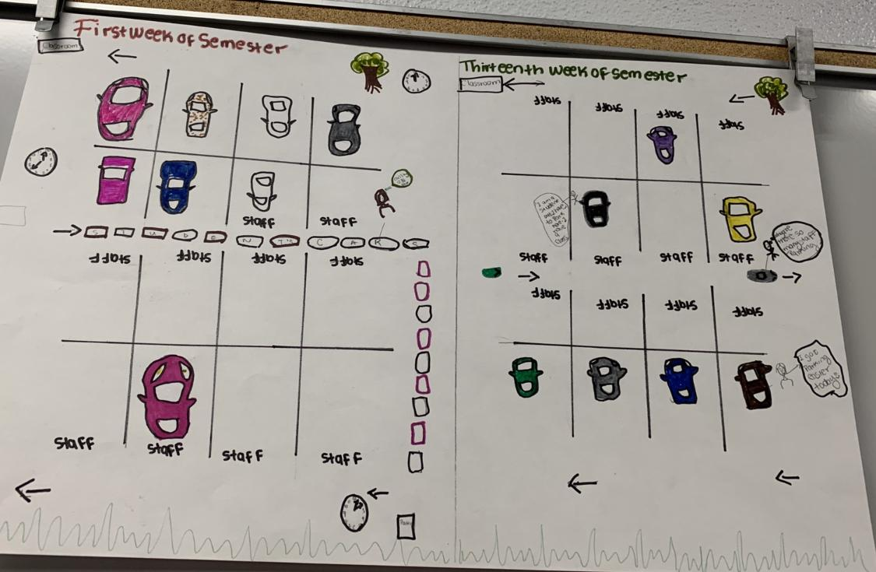

Slide 3
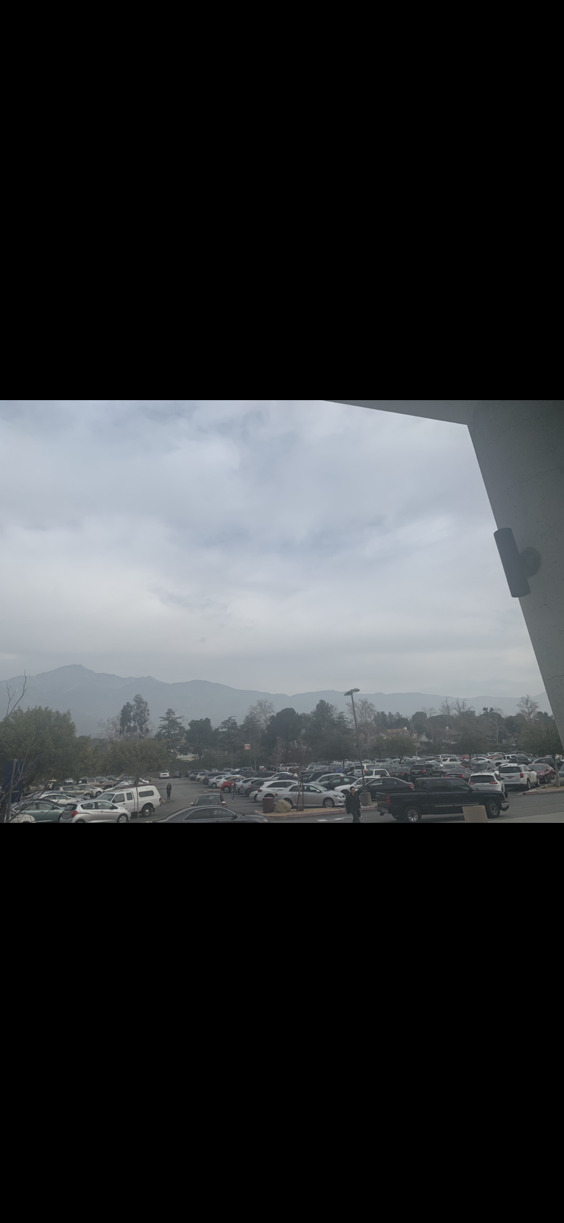
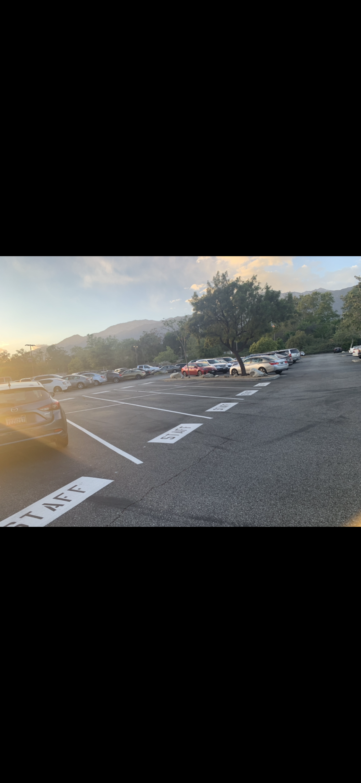
The Problem

Slide 4

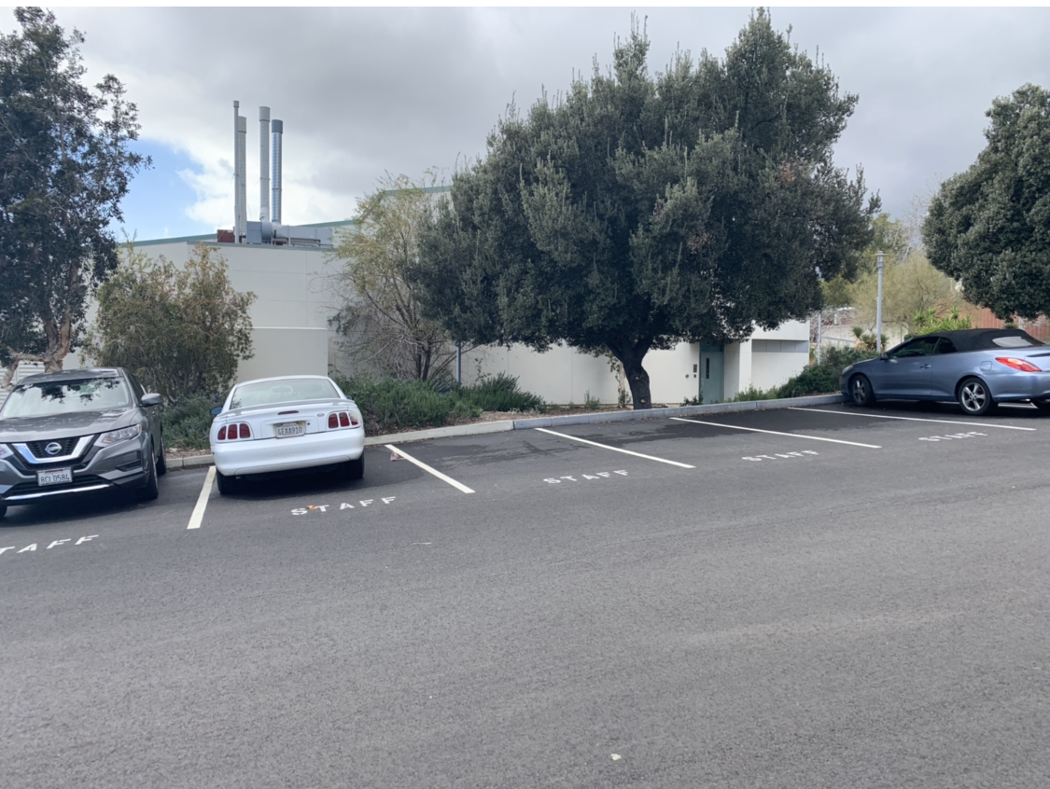
Why is this a Problem?

Slide 5
Spoken Words:
I could not figure out how to add the video on the slide.
( I sent the video to you)

