Slide 1
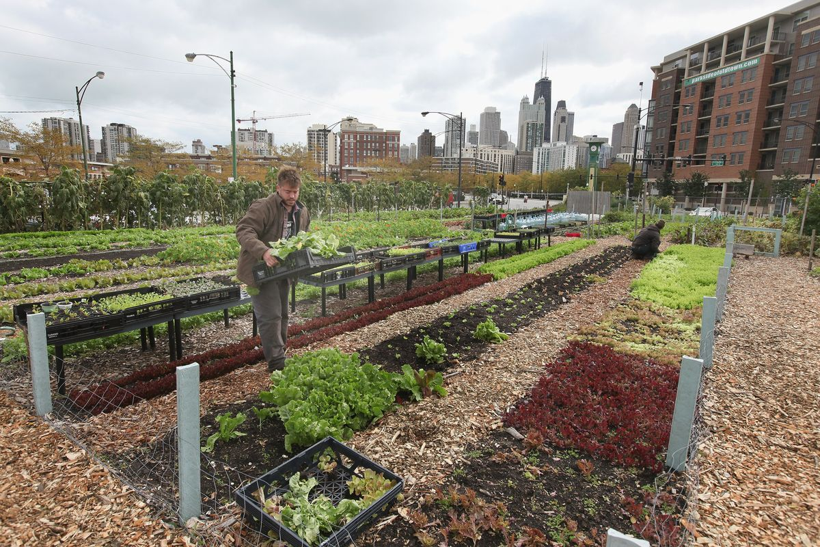
Abandoned Property

Slide 2
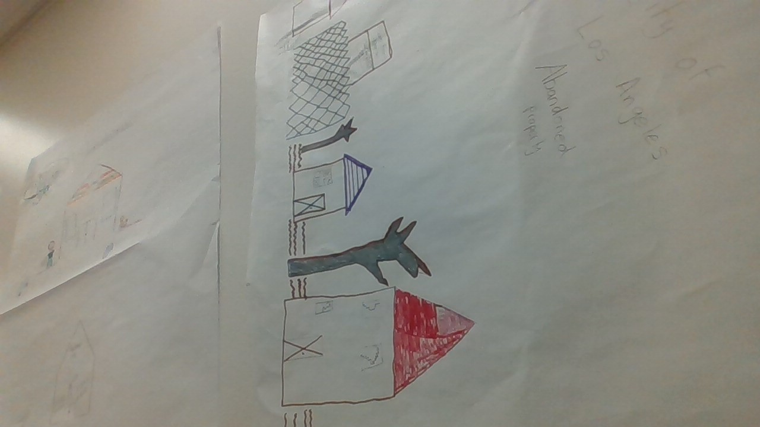

Slide 3
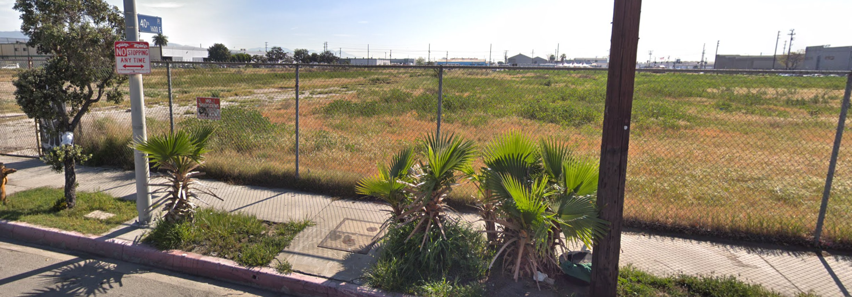

Slide 4
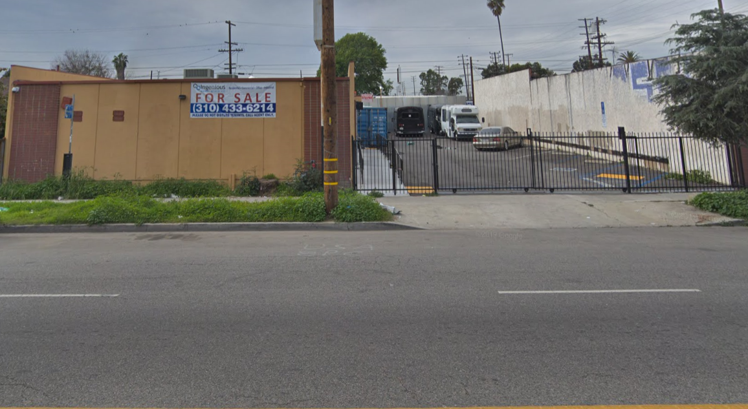

Slide 5
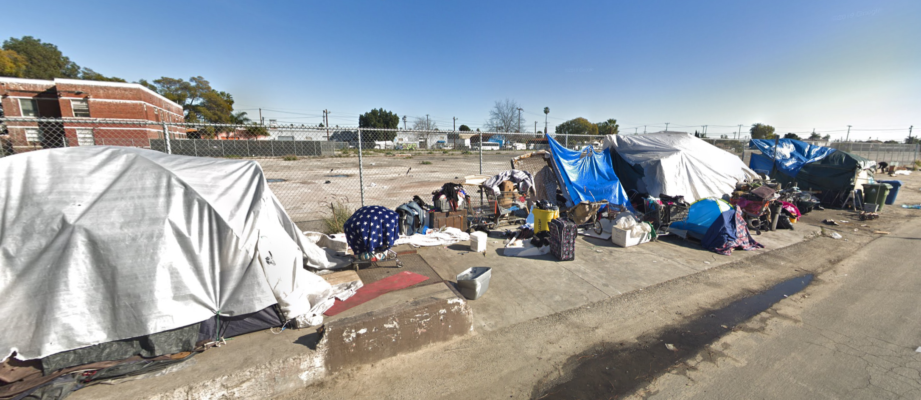

Slide 6

Spoken word
A community that cares for each other creates strong relationships
It strengthens your spirit and it will guide you through the turbulence
The struggles you encounter will chisel and define you
But remember the night is at its darkest right before the sun has its breakthrough
It takes a village to raise a child
A community to give them tools to carve out there own future

