Slide 1

Tuesday November 8
"What is Language and Why Does It Matter" - Noam Chomsky
Language Matters with Bob Holman » Why Language Matters
Why Language Matters

Slide 2
https://youtu.be/nLAWPrCUQQ0 https://youtu.be/g6T85X1ClmI
"La Bamba" (pronounced [la ˈβamba]) is a Mexican folk song, originally from the state of Veracruz, best known from a 1958 adaptation by Ritchie Valens, a top 40 hit in the U.S. charts and one of early rock and roll's best-known songs. Valens' version of "La Bamba" is ranked number 345 on Rolling Stone magazine′s list of the 500 Greatest Songs of All Time. It is the only song on the list sung in a language other than English.
"La Bamba" has been covered by numerous artists, most notably by Los Lobos, whose version was the title track of the 1987 film La Bamba and reached No. 1 in the U.S. and UK singles charts in the same year. The Los Lobos version remained No. 1 for three weeks in the summer of 1987. The music video for Los Lobos' version, directed by Sherman Halsey, won the 1988 MTV Video Music Award for Best Video from a Film.

Slide 3
Counterprotesters play 'La Bamba' over White Lives Matter rally speaker
BY JOHN BOWDEN - 10/28/17 03:55 PM EDT
https://thehill.com/blogs/blog-briefing-room/news/357649-counterprotesters-play-la-bamba-over-white-lives-matter-rally

Slide 4
Noam Chomsky - One Human Language
https://youtu.be/DIJ5jD1jHwo

Slide 5
Linguistics, Style and Writing in the 21st Century - with Steven Pinker
https://youtu.be/OV5J6BfToSw

Slide 6
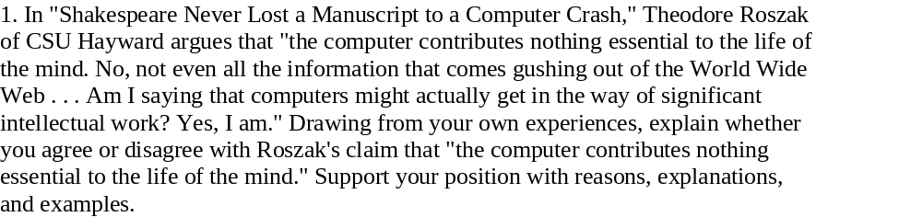

Slide 7
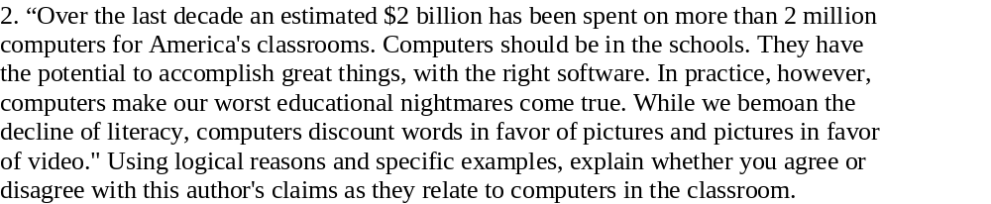

Slide 8
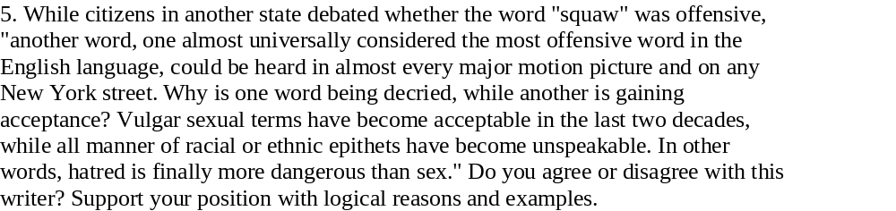

Slide 9
HIP/SLICE FIX-IT Call to Action essay #4 Proposal – 1 page, typed, due Tuesday, Nov 13
1. Which problem have chosen? Why have you chosen that problem?
2. What do you already know about the problem? What do you need to find out?
3. What are some possible solutions to that problem? What kinds of research do you need to look for?
4. Who might disagree with you? What are some possible arguments against your position?
5. What obstacles or challenges might you face as you write? How will you overcome those?
6. When & where will you write the essay?

Slide 10
http://fliphtml5.com/case-studies/embed-examples
http://fliphtml5.com/video-tutorial/
http://fliphtml5.com/case-studies/featured-examples
http://fliphtml5.com/case-studies/creation-tutorial
http://fliphtml5.com/case-studies/customer-examples​

Slide 11
with these additional genres...
Written Document (PDF)
Photograph (PDF)
Cartoon (PDF)
Poster (PDF)
Map (PDF)
Artifact (PDF)
CC0 Materials created by the National Archives and Records Administration are in the public domain​

Slide 12
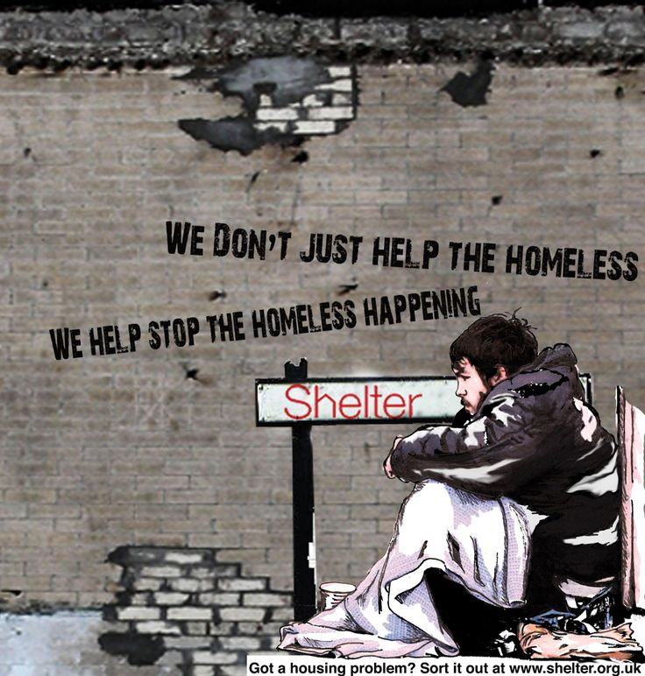

Slide 13
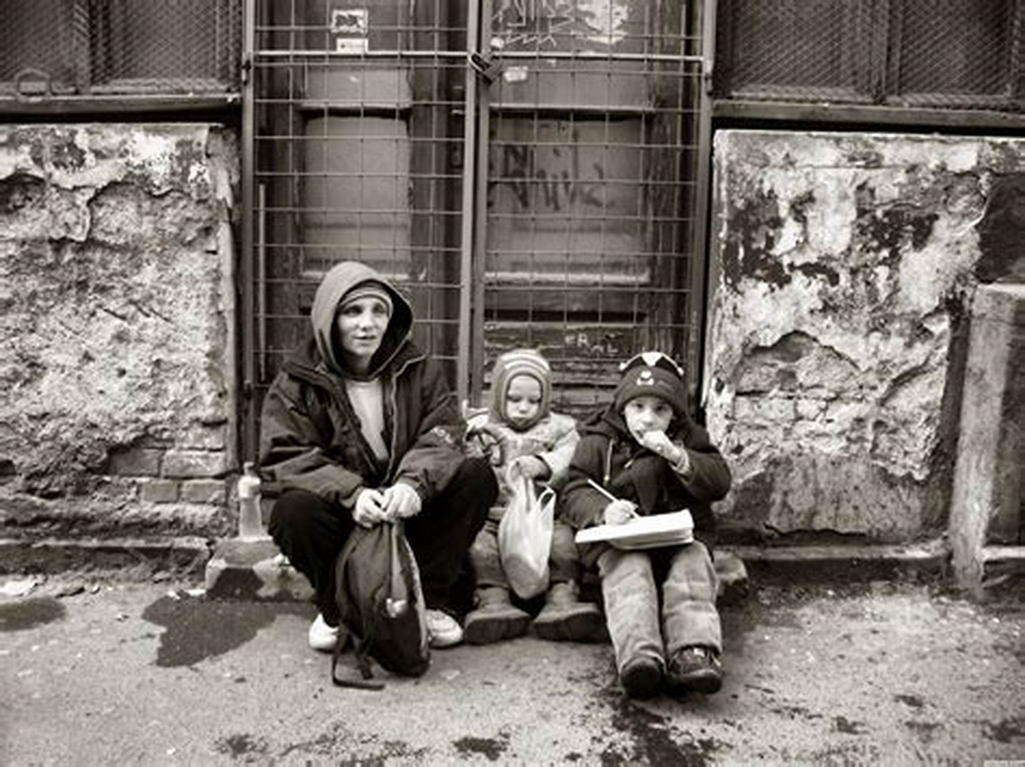

Slide 14
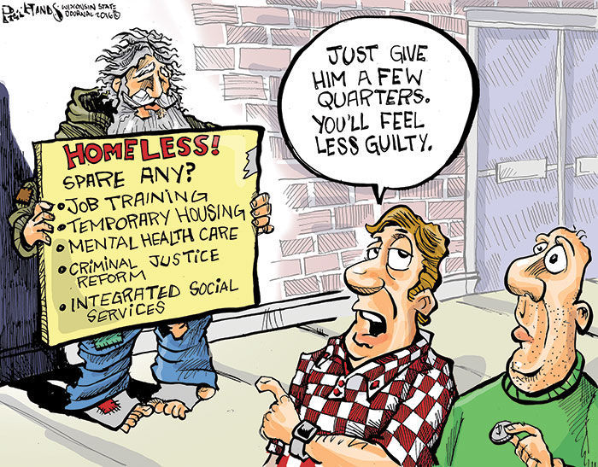

Slide 15
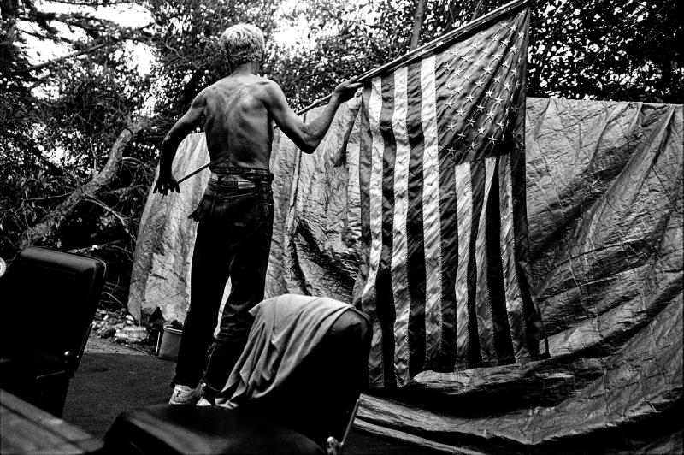

Slide 16
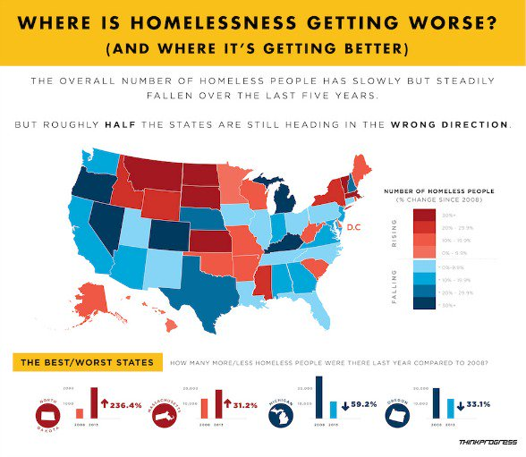

Slide 17
In reading Twilight: Los Angeles, 1992, you probably noticed that some of the speakers highlighted the turmoil and social problems leading to and surrounding the Los Angeles riots in the early 1990s. Reading the book now in 2018, you might wonder whether American cities have improved or fallen into decline.
In this essay (6+ pages, 8+ paragraphs), you will explain the HIP/SLICE “Fix-It” crisis topic that you have identified, observed, and interviewed participants who are involved, either directly or indirectly. Using your twenty-page journal (observations and interviews) and research, argue for reasonable solutions (the call-to-action, or “Fix-It” as Sonia Sanchez recommends) that can be implemented. Possible topics include:
• homelessness • transportation (traffic, public transit, etc,)
• low voter turnout • police issues (use of force, profiling, etc.)
• gun violence / mass shootings • drug addiction / drug trafficking
The thesis statement of your paper should clearly specify the crisis (problem) and your call-to-action (proposed solutions); the supporting paragraphs can be organized subject by subject or alternating style.
One half of the essay should explain the crisis:
-What is the problem? Where does it take place? - What are the causes?
-What or who is most affected? - Who might not see it as a problem?
The other half of the essay should include your call to action:
-What are the possible solutions? - What are the benefits of the solutions?
-What are possible limitations of the solutions? - How much will the solutions cost? Who will pay for them?
-Who might best solve the problem? Individuals, government, businesses, or a combination?

