Slide 1

Context Clues for writing….
Dean Ramser, Ed.D.

Slide 2











Audience- who is the intended reader or viewer
Purpose- what was the author's objective
Context- When ? Where ? Why ? Who ? What ? How ?
Stance- What is the author's attitude?
Media- Design- Pathos What is the publishing format? Ethos Tweet, Blog, Article, Interview, Book? Logos
This Photo by Unknown Author is licensed under CC BY-NC-SA

Slide 3
Context Clues
Look at the words surrounding the word in question
Definition of the word – sometimes the word in question is restated in a different word or phrase (another way of using the word in a sentence)
Examples help explain the meaning of the word – see the word in question in a different context
Synonyms – like the word in question
Antonyms – opposite to the word in question
Substitution – use a word you do know to help understand the word in question

Slide 4

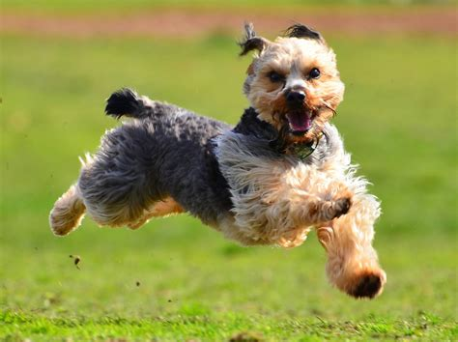
Subject-Verb Agreement
Look for context clues
Example:
The dog ran.
Article - Subject - Verb

Slide 5


Subject-Verb Agreement:
The Black Dog and Brown Dog run outside.
https://youtu.be/DOIbwI6ixxE
Look for context clues
The Black Dog and Brown Dog run
Article – MODIFIER Subject –conjunction - MODIFIER Subject – Verb –
outside.
Noun

Slide 6
Rhetorical Analysis Context Clues
Who is my audience?
What is my purpose in writing that sentence?..................
  Why am I writing that sentence?.......................
  Where am I writing that sentence?......................
  When am I writing that sentence?.....................
  Who is writing that sentence?.........................
  What happened to cause me to write that sentence?
How do I feel about what I am writing?
What type of media or genre or publication is my writing?
What is the design or structure or style of writing?

Slide 7

Modifiers
The brown and black dog ran fast.
The
Article
brown and black
Modifier
dog / ran
Subject/Verb
fast.
Modifier

Slide 8
What context clues could we add to make the sentence more descriptive and more detailed?
What type of audience would enjoy reading about this story?
More about the purpose for writing the sentence? Is the dog mine? Do we share history?
Where? When? Why? Who? What? And How?
How do I feel about the story? Happy? Sad? Motivated?
Describe the type of publication or genre? Adventure? Novel? Blog? Tweet? Photograph?
What design or structure of the sentence would be best for my purpose?

Slide 9

example
The brown and black [Yorkshire Terrier] dog [sprinted]ran [happily] fast [in the lush green grass in our backyard], [its youthfulness on full display for the children at the birthday party].
Did the sentence reveal the
rhetorical analysis, that is, did
the sentence tell [show] the reader more?

Slide 10
Audience- who is the intended reader or viewer
Purpose- what was the author's objective
Context- When ? Where ? Why ? Who ? What ? How ?
Stance- What is the author's attitude?
Media- Design- Pathos What is the publishing format? Ethos Tweet, Blog, Article, Interview, Book? Logos
This Photo by Unknown Author is licensed under CC BY-NC-SA

Slide 11
Context Clues for writing….
Dean Ramser, Ed.D.

