Slide 1

Context Clues for reading….
Dean Ramser, Ed.D.

Slide 2





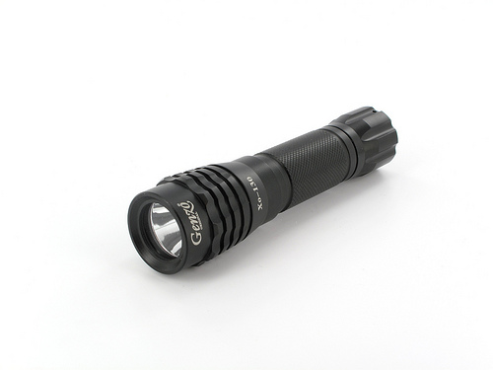

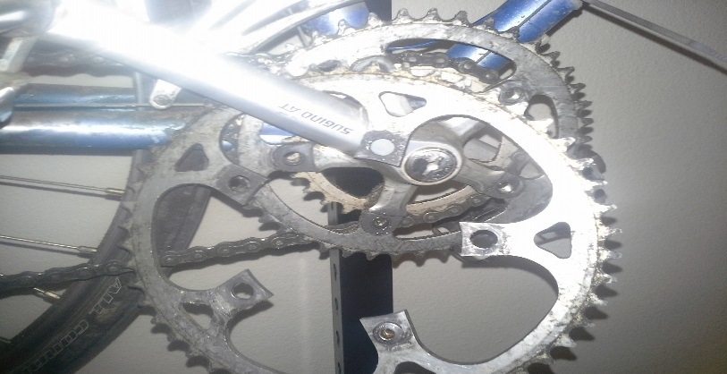

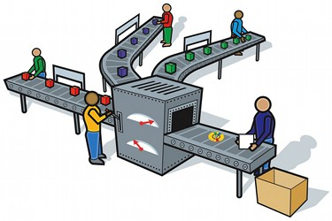

Audience- who is the intended reader or viewer
Purpose- what was the author's objective
Context- When ? Where ? Why ? Who ? What ? How ?
Stance- What is the author's attitude?
Media- Design- Pathos What is the publishing format? Ethos Tweet, Blog, Article, Interview, Book? Logos
This Photo by Unknown Author is licensed under CC BY-NC-SA

Slide 3
Context Clues
Look at the words surrounding the word in question
Definition of the word – sometimes the word in question is restated in a different word or phrase (another way of using the word in a sentence)
Examples help explain the meaning of the word – see the word in question in a different context
Synonyms – like the word in question
Antonyms – opposite to the word in question
Substitution – use a word you do know to help understand the word in question

Slide 4


Slide 5


Slide 6
Rhetorical Analysis Context Clues
Who is the audience?
What is the purpose in writing that sentence?..................
  Why is someone writing that sentence?.......................
  Where is the writer when they write that sentence?..........
  When did the writer write that sentence?.....................
  Who wrote that sentence?.........................
  What happened to cause the writer to write that sentence?
How do I feel about what I am writing?
What type of media or genre or publication is my writing?
What is the design or structure or style of writing?

Slide 7
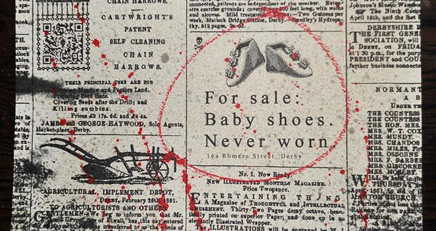
Does the meaning change now because of the (media) location?
Audience-
Purpose-
Context- When, Where, Why, Who, What happened, and How did it happen?
Stance-
Media-
Design-

Slide 8
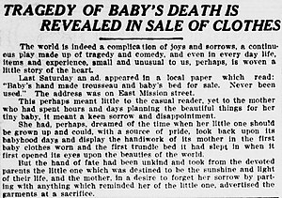
Does the meaning change now because of the added story?
Audience-
Purpose-
Context- When, Where, Why, Who, What happened, and How did it happen?
Stance-
Media-
Design-

Slide 9
Audience- who is the intended reader or viewer
Purpose- what was the author's objective
Context- When ? Where ? Why ? Who ? What ? How ?
Stance- What is the author's attitude?
Media- Design- Pathos What is the publishing format? Ethos Tweet, Blog, Article, Interview, Book? Logos
This Photo by Unknown Author is licensed under CC BY-NC-SA

Slide 10
Context Clues….
Look for context clues to understand
the words or image or sound more
deeply.

