Slide 1

Context Clues for reading and writing….
Dean Ramser, Ed.D.

Slide 2





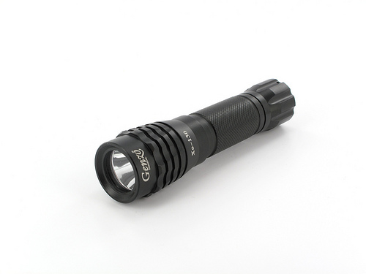

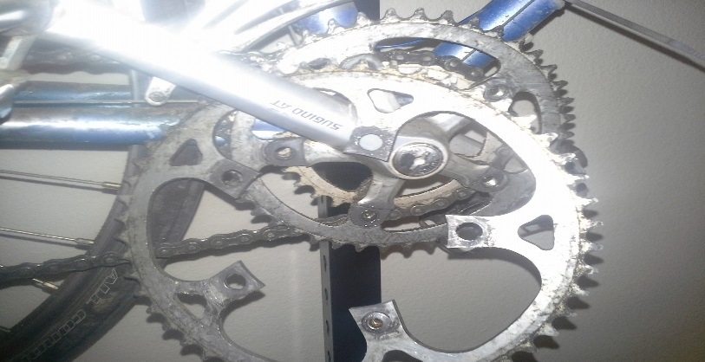

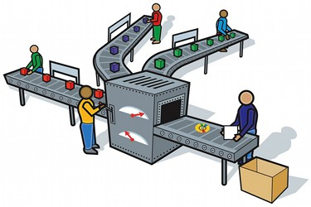

Audience- who is the intended reader or viewer
Purpose- what was the author's objective
Context- When ? Where ? Why ? Who ? What ? How ?
Stance- What is the author's attitude?
Media- Design- Pathos What is the publishing format? Ethos Tweet, Blog, Article, Interview, Book? Logos
This Photo by Unknown Author is licensed under CC BY-NC-SA

Slide 3
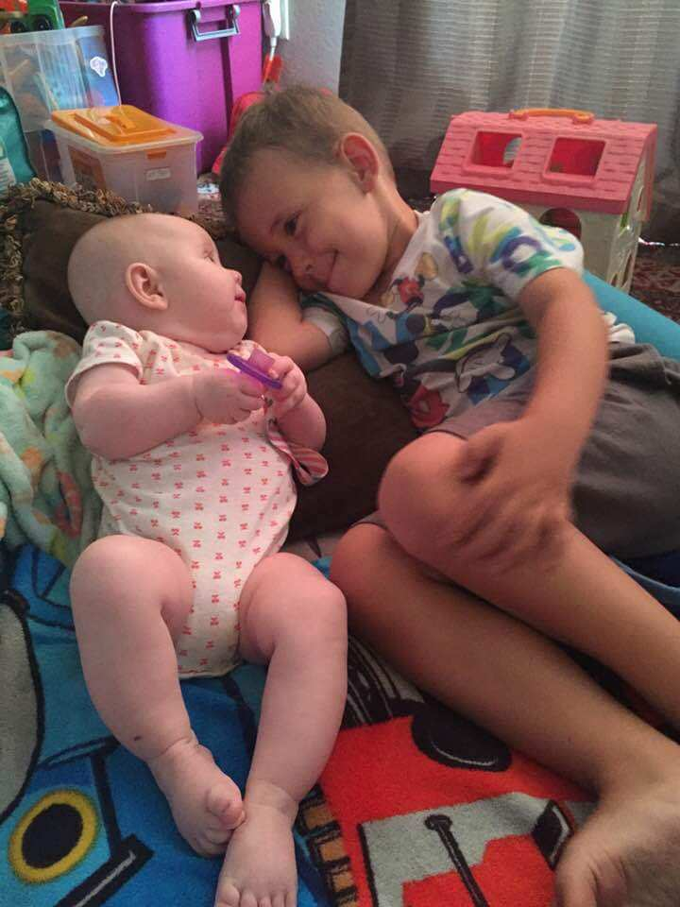
Let me tell you about my 3 –year old grandson Gage and his 4-month old sister Ellie, our granddaughter, sharing a moment.

Slide 4
Context clues for reading
Look at the words surrounding the word in question
Definition of the word – sometimes the word in question is restated in a different word or phrase (another way of using the word in a sentence)
Examples help explain the meaning of the word – see the word in question in a different context
Synonyms – like the word in question
Antonyms – opposite to the word in question
Substitution – use a word you do know to help understand the word in question

Slide 5
Let me tell you about my 3 –year old grandson Gage and his 4-month old sister Ellie sharing a moment.
Who is “me”?
Who is “you”?
Who is “our”?
What is “grandson”?

Slide 6
Context clues for writing
Who is my audience?
What is my purpose in writing that sentence?..................
  Why am I writing that sentence?.......................
  Where am I writing that sentence?......................
  When am I writing that sentence?.....................
  Who is writing that sentence?.........................
  What happened to cause me to write that sentence?
How do I feel about what I am writing?
What type of media or genre or publication is my writing?
What is the design or structure or style of writing?

Slide 7

Who is writing?
Let me tell you about my 3 –year old grandson Gage and his 4-month old sister Ellie sharing a moment.
Let me tell you about my 3-year old brother Gage.
Let me tell you about my 4-month old sister Ellie.

Slide 8
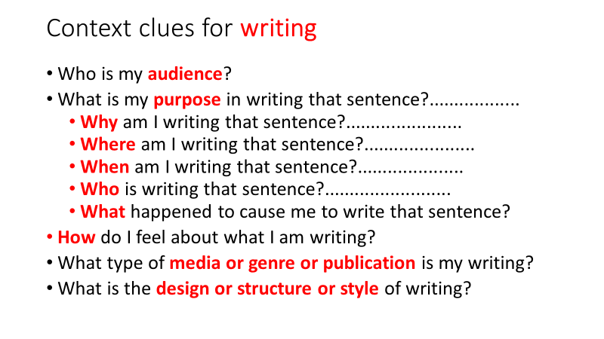
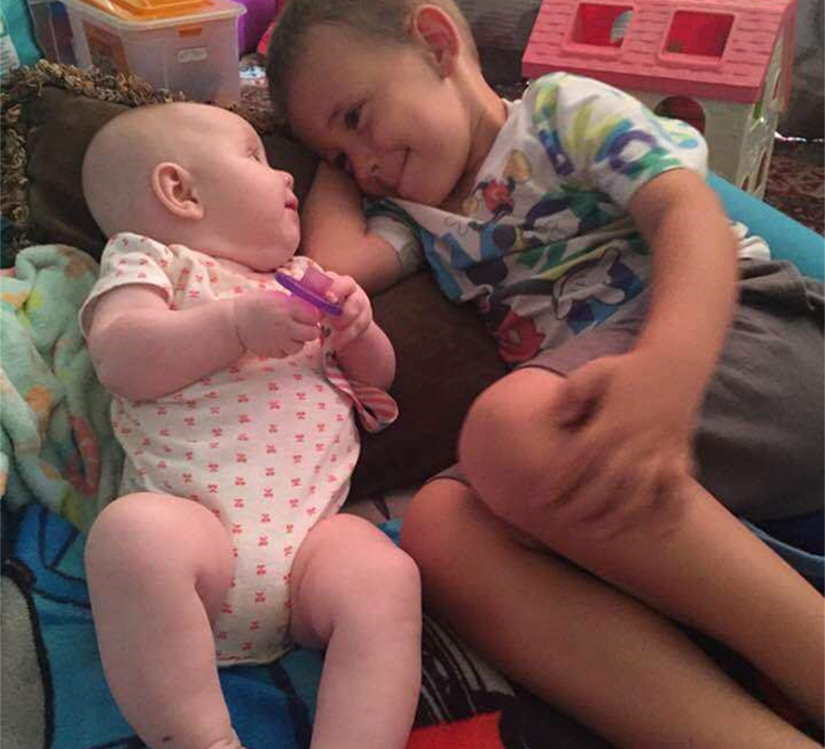
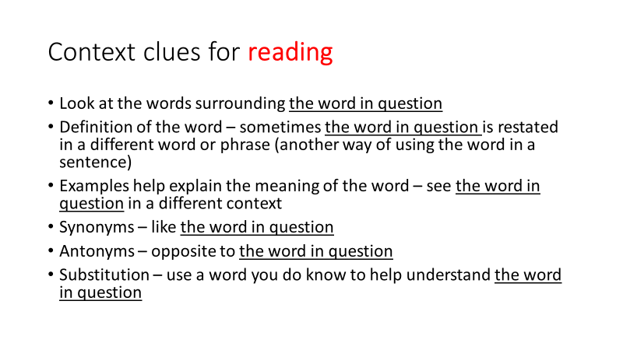
Context Clues for reading and writing….

Slide 9
Context Clues for reading and writing….
Dean Ramser, Ed.D.

