Slide 1

MLA Style
Integrating Sources into Your Writing
Gavilan College
Writing Center
LI120
HOURS: Mon-Thu 8:00-5:00, Fri 8:00-1:00
PHONE: (408)848-4811
  WEBSITE: gavilan.edu/writing
The Writing Center will make reasonable accommodations for persons with disabilities who wish to participate in this event. If you require an accommodation, contact the Writing Center at (408)848-4811. Please include the requested accommodation along with your contact information.

Slide 2

Research Process
  Establishing a Purpose (Research Question(s), Topic Proposal, Working Thesis Statement)
  Finding Sources
  Evaluating Sources
  Understanding Academic Articles
  Integrating Sources
  MLA Style: Citing Sources
  Revising Your Essay
  Proofreading

Slide 3
Review
For each source: | Does the source meet the requirements of the assignment? | Type of source Checked for credibility
 | So what? | Why did you pick this source instead of another?
 | Who cares? | What is your reader going to get out of having this source in your paper? What work is this source going to do in your paper?
 | Integrating | Why here? Why this?

Slide 4
Why Integrate Sources?
Definition | Presenting and using information from other sources in order to develop and strengthen your own ideas
Reasons | To give background information so reader understands topic. To put your ideas inside of a larger conversation: you first have to say what other people say in order to have something to respond to. To make what you have to say more meaningful by putting it next to what other people say. To build stronger arguments. To establish your credibility: the reader is more likely to believe what you say if you’re fair to the other side.
Steps | Decide how the information or ideas will be useful to you. Decide which is appropriate: summary, paraphrase, or quotation. Integrate the source into your paper using MLA Style guidelines.
Notes:
I'm going to share the APA Citing Sources presentation with you-- I made the master fit the material better and added in the WC info on the bottom (I had to change the black stripe, shadowing, and green border positioning to do so). I'm not sure if you can copy my master stuff, but it might be worth a try.

Slide 5

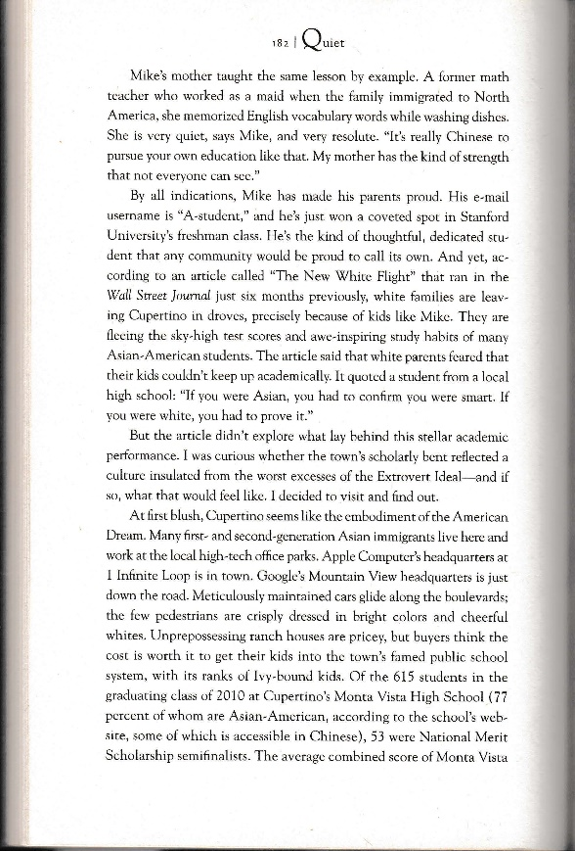
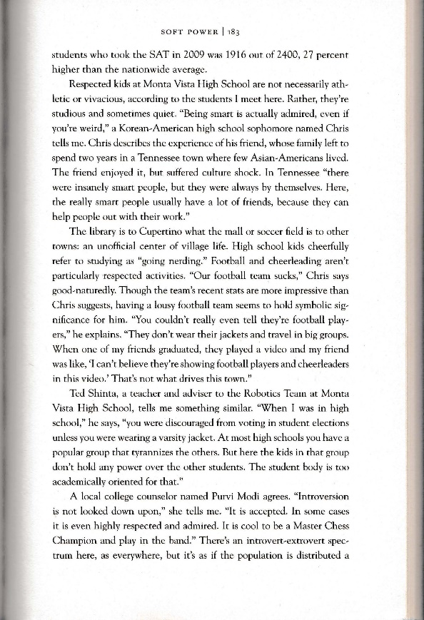
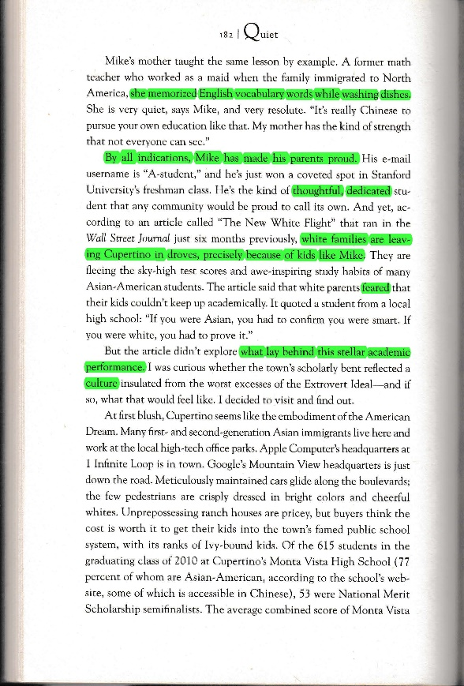
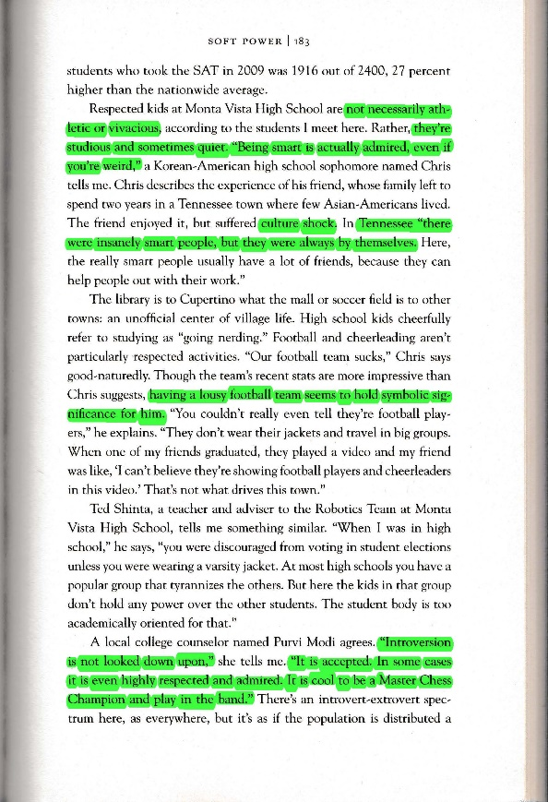
Reading and Annotating Source Material
example of quiet determination
are these qualities most people want/ desire?
Is this really (just) a “Chinese” thing?
Cupertino = admiring quiet intelligence
vs.
Tennessee = smart people are on margins, don’t have lots of friends
What determines parents’ pride in their kids?
success=?
They are leaving
b/c of thoughtful + dedicated kids?? Why?
what is connection between
Because they are scared of failure? or something else?
bad at sports
=
good at school
Cupertino has an insulated, introverted culture + that’s what these white parents aren’t comfortable with?
When introversion is the norm, are extroverts frowned upon?
Is this why white parents are taking kids out of Cupertino?

Slide 6
How is this source useful to you?
How is this source helping you enter into the larger conversation?
How is this source enriching your understanding of your subject/topic/argument?
Does this source change the way you think about the topic?
Does this source give the reader an alternative perspective or help them look at your topic in a different way? Is it going to help the reader understand what you’re trying to say?
Does this source support your argument or agree with your perspective?
Does this source oppose your argument or disagree with your perspective?

Slide 7
Incorporate the Information
Signal and introduce
The information
(summary, paraphrase, quotation)
Interpret: explain and connect

Slide 8
The Information
There are three ways to incorporate information.
Summary | Put only the main ideas from a source into your own words using as few words as possible.
Paraphrase | Put a short passage into your own words, sentence structure, and style without changing the author’s original meaning.
Quotation | Copy the source material word for word without changing anything.

Slide 9
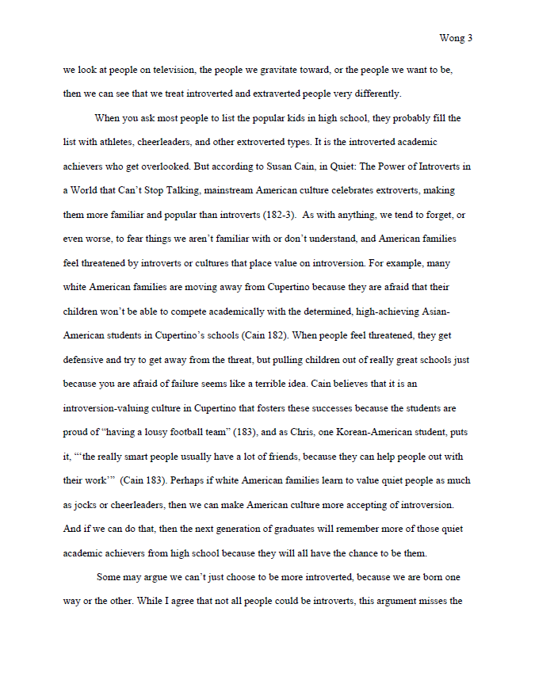
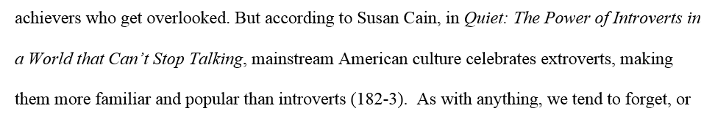
Signal & Introduce
A signal phrase is made up of certain information.
“But” suggests a contrast between the previous and next idea.
Alerts the reader as to why you chose to include this information.
Title of the source
Author’s name

Slide 10
Interpretation
(Explain & Connect)
Information isn't meaningful by itself. It is the writer’s job to make the information meaningful by interpreting it for the reader: to explain the significance of the information, to connect it to other ideas in the paper, and to tell the reader why they should care about it.
Here are some ways to do that: | Explain the information in your own words to clarify what it means to your argument or ideas.
 | Analyze the information--agree, disagree, agree with a difference
 | Point out to your reader why this information should be meaningful to them.
 | Connect the information to an idea you already stated earlier in your paper.
 | If the information is supporting an idea you've written, tell the reader what that connection is.
 | If the information disagrees with your point of view, tell the reader why you disagree.

Slide 11
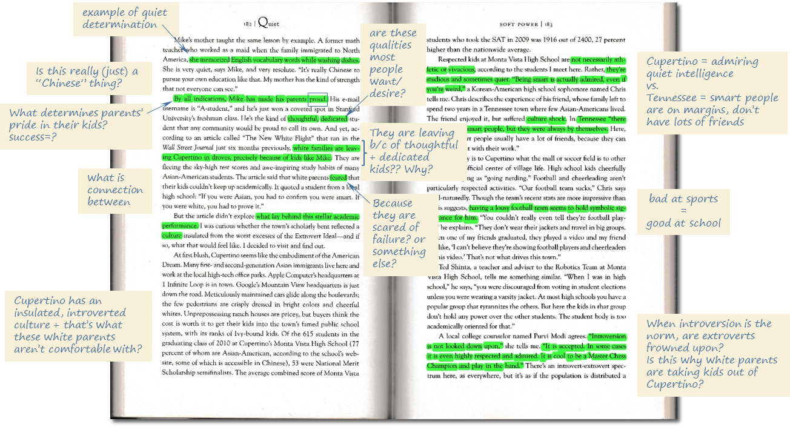
Incorporate Information: Summary
Use summary when you want to include just the main ideas from a source.
Summary is the most common way to incorporate sources into your own writing.
You might summarize the main ideas of an entire article or chapter in a few sentences or short paragraph.
Be concise: use as few words as possible.
Put only the main ideas from a source into your own words.
Notes:
I think this looks really terrible and I know you have another plan...I just wanted to see whether the model matched up with the paragraph...and tada! I think it does pretty well. Good model :)

Slide 12
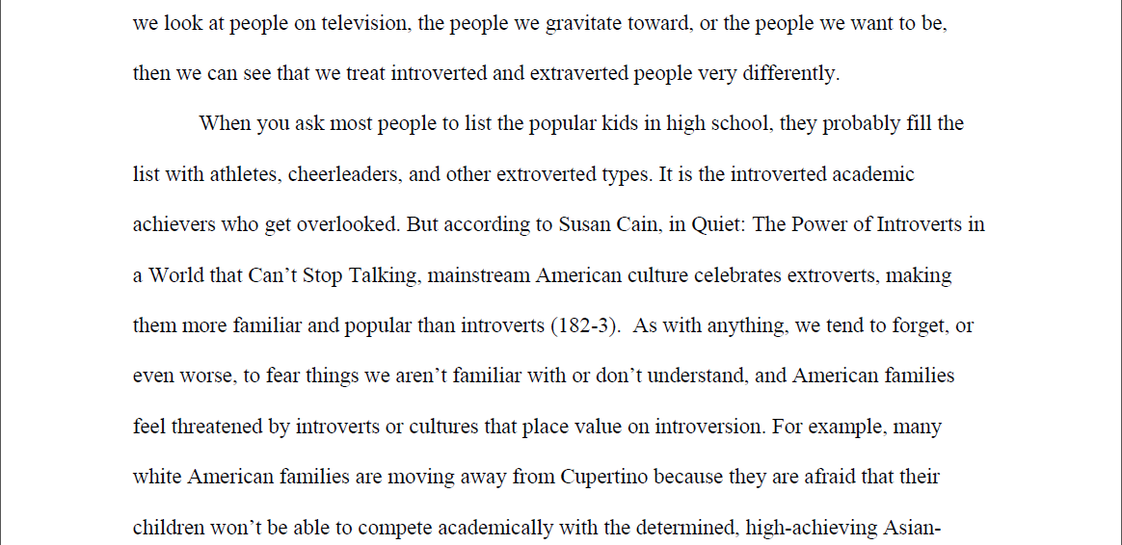
Incorporate Information: Summary
When you ask most people to list the popular kids in high school, they probably fill the list with athletes, cheerleaders, and other extroverted types. It is the introverted academic achievers who get overlooked. But according to Susan Cain, in Quiet: The Power of Introverts in a World that Can’t Stop Talking,
mainstream American culture celebrates extroverts, making them more familiar and popular than introverts (182-3).
As with anything, we tend to forget, or even worse, to fear things we aren’t familiar with or don’t understand, and American families feel threatened by introverts or cultures that place value on introversion.

Slide 13
Incorporate Information: Paraphrase
Use paraphrase when you want to use most or all of the information from a short passage from a source.
Change the language and style of a text to make the information of the source more useful to you.
Use paraphrase when you want to include WHAT the original author said, but not HOW they said it.
Use paraphrase to make information fit better into your writing style or to clarify what the original author said for your readers.
Notes:
I think this looks really terrible and I know you have another plan...I just wanted to see whether the model matched up with the paragraph...and tada! I think it does pretty well. Good model :)

Slide 14
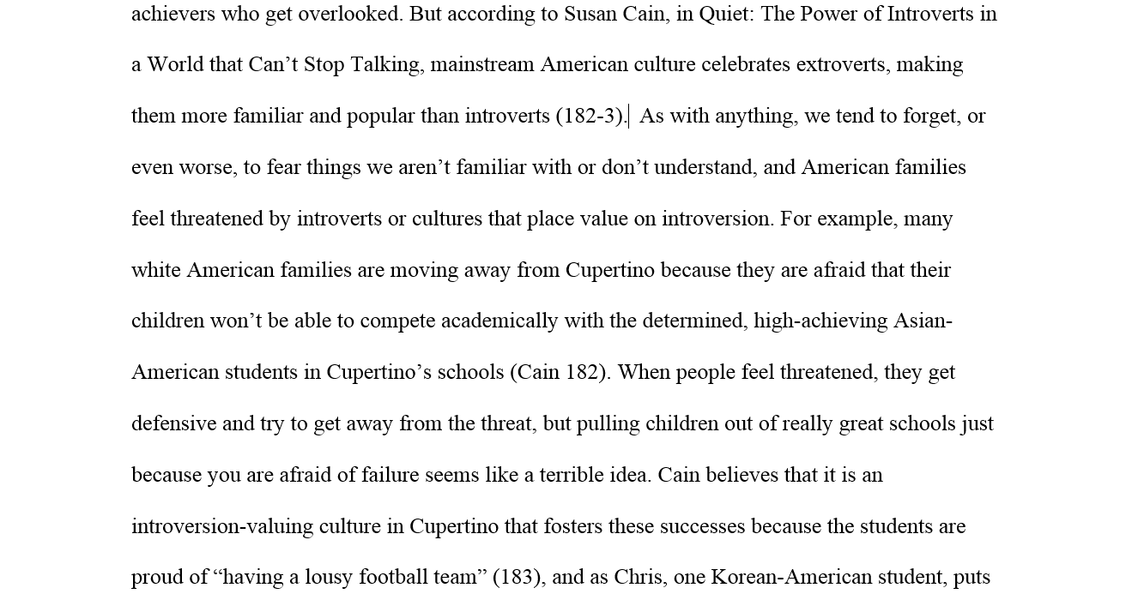
Incorporate Information: Paraphrase
As with anything, we tend to forget, or even worse, to fear things we aren’t familiar with or don’t understand, and American families feel threatened by introverts or cultures that place value on introversion. For example,
many white American families are moving away from Cupertino because they are afraid that their children won’t be able to compete academically with the determined, high-achieving Asian-American students in Cupertino’s schools (Cain 182).
When people feel threatened, they get defensive and try to get away from the threat, but pulling children out of really great schools just because you are afraid of failure seems like a terrible idea.

Slide 15
Incorporate Information: Quotation
Use quotation when you want to include exactly what a source says without making any style, word, or other changes.
Quotations are exact copies.
Quotations should only be used when everything the writer said is important to your paper, or when changing the writer's style or language makes it less significant to your own writing.
Use quotation when you want to include WHAT the original author said exactly HOW they said it.
Notes:
I think this looks really terrible and I know you have another plan...I just wanted to see whether the model matched up with the paragraph...and tada! I think it does pretty well. Good model :)

Slide 16
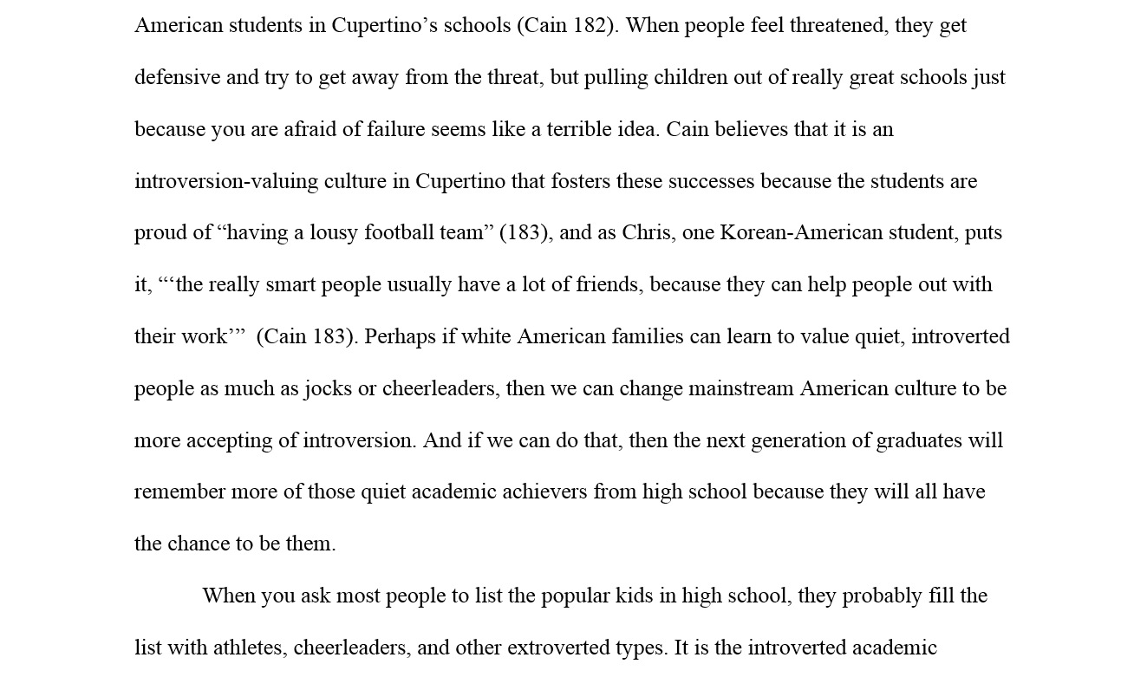
Incorporate Information: Quotation
Cain believes that it is an introversion-valuing culture in Cupertino that fosters these successes because the students are proud of
“having a lousy football team” (183), and as Chris, one Korean-American student, puts it, “‘the really smart people usually have a lot of friends, because they can help people out with their work’” (Cain 183).
Perhaps if white American families can learn to value quiet, introverted people as much as jocks or cheerleaders, then we can change mainstream American culture to be more accepting of introversion. And if we can do that, then the next generation of graduates will remember more of those quiet academic achievers from high school because they will all have the chance to be them.

Slide 17
Review
When you ask most people to list the popular kids in high school, they probably fill the list with athletes, cheerleaders, and other extroverted types. It is the introverted academic achievers who get overlooked. But according to Susan Cain, in Quiet: The Power of Introverts in a World that Can’t Stop Talking, mainstream American culture celebrates extroverts, making them more familiar and popular than introverts (182-3). As with anything, we tend to forget, or even worse, to fear things we aren’t familiar with or don’t understand, and American families feel threatened by introverts or cultures that place value on introversion. For example, many white American families are moving away from Cupertino because they are afraid that their children won’t be able to compete academically with the determined, high-achieving Asian-American students in Cupertino’s schools (Cain 182). When people feel threatened, they get defensive and try to get away from the threat, but pulling children out of really great schools just because you are afraid of failure seems like a terrible idea. Cain believes that it is an introversion-valuing culture in Cupertino that fosters these successes because the students are proud of “having a lousy football team” (183), and as Chris, one Korean-American student, puts it, “‘the really smart people usually have a lot of friends, because they can help people out with their work’” (Cain 183). Perhaps if white American families can learn to value quiet, introverted people as much as jocks or cheerleaders, then we can change mainstream American culture to be more accepting of introversion. And if we can do that, then the next generation of graduates will remember more of those quiet academic achievers from high school because they will all have the chance to be them.
When you ask most people to list the popular kids in high school, they probably fill the list with athletes, cheerleaders, and other extroverted types. It is the introverted academic achievers who get overlooked. But according to Susan Cain, in Quiet: The Power of Introverts in a World that Can’t Stop Talking, mainstream American culture celebrates extroverts, making them more familiar and popular than introverts (182-3). As with anything, we tend to forget, or even worse, to fear things we aren’t familiar with or don’t understand, and American families feel threatened by introverts or cultures that place value on introversion. For example, many white American families are moving away from Cupertino because they are afraid that their children won’t be able to compete academically with the determined, high-achieving Asian-American students in Cupertino’s schools (Cain 182). When people feel threatened, they get defensive and try to get away from the threat, but pulling children out of really great schools just because you are afraid of failure seems like a terrible idea. Cain believes that it is an introversion-valuing culture in Cupertino that fosters these successes because the students are proud of “having a lousy football team” (183), and as Chris, one Korean-American student, puts it, “‘the really smart people usually have a lot of friends, because they can help people out with their work’” (Cain 183). Perhaps if white American families can learn to value quiet, introverted people as much as jocks or cheerleaders, then we can change mainstream American culture to be more accepting of introversion. And if we can do that, then the next generation of graduates will remember more of those quiet academic achievers from high school because they will all have the chance to be them.
When you ask most people to list the popular kids in high school, they probably fill the list with athletes, cheerleaders, and other extroverted types. It is the introverted academic achievers who get overlooked. But according to Susan Cain, in Quiet: The Power of Introverts in a World that Can’t Stop Talking, mainstream American culture celebrates extroverts, making them more familiar and popular than introverts (182-3). As with anything, we tend to forget, or even worse, to fear things we aren’t familiar with or don’t understand, and American families feel threatened by introverts or cultures that place value on introversion. For example, many white American families are moving away from Cupertino because they are afraid that their children won’t be able to compete academically with the determined, high-achieving Asian-American students in Cupertino’s schools (Cain 182). When people feel threatened, they get defensive and try to get away from the threat, but pulling children out of really great schools just because you are afraid of failure seems like a terrible idea. Cain believes that it is an introversion-valuing culture in Cupertino that fosters these successes because the students are proud of “having a lousy football team” (183), and as Chris, one Korean-American student, puts it, “‘the really smart people usually have a lot of friends, because they can help people out with their work’” (Cain 183). Perhaps if white American families can learn to value quiet, introverted people as much as jocks or cheerleaders, then we can change mainstream American culture to be more accepting of introversion. And if we can do that, then the next generation of graduates will remember more of those quiet academic achievers from high school because they will all have the chance to be them.
SUMMARY
When you ask most people to list the popular kids in high school, they probably fill the list with athletes, cheerleaders, and other extroverted types. It is the introverted academic achievers who get overlooked. But according to Susan Cain, in Quiet: The Power of Introverts in a World that Can’t Stop Talking, mainstream American culture celebrates extroverts, making them more familiar and popular than introverts (182-3). As with anything, we tend to forget, or even worse, to fear things we aren’t familiar with or don’t understand, and American families feel threatened by introverts or cultures that place value on introversion. For example, many white American families are moving away from Cupertino because they are afraid that their children won’t be able to compete academically with the determined, high-achieving Asian-American students in Cupertino’s schools (Cain 182). When people feel threatened, they get defensive and try to get away from the threat, but pulling children out of really great schools just because you are afraid of failure seems like a terrible idea. Cain believes that it is an introversion-valuing culture in Cupertino that fosters these successes because the students are proud of “having a lousy football team” (183), and as Chris, one Korean-American student, puts it, “‘the really smart people usually have a lot of friends, because they can help people out with their work’” (Cain 183). Perhaps if white American families can learn to value quiet, introverted people as much as jocks or cheerleaders, then we can change mainstream American culture to be more accepting of introversion. And if we can do that, then the next generation of graduates will remember more of those quiet academic achievers from high school because they will all have the chance to be them.
PARAPHRASE
QUOTATION
Notes:
Again--I'm just throwing stuff into the powerpoint that you might find useful...or not...I made a "pretend" essay out of the paragraph to show how sources would actually look incorporated. I wanted to have a line or two from a previous page, but oh well. If we make the paragraph shorter, I can do that.
M

Slide 18

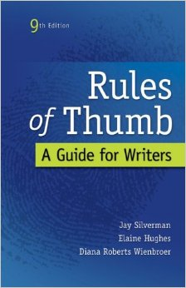
Additional Resources
Handbooks
        A Writer’s Reference
        by Diana Hacker
        Rules of Thumb:
        A Guide for Writers
        by Jay Silverman
Websites
OWL Purdue
Gavilan College Library
Gavilan College
Writing Center
LI120
HOURS: Mon-Thu 8:00-5:00, Fri 8:00-1:00
PHONE: (408)848-4811
  WEBSITE: gavilan.edu/writing

Slide 19
Handout

Slide 21



