Slide 1
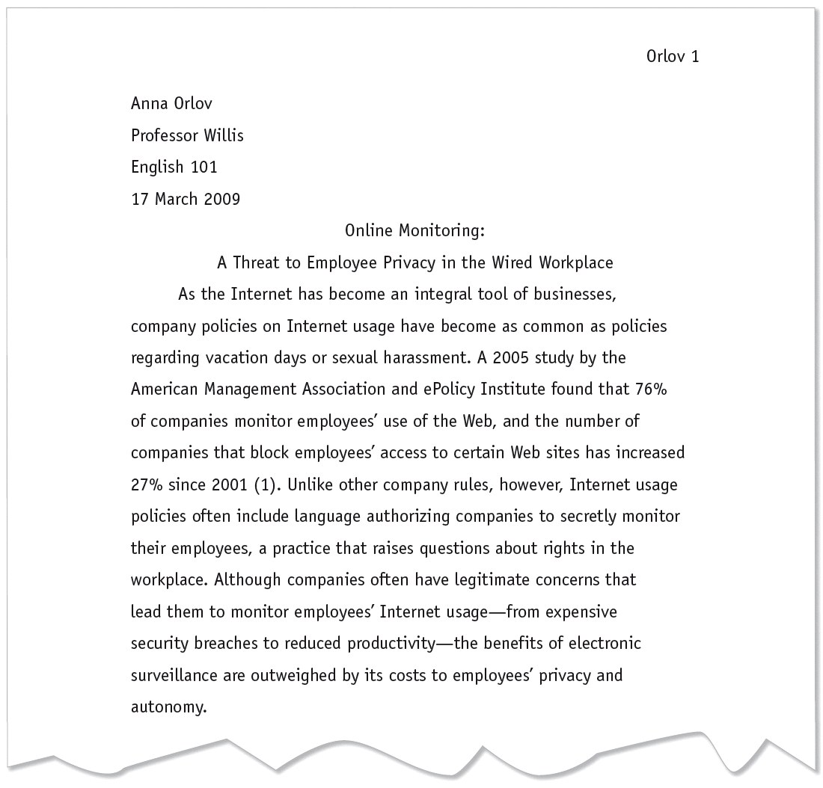
Sample MLA Research Paper
Title is centered.
Opening sentences provide background for the thesis.
Thesis asserts Orlov’s main point.

Slide 2
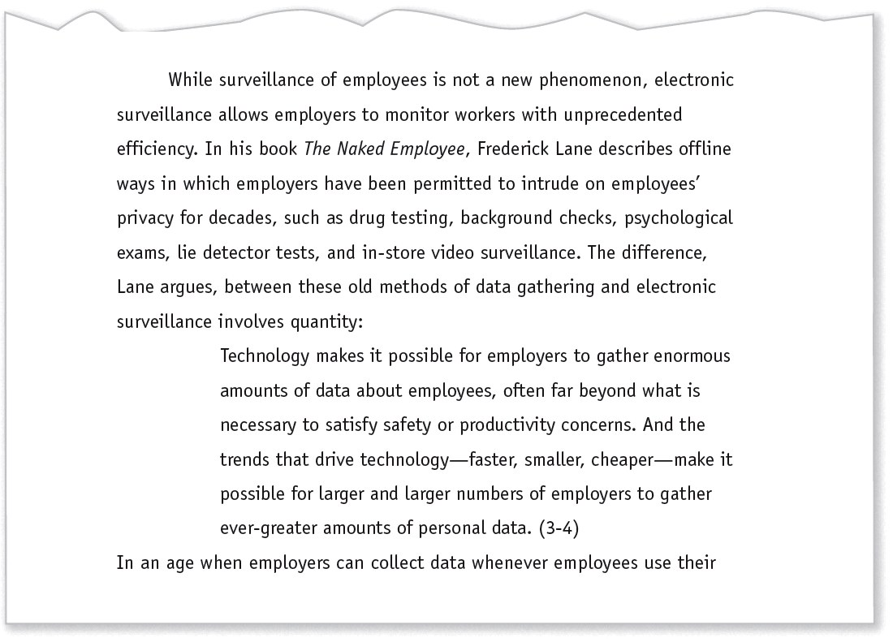
Sample MLA Research Paper
Summary and long quotation are each introduced with a signal phrase naming the author.
Long quotation is set off from the text; quotation marks are omitted.
Page number is given in parentheses after the final period.
Marginal annotations indicate MLA-style formatting and effective writing.

Slide 3
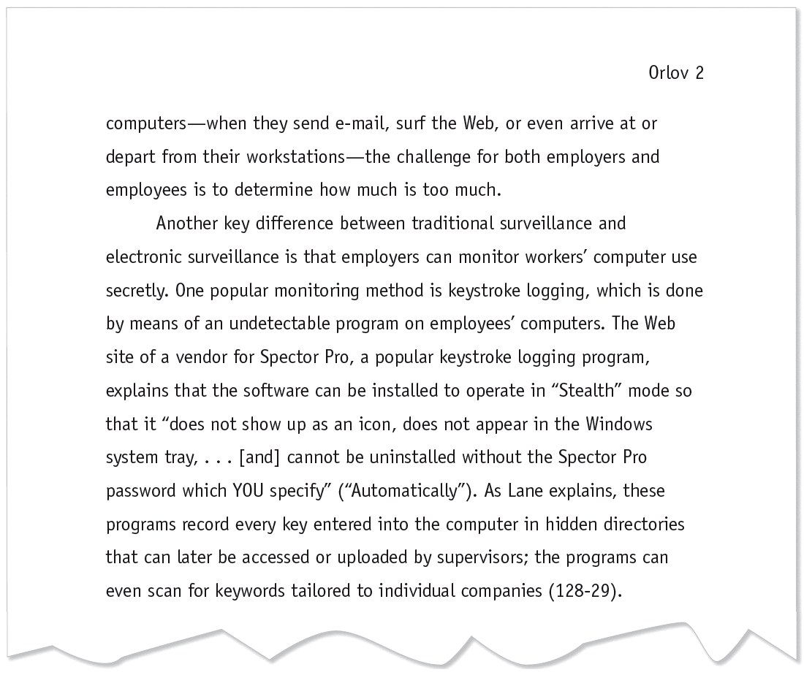
Sample MLA Research Paper
Clear topic sentences, like this one, are used throughout the paper.
Source with an unknown author is cited by a shortened title.

Slide 4
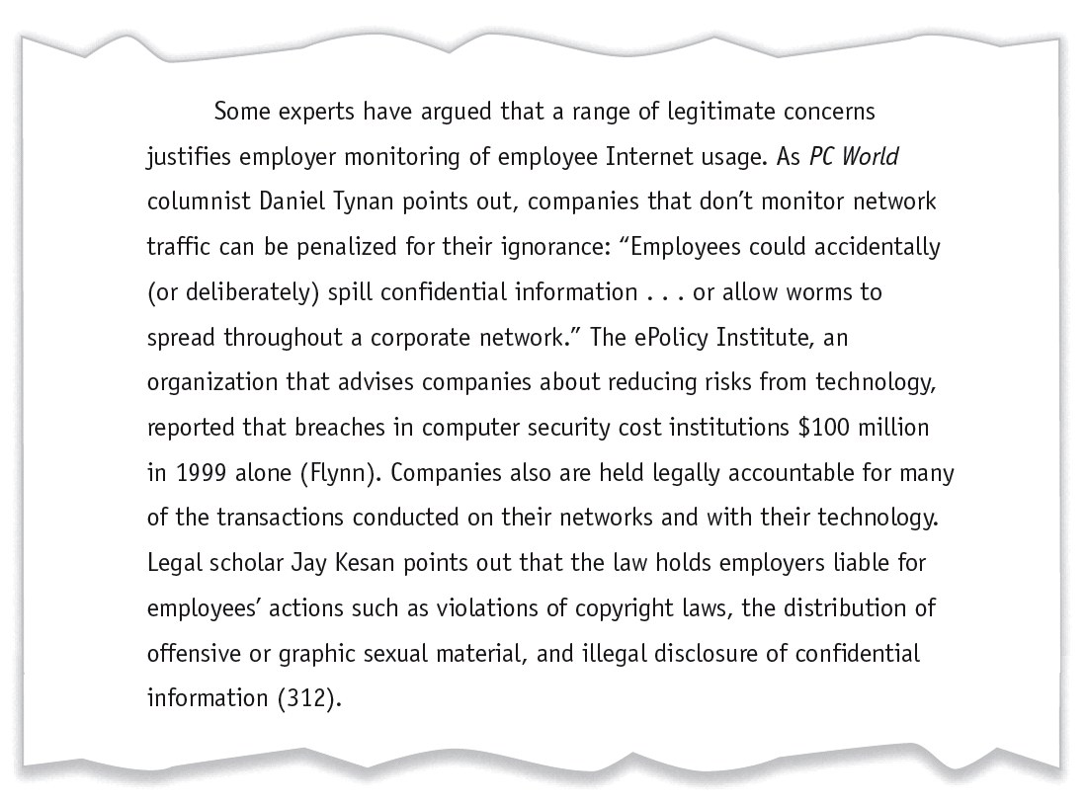
Sample MLA Research Paper
Orlov anticipates objections and provides sources for opposing views.

Slide 5
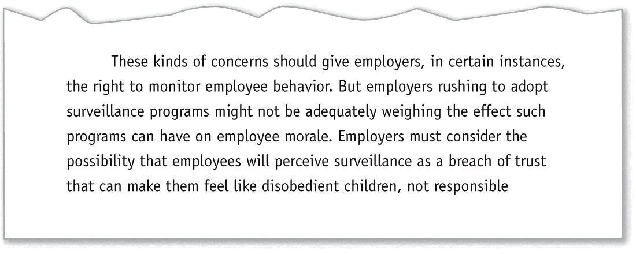
Sample MLA Research Paper
Transition helps readers move from one paragraph to the next.

Slide 6
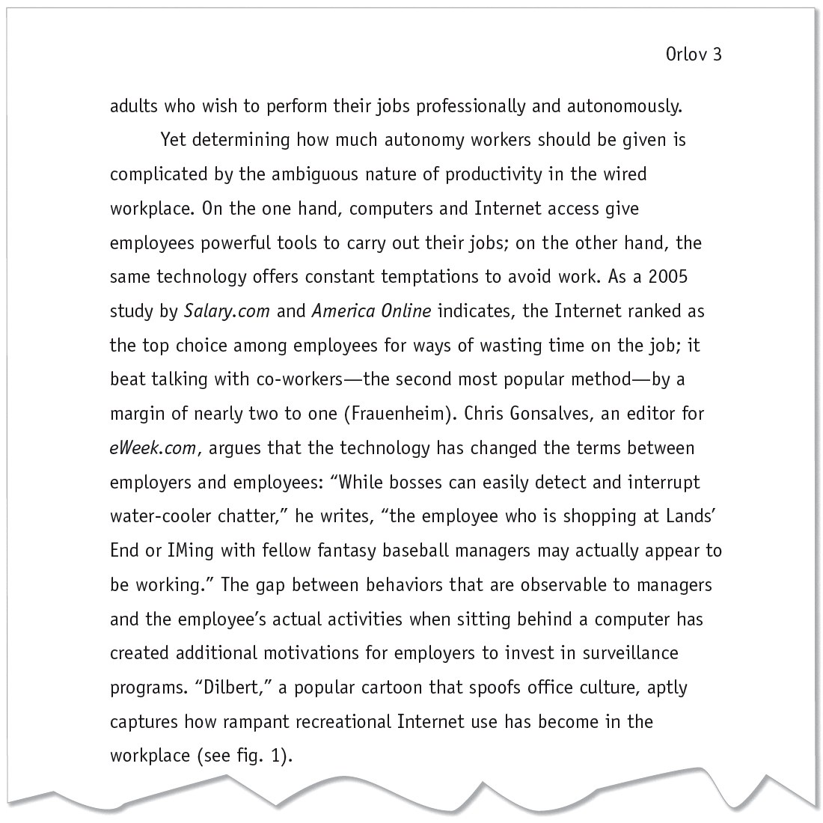
Sample MLA Research Paper
Orlov treats both sides fairly; she provides a transition to her own argument.
No page number is available for this Web source.

Slide 7
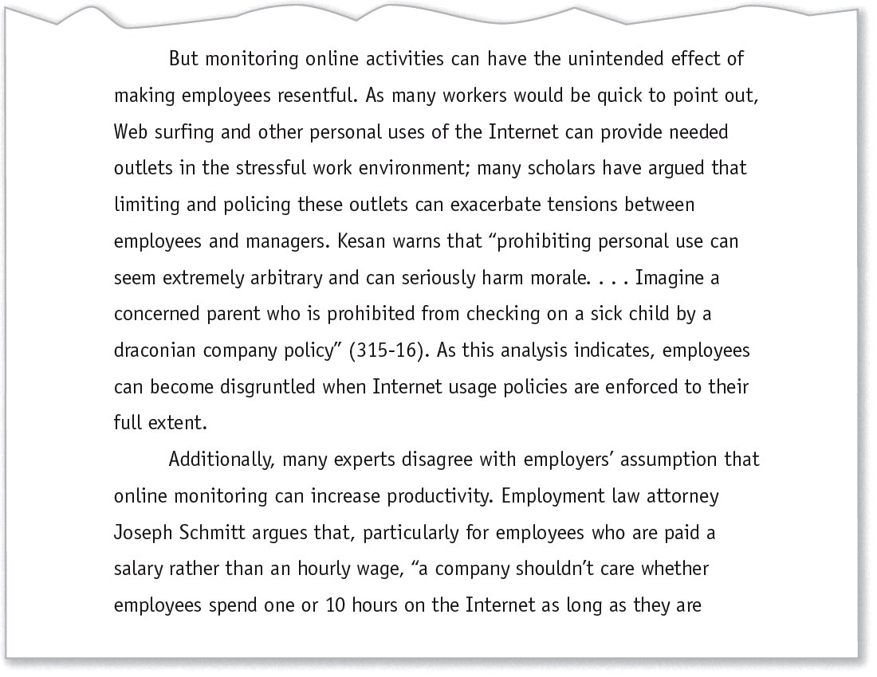
Sample MLA Research Paper
Orlov counters opposing views and provides support for her argument.
Orlov uses a brief signal phrase to move from her argument to the words of a source.

Slide 8
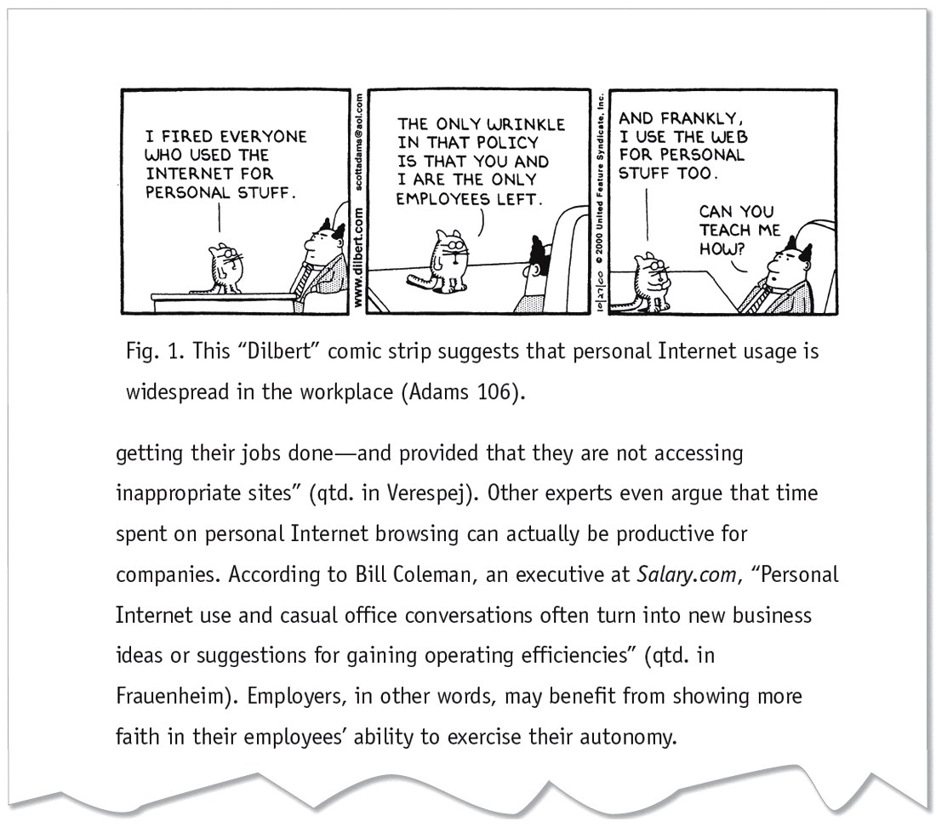
Sample MLA Research Paper
Illustration has figure number, caption, and source information.
Orlov cites an indirect source: words quoted in another source.

Slide 9
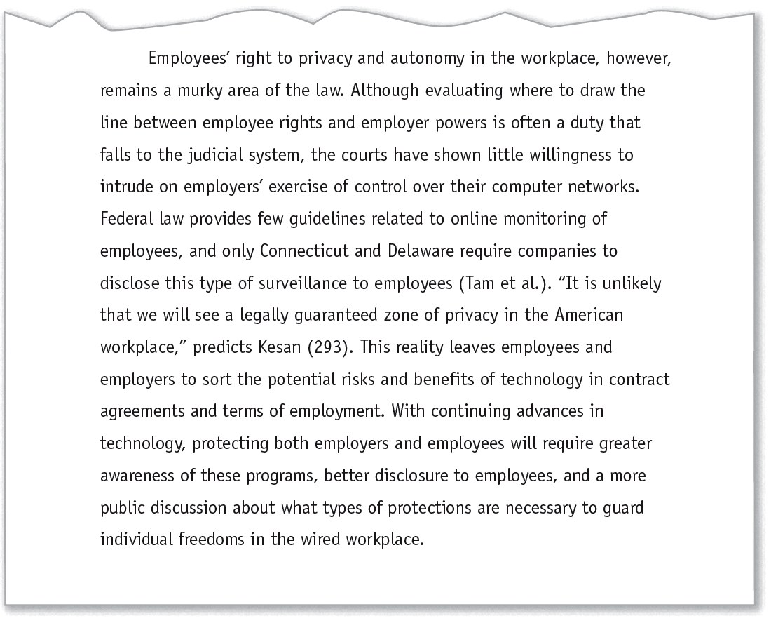
Sample MLA Research Paper
Orlov sums up her argument and suggests a course of action.

Slide 10
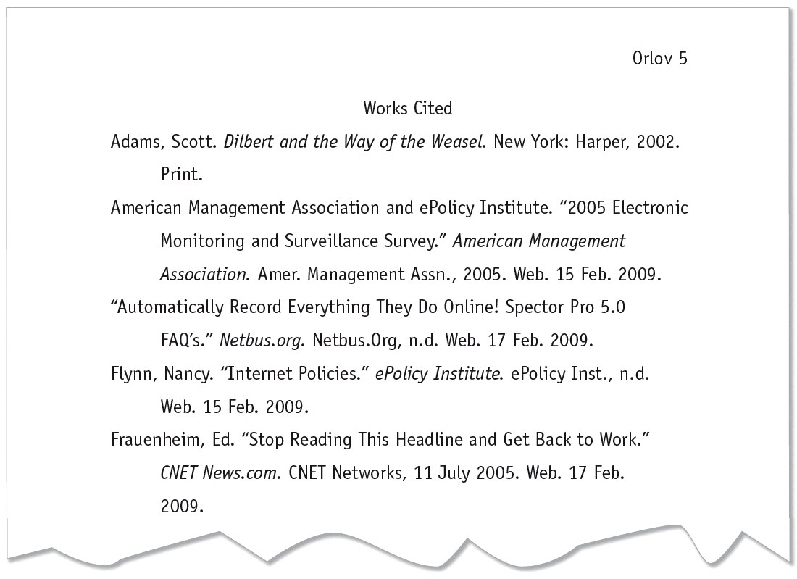
Sample MLA Research Paper
Heading is centered.
List is alphabetized by authors’ last names (or by title when a work has no author).
Abbreviation “n.d.” indicates that the online source has no update date.

Slide 11
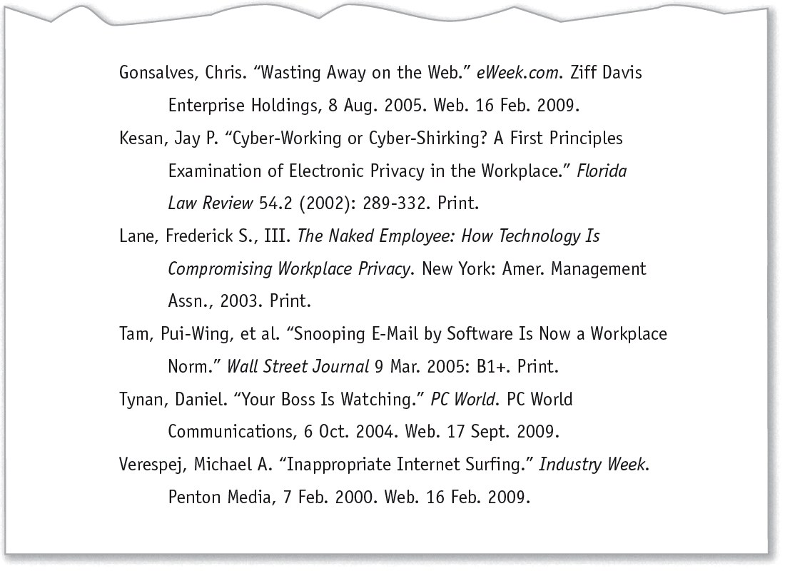
Sample MLA Research Paper
First line of each entry is at the left margin; extra lines are indented ¹/₂”.
Double-spacing is used throughout.
A work with four authors is listed by the first author’s name and the abbreviation “et al.” (for “and others”).

Slide 12
An Interview
Interviews typically fall into two categories: print or broadcast published and unpublished (personal) interviews, although interviews may also appear in other, similar formats such as in email format or as a Web document.
Personal Interviews
Personal interviews refer to those interviews that you conduct yourself. List the interview by the name of the
interviewee. Include the descriptor Personal interview and the date of the interview.
Smith, Jane. Personal interview. 19 May 2014.

