Slide 1
SP
“SAY NO TO LITTERING”
ENG 111-22
MAY 8, 2018
High Impact Practices (HIP) Service Learning Internship Community Engagement (SLICE)Presentation

Slide 2
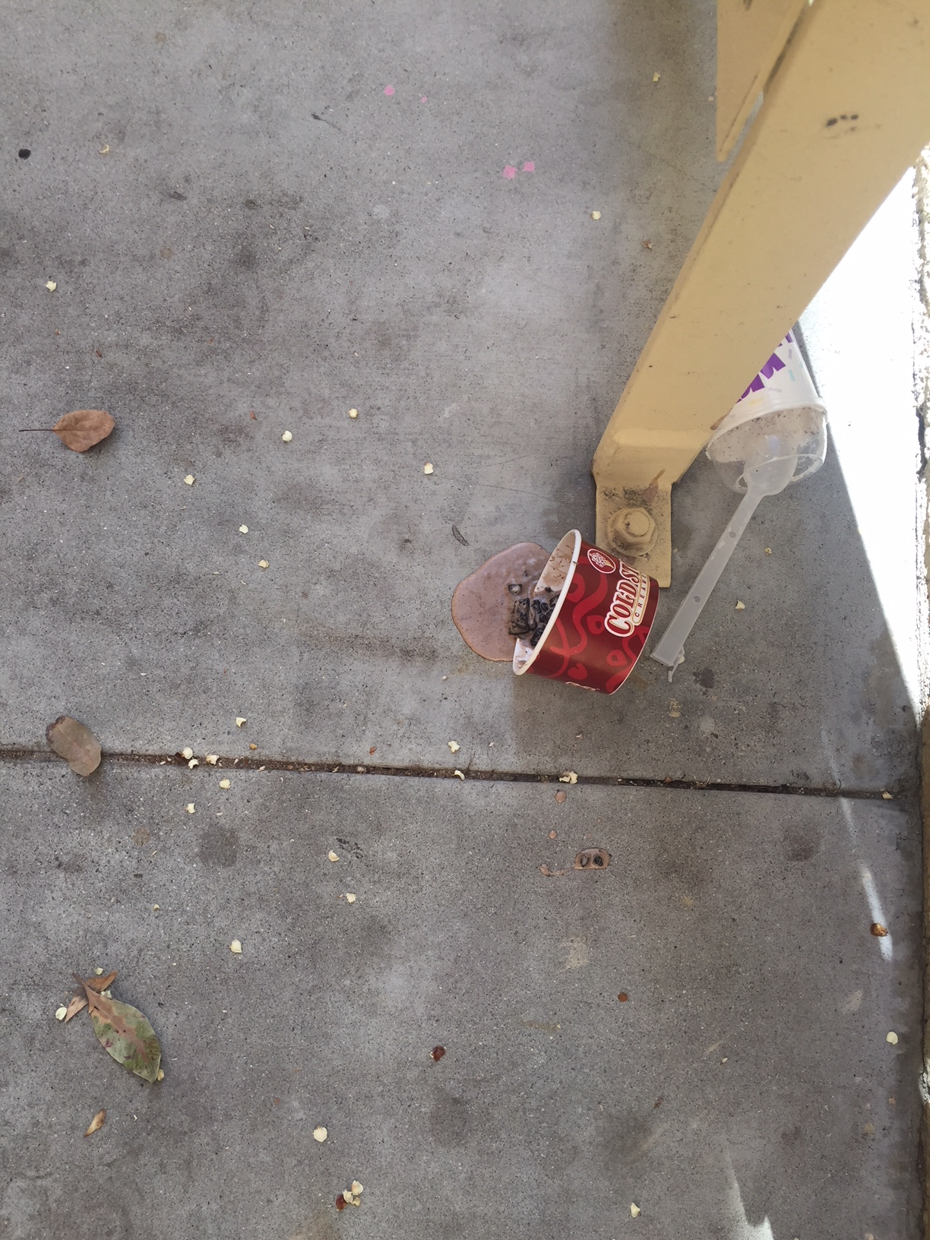
In front of Coldstone ice cream shop

Slide 3
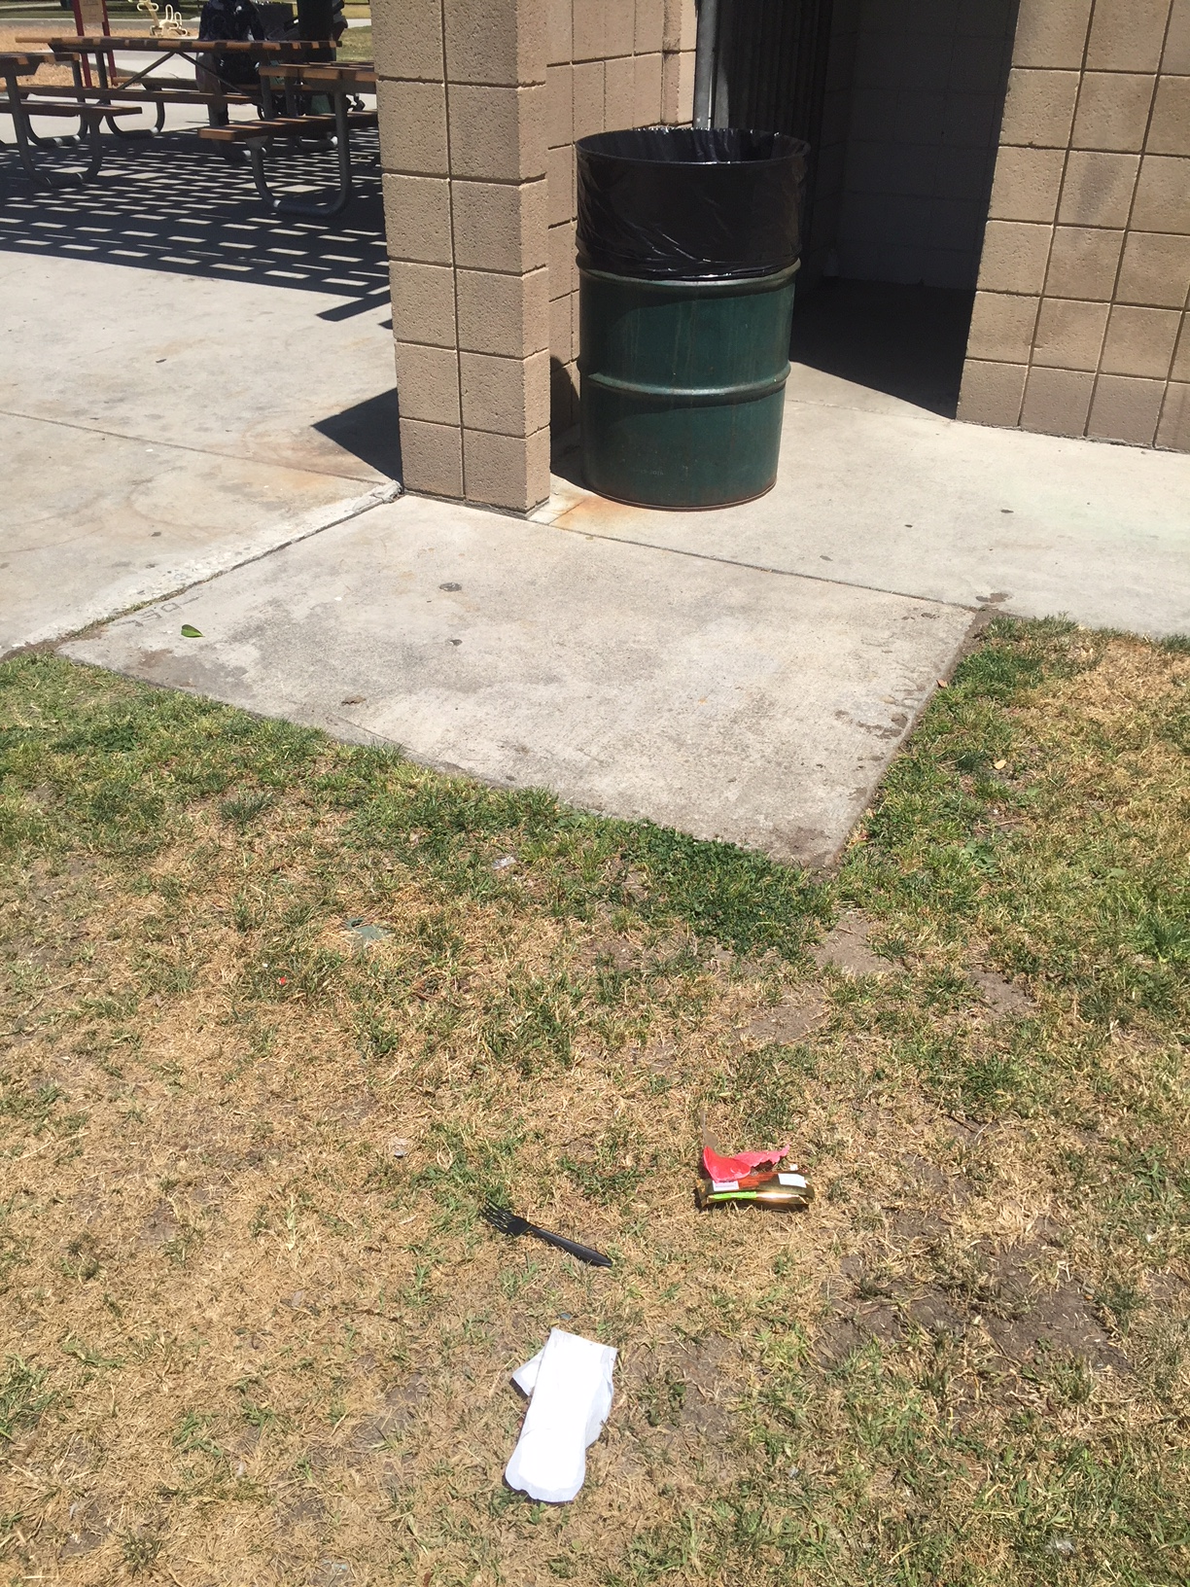
At Evergreen Park in front of the bathrooms

Slide 4
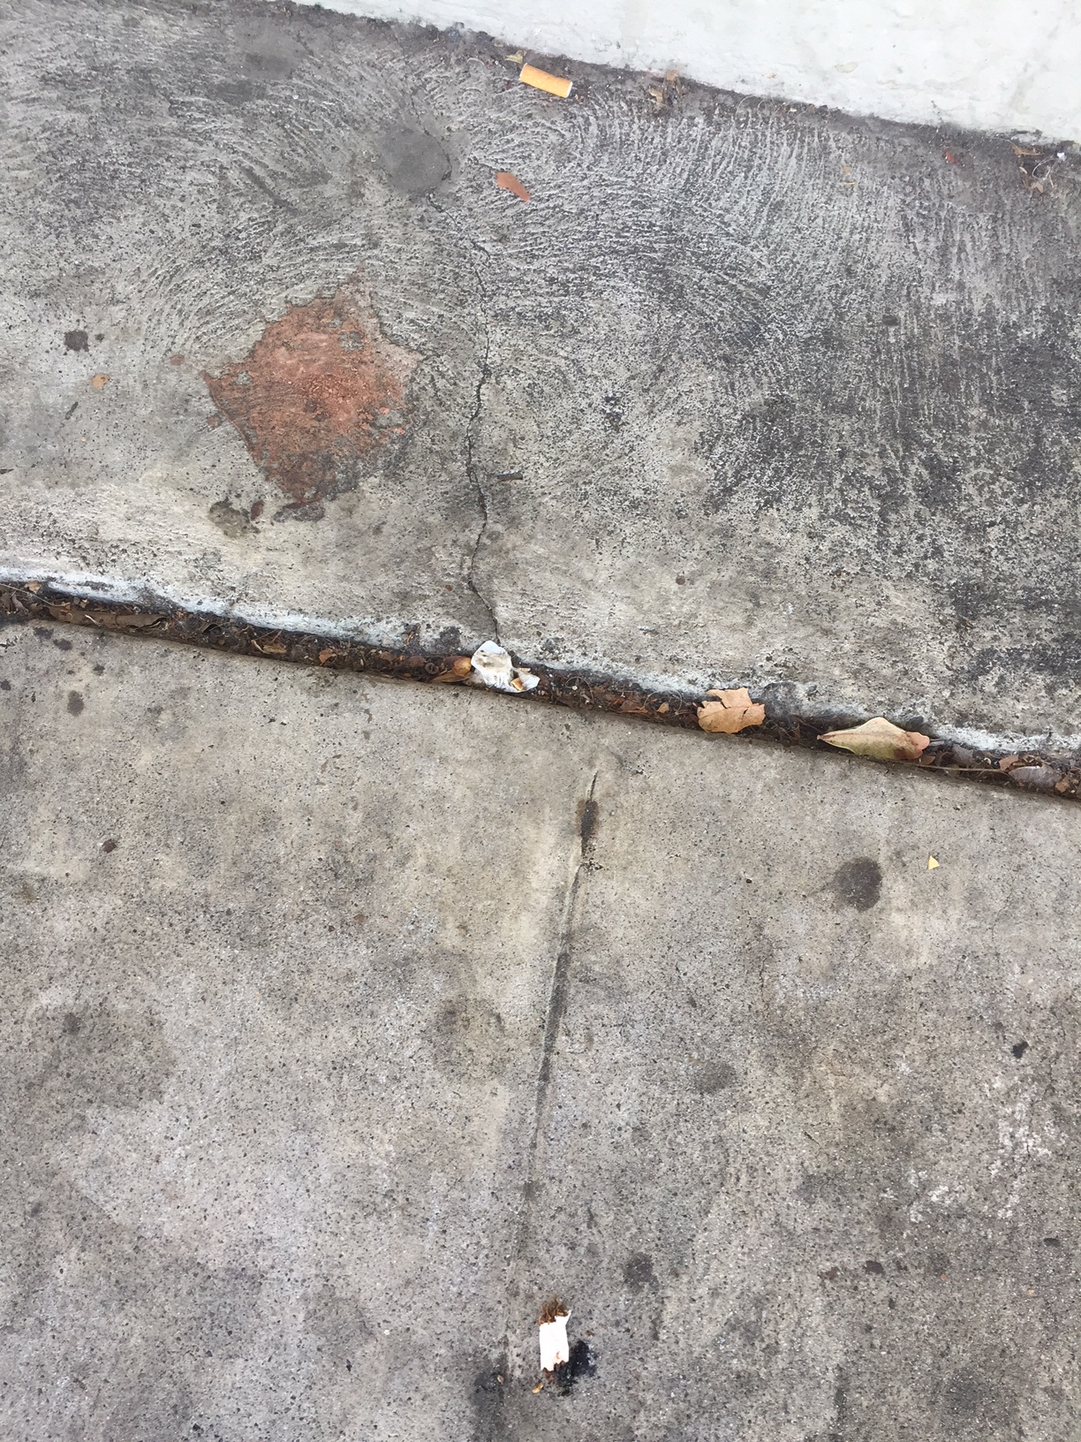
Cigarettes are the most seen litters and on every corner of the streets

Slide 5
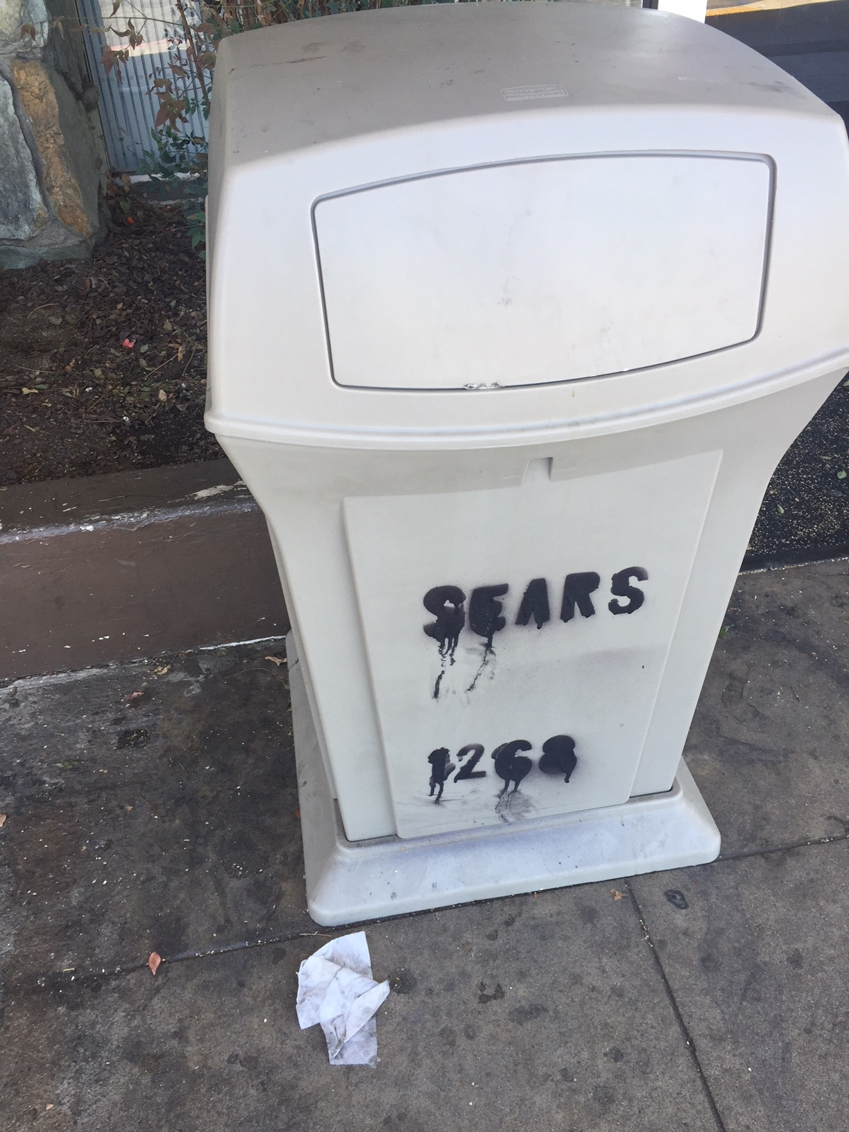
Trash are always thrown in front of the cans which makes the idea of trashcans useless

Slide 6
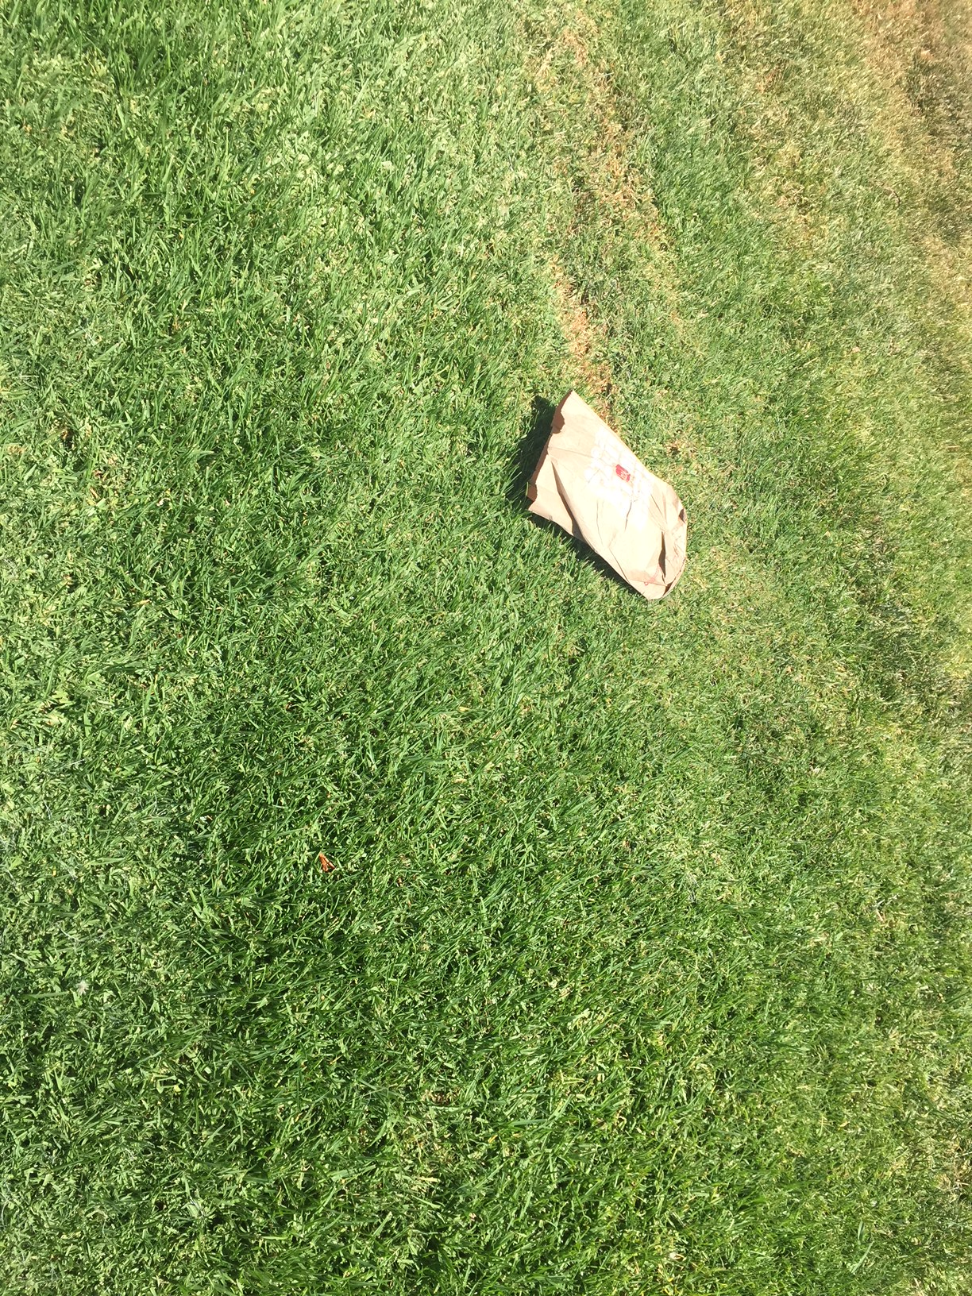
Students on campus, throw their trash away on the grass polluting the Earth

