Slide 1
Animal Overpopulation
MP
Eng 350-17

Slide 2
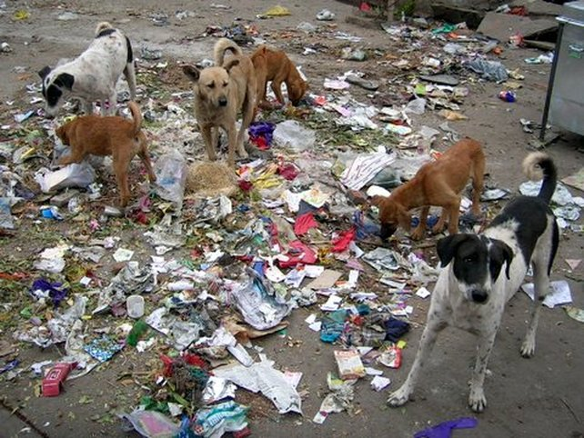
The Crisis
Animal overpopulation is a serious crisis within not just our communities, but it also extends to be a nation wide and world wide crisis as well.
The overwhelming number of animals in the world has lead them to crowd our streets, our animal hospitals, and our shelters to the point that euthanasia is a solution to most overcrowding situations in the rescue process.

Slide 3
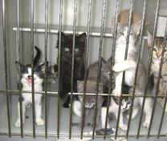
The underlying Effects
Because there are so many animals wandering the streets, they are subject and highly prone to infections and diseases that reported by veterinarians and shelter rescue groups become the very reason for most stray animals deaths.
Common illnesses include: upper respiratory infections in cats, and skin infections and canine parvovirus in dogs. These specific conditions have the tendency to be very difficult to get rid of and end up most likely remaining with the animal until death.

Slide 4
The solution
The solution to animal overpopulation is spaying and neutering your pets. It sounds too simple to be true for such a huge crisis, but its honestly the number one cause of animal overpopulation, the lack of spaying and neutering our pets.
Its very common for animals to run away or become lost, and when they do they mate and leave litters of kittens and puppies on the streets that have little chance of surviving or living a healthy life.
As of October 1, 2015 it has been a law requirement to spay and neuter your pets, all dogs over 6 months of age, and all cats over 3 months are subject to this law and still people some how get around it, contributing to the animal overpopulation crisis.

Slide 5
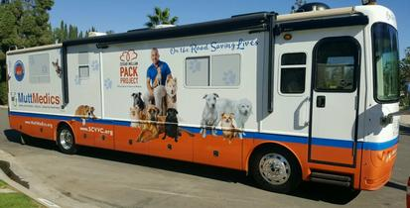

What if I cant afford it?
Most people don’t know about this but there are actually numerous mobile animal clinics in almost every community today that offer low-cost to absolutely FREE animal care and spay and neutering.
SCVVC- Society for California Veterinary & Vaccine Care
Fix it Long Beach- in my community, is a program run by the city animal care services that aids in the fight against animal overpopulation by offering free spay and neutering services with mobile clinics as well.

Slide 6

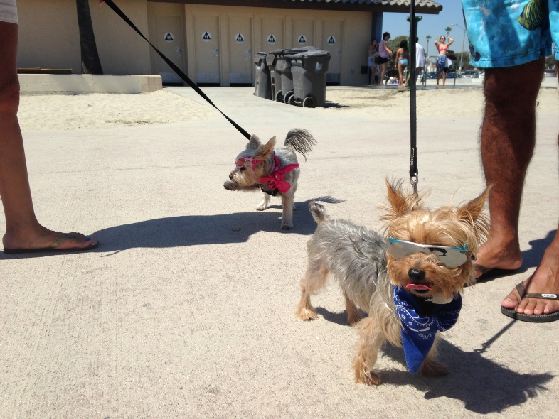
Concluding Benefits to solution
Benefits of spaying and neutering your pets include:
    Less chance of health problems later in life
    Most pets are calmer, more obedient, and more affectionate.
    Males are less likely to roam, bite, and be aggressive.
    Reduces amount of mounting and territorial marking
    And last but not least it reduces the number of unwanted pets in the community!

