Slide 1
High Impact Practices (HIP) Service Learning Internship Community Engagement (SLICE)Presentation
Gabriela Valdez
Graffiti in urban areas.
English 350
5/8/18

Slide 2
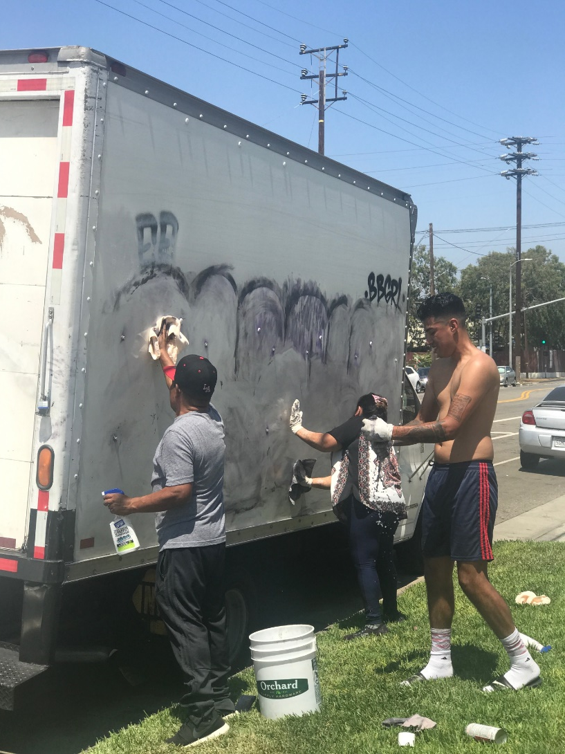
Neighborhoods, Residential and Businesses targeted.

Slide 3
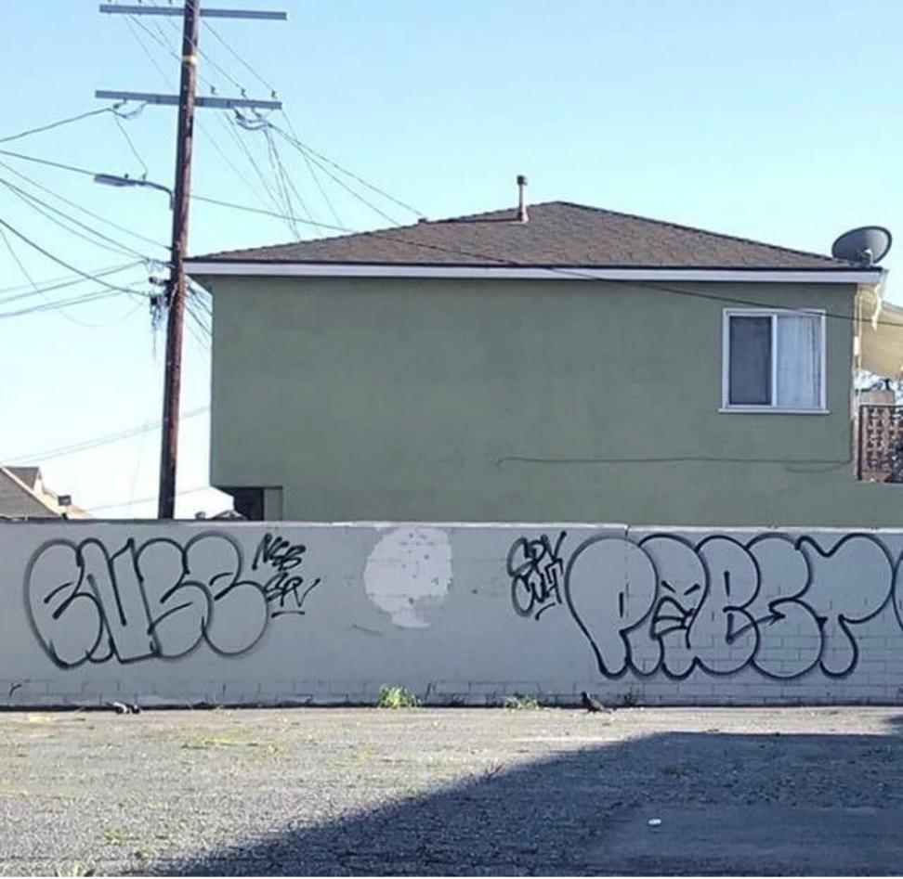
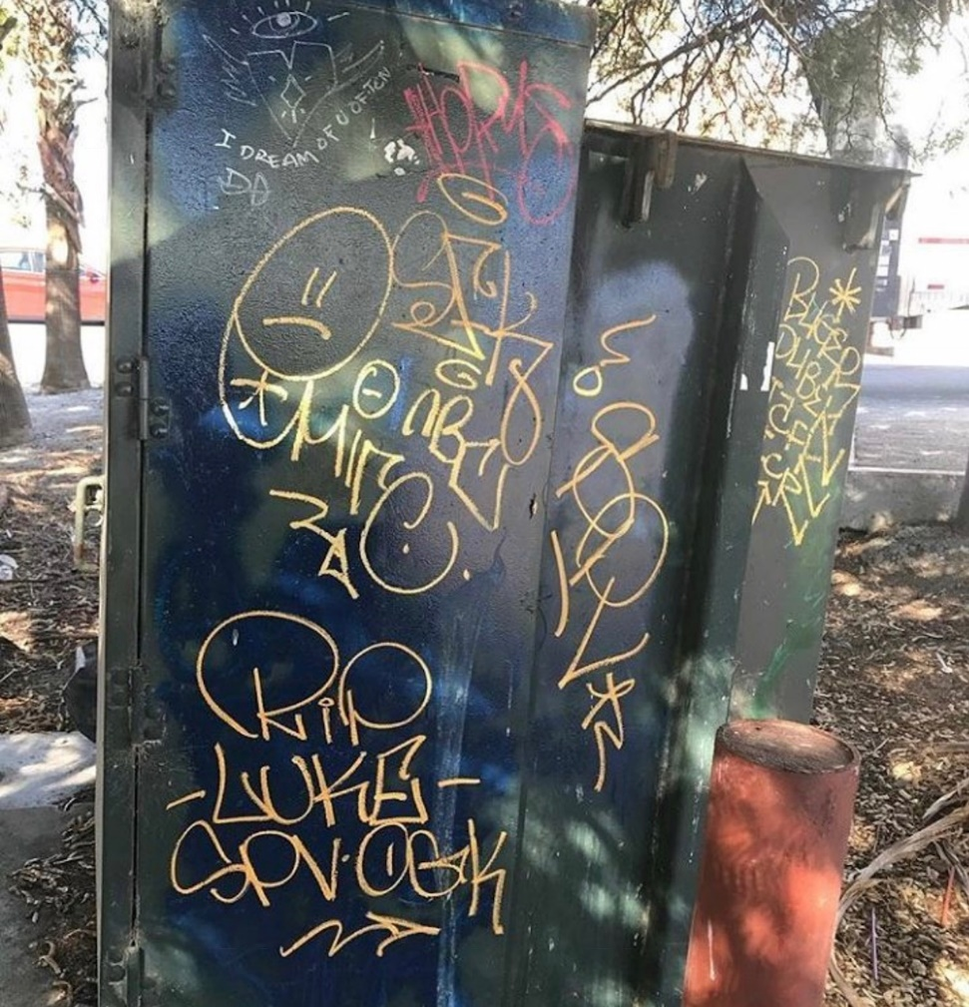
East Los Angeles Graffiti

Slide 4
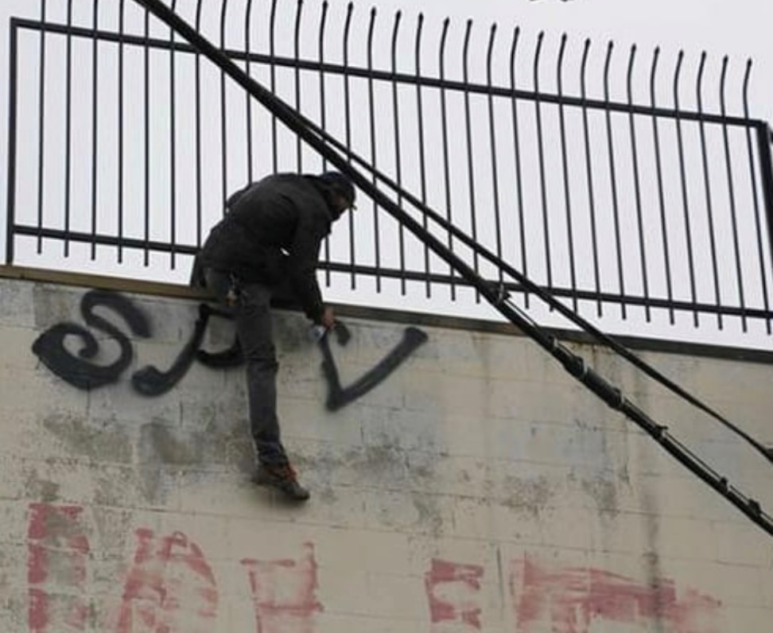
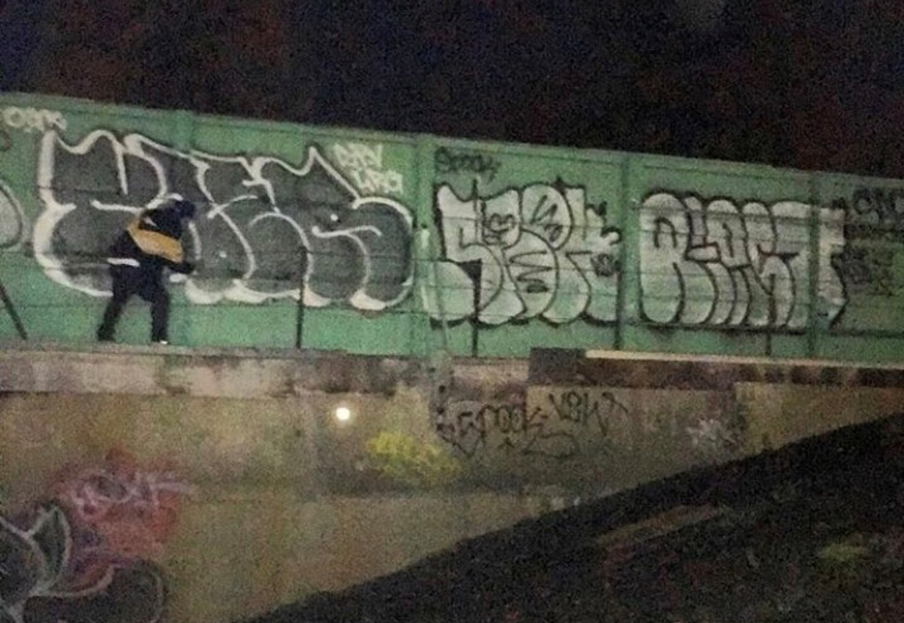
Downtown Los Angeles

Slide 5
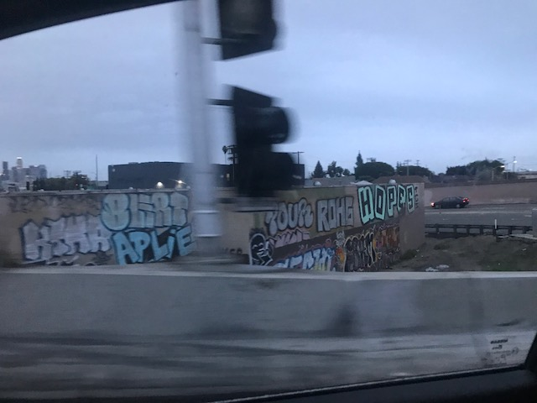
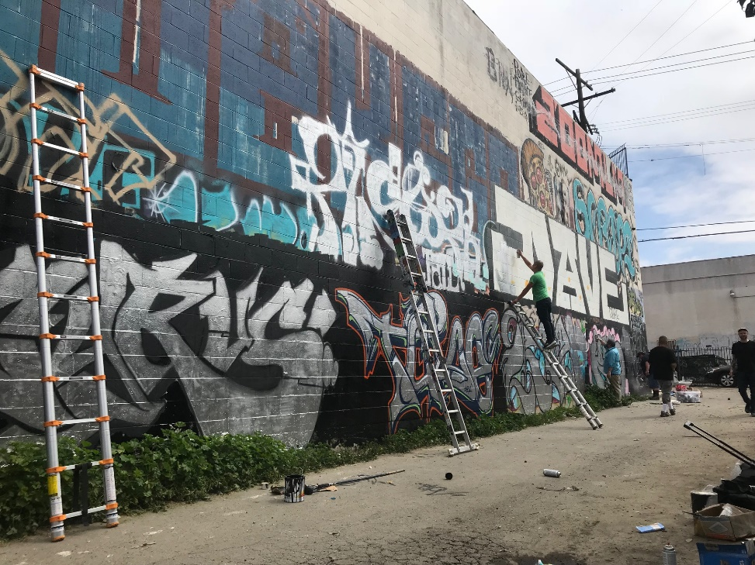
Solutions and differences
Illegal Graffiti
Legal Graffiti

