Slide 1
High Impact Practices (HIP) Service Learning Internship Community Engagement (SLICE)Presentation
Serina Ortiz
Living in a Litter Box
Eng 350
9-May-18

Slide 2
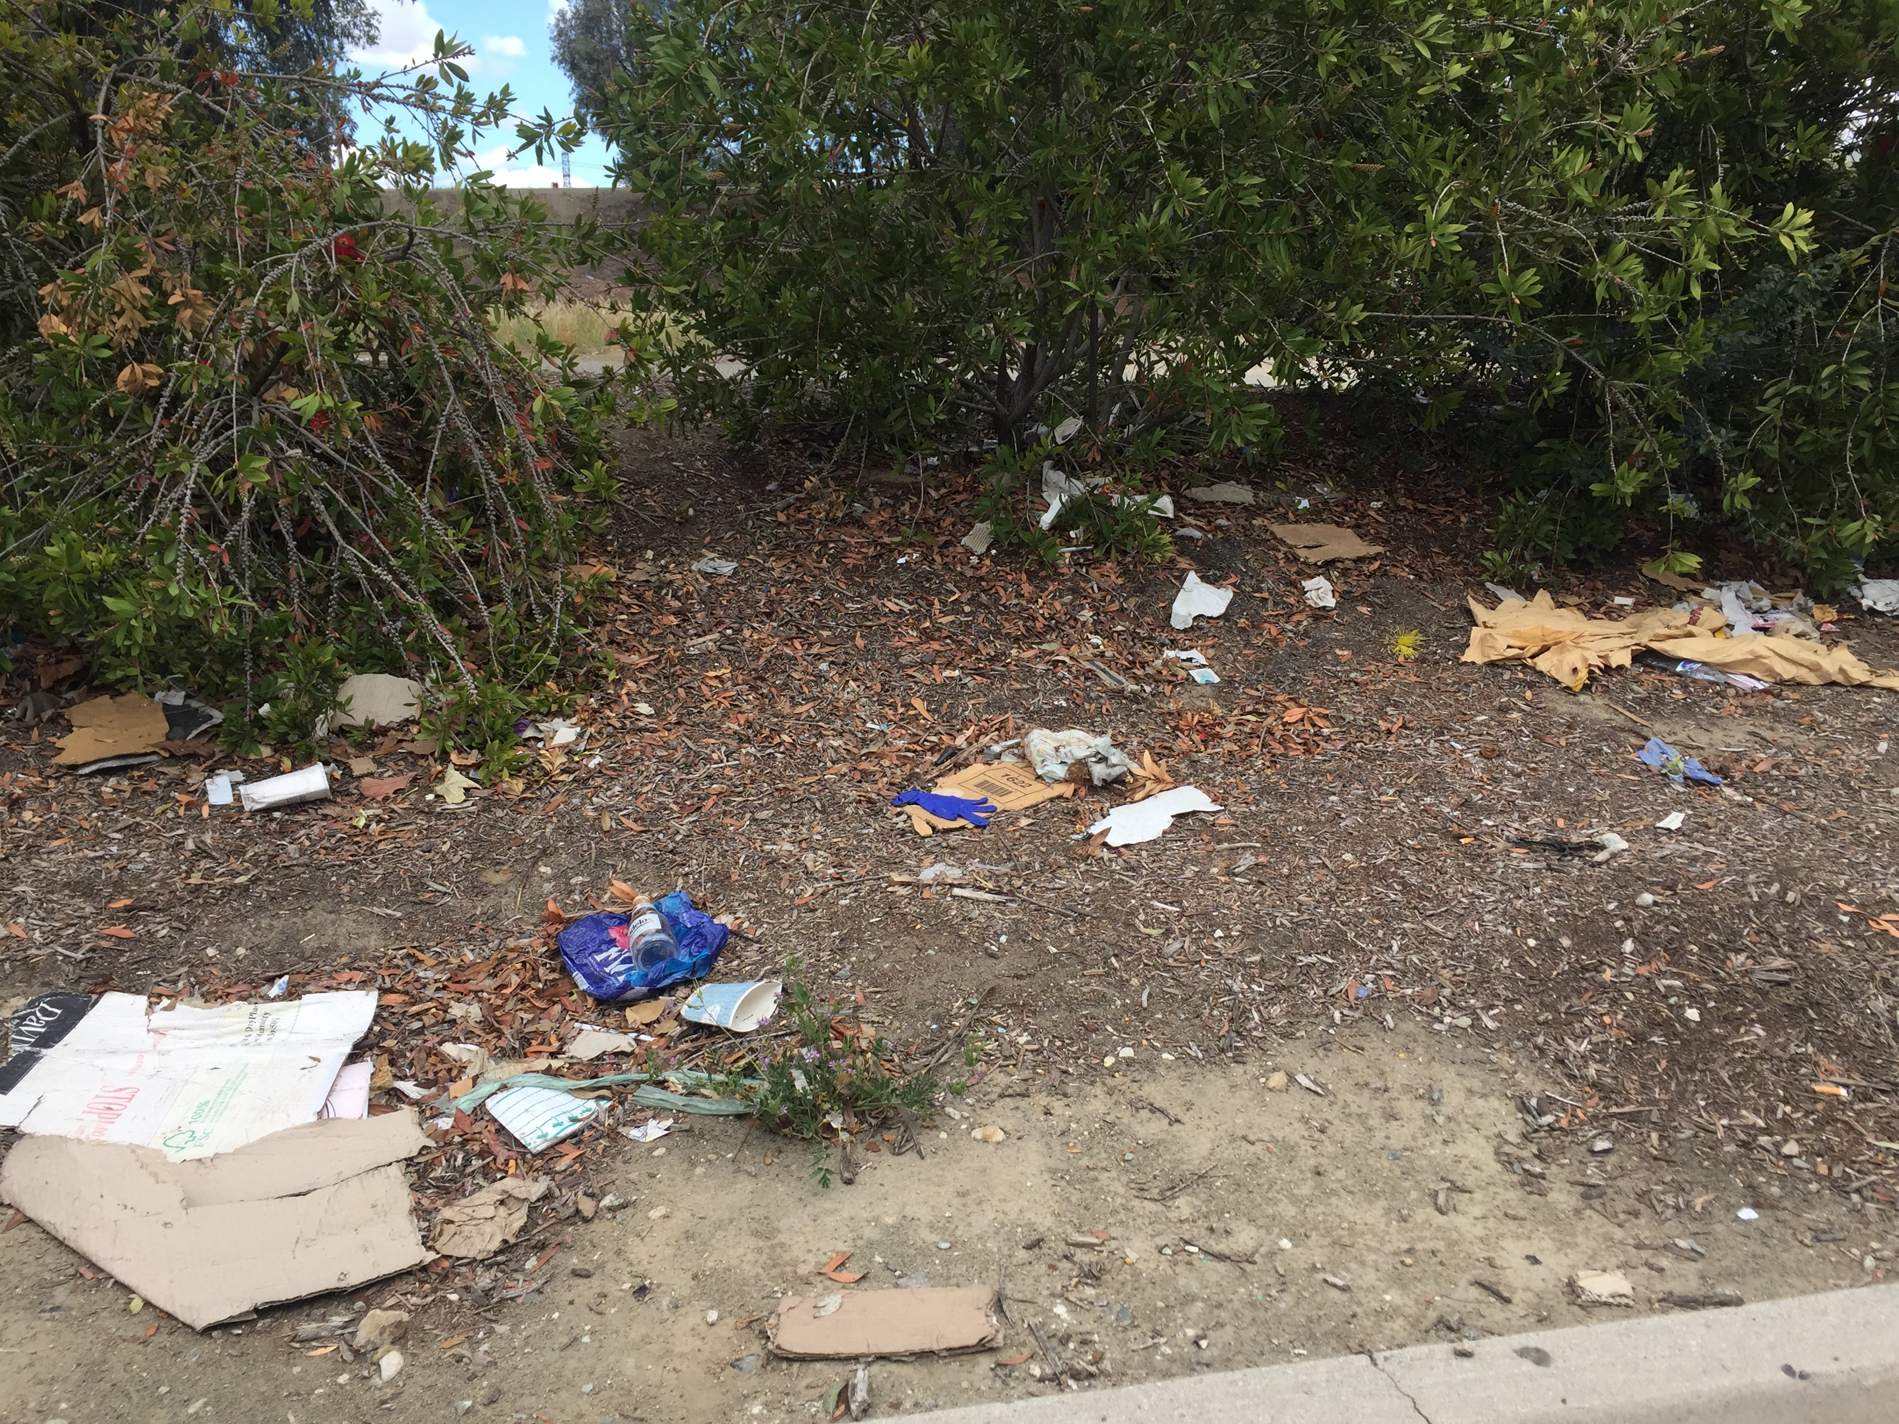

Slide 3
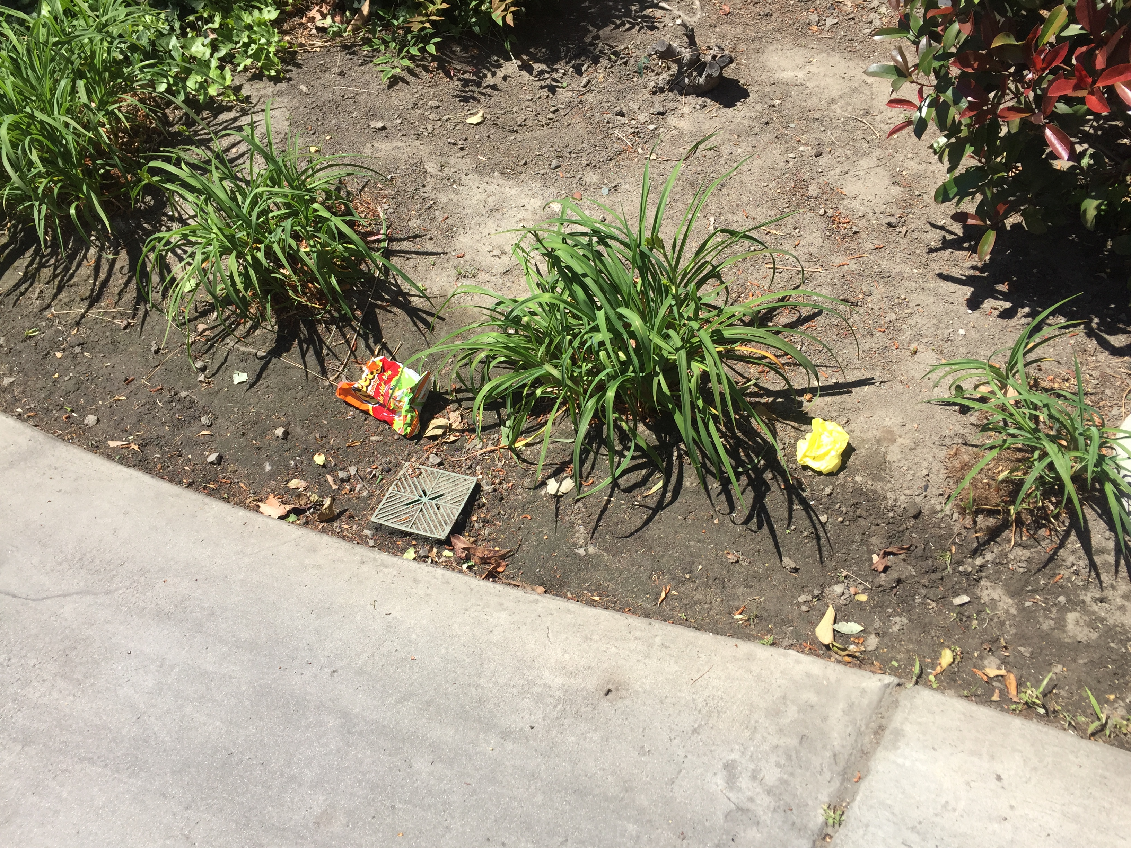
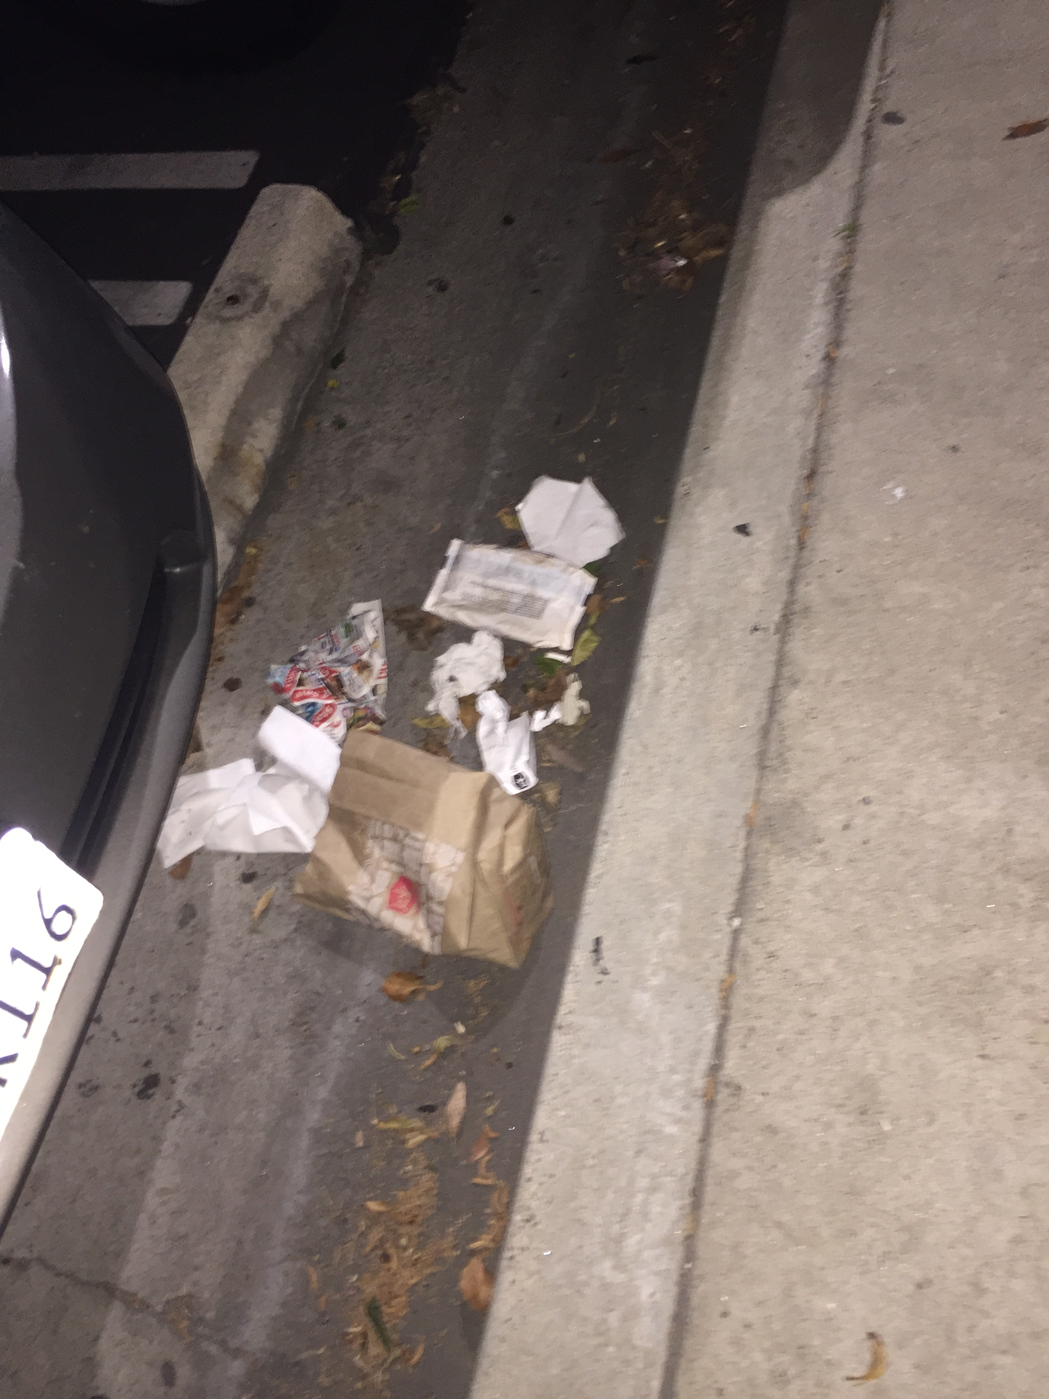

Slide 4
