Slide 1
HIP/SLICE “Fix-It” Journal: Littering
By: DB
“Slowly Harming the Earth”

Slide 2
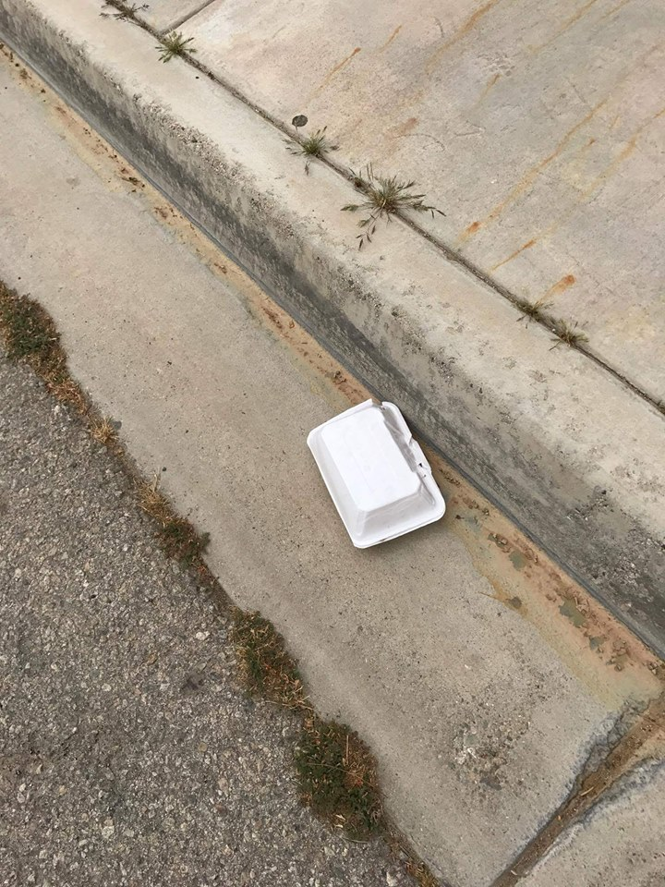
Styrofoam food container
  500 years to forever to fully decompose
  Harmful to environment and wild life

Slide 3
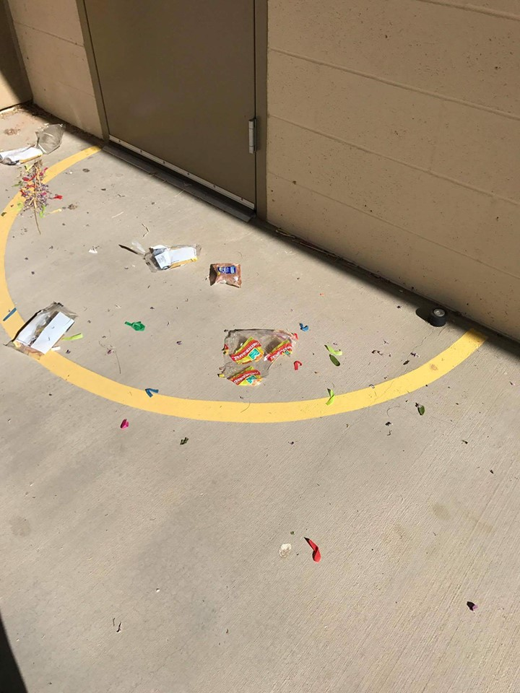
Weather such as wind, causes trash to pile up.
  Food wrappers

Slide 4
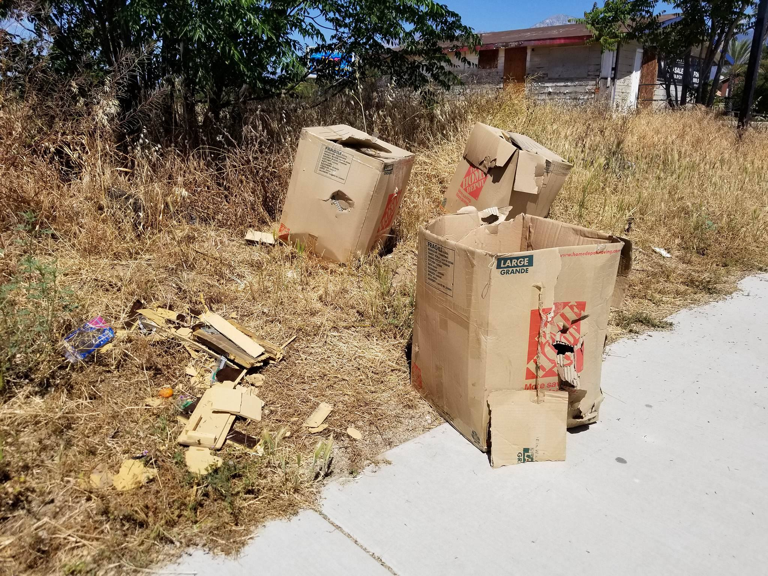

Slide 5
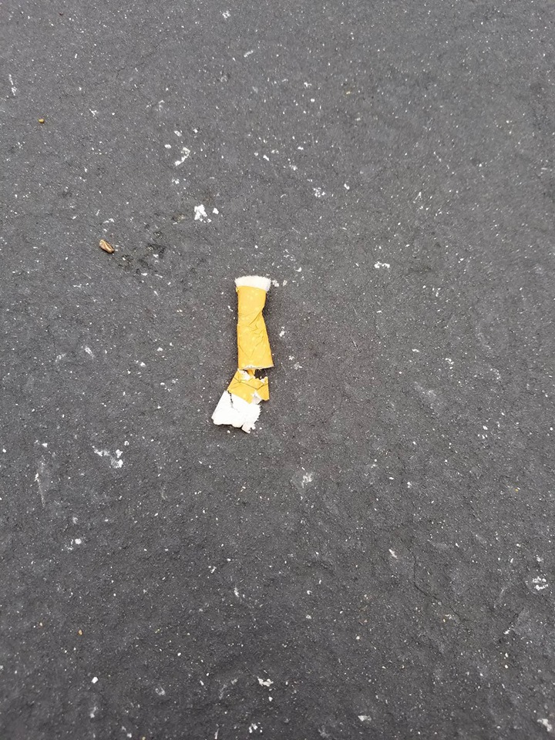
Cigarette
  Most item found in the ocean

Slide 6
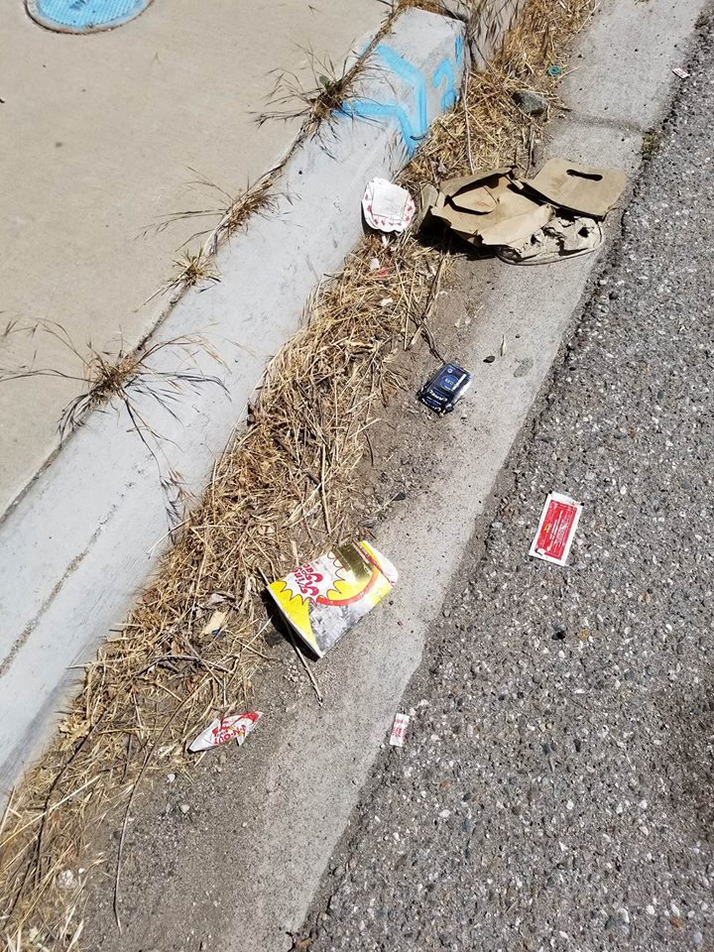
Ketchup packet, cup holders, cigarette pack, soda cup.

