Slide 1
Pollution In our community

Slide 2
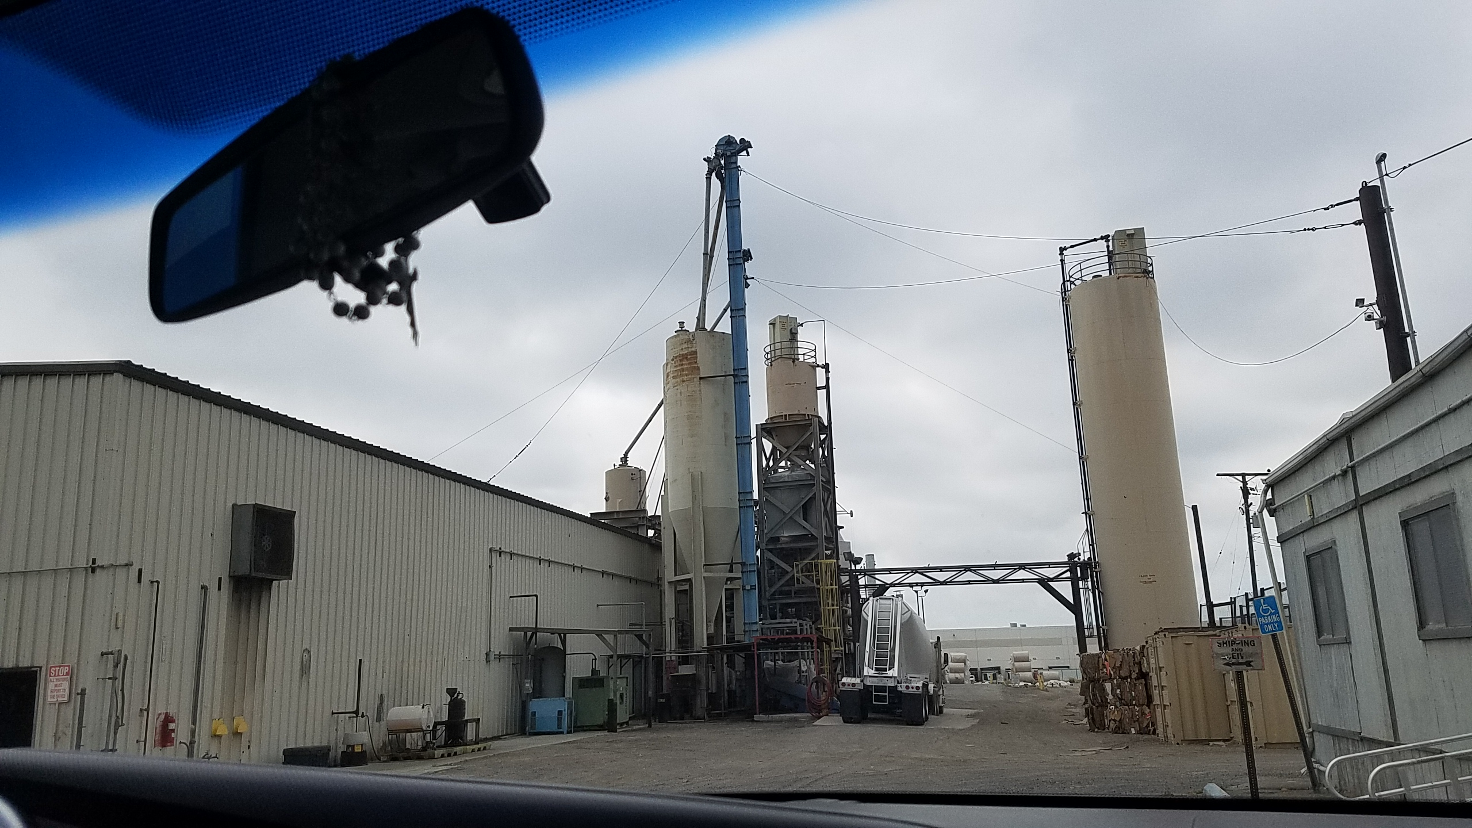
Fontana paper mills

Slide 3
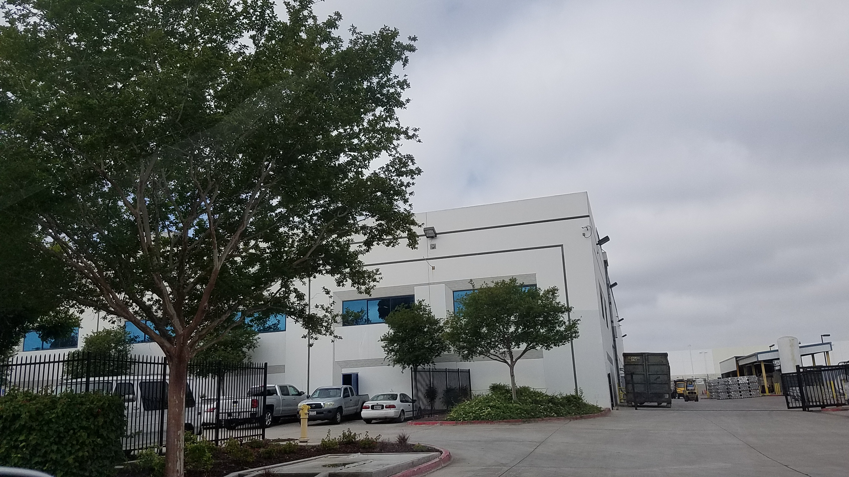
Sierra aluminum co

Slide 4
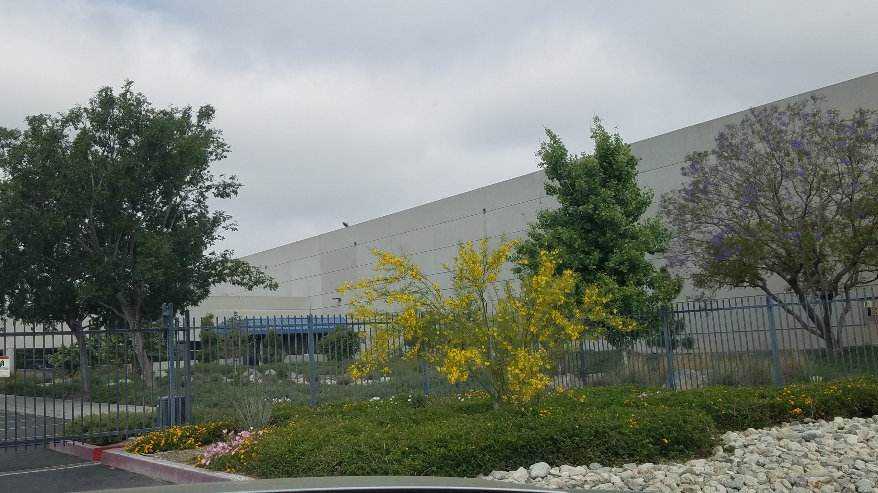
METAL CONTAINER CORPORATION

Slide 5
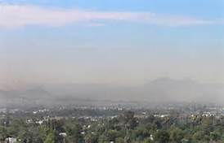
Smog in fontana California 2012

