Slide 1
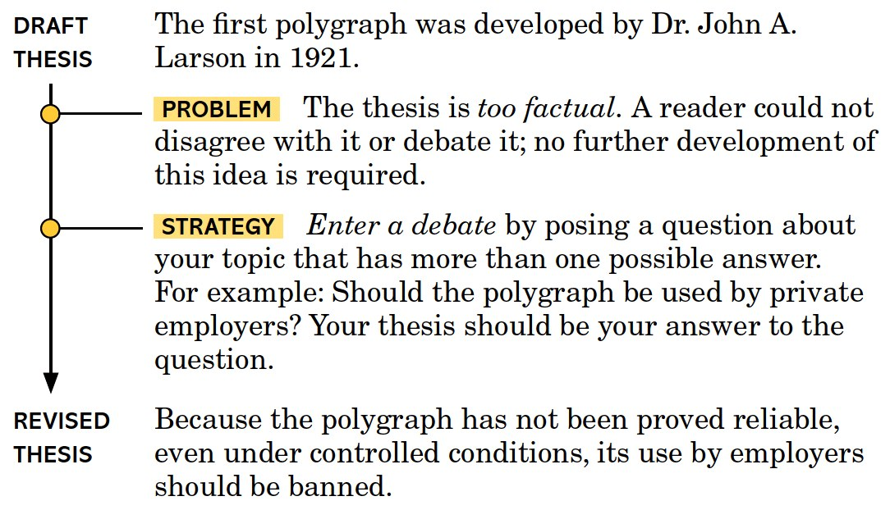
Writing an Effective Thesis

Slide 2
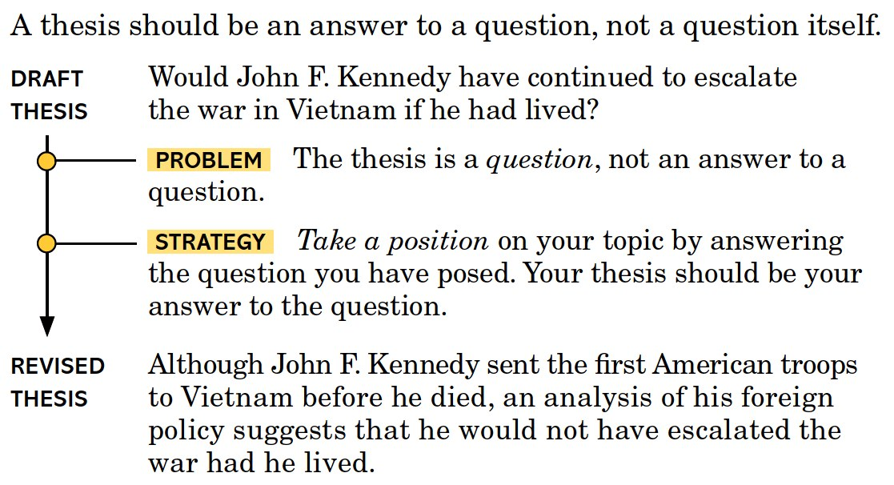
Writing an Effective Thesis

Slide 3
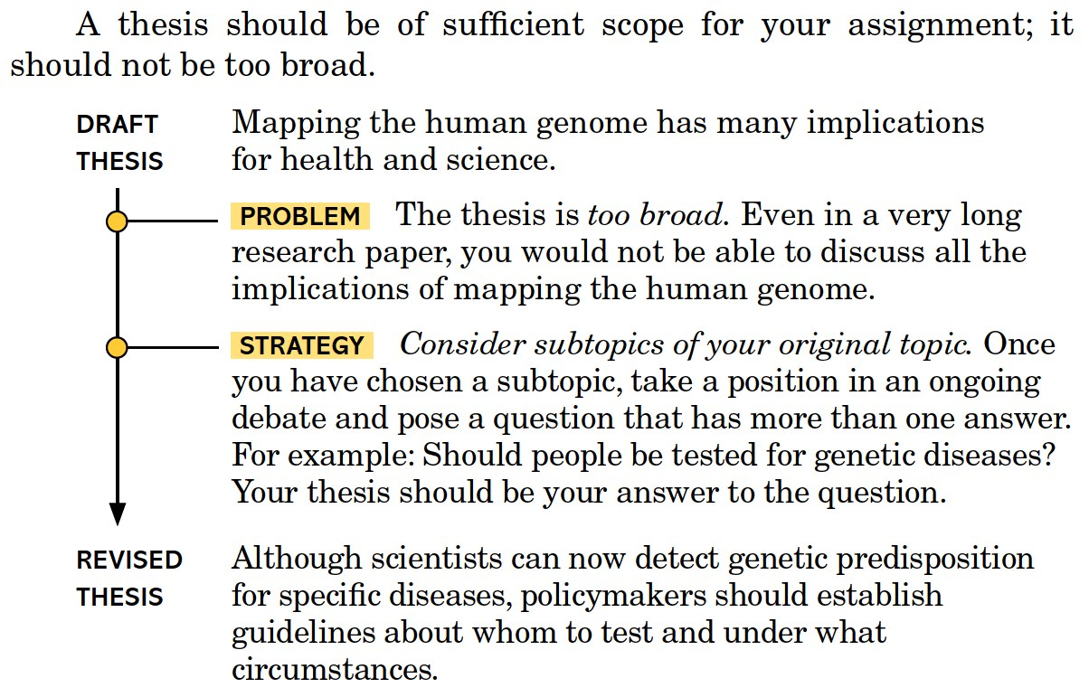
Writing an Effective Thesis

Slide 4
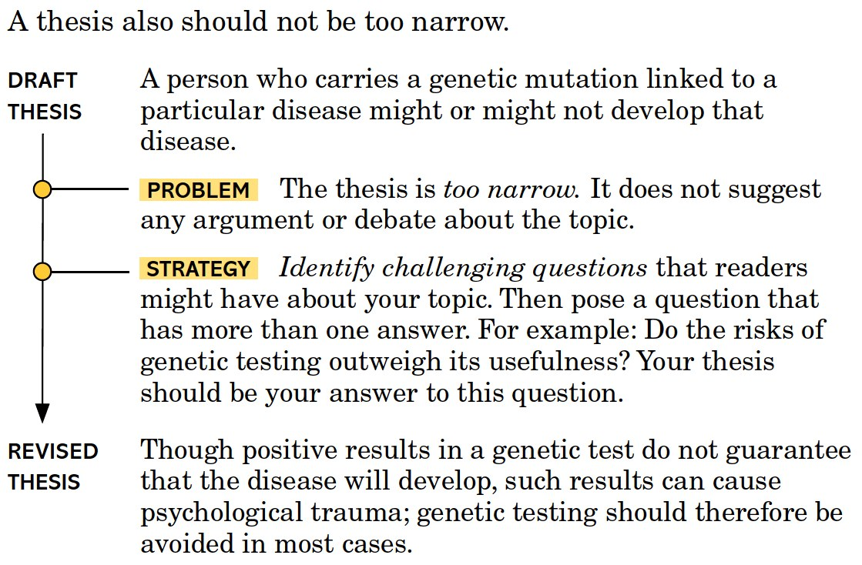
Writing an Effective Thesis

Slide 5
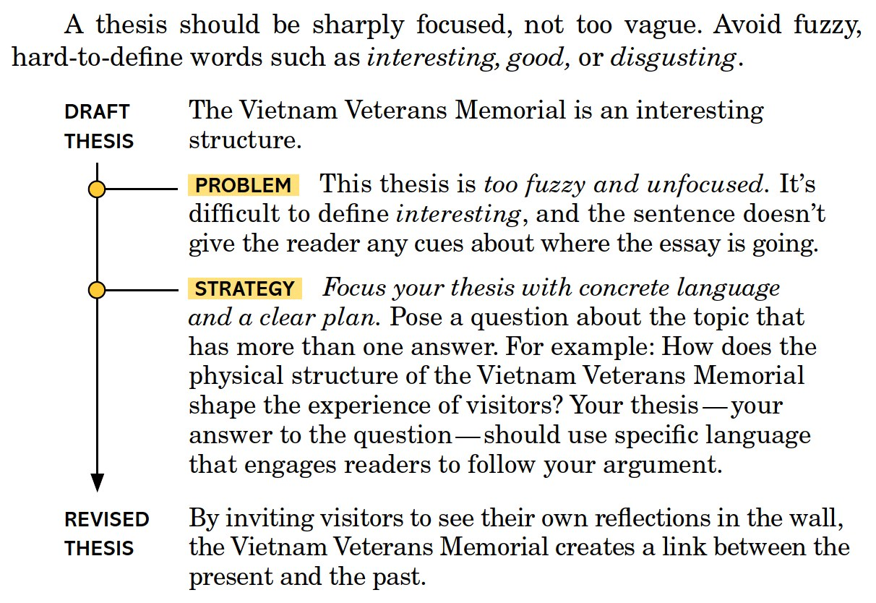
Writing an Effective Thesis

