Slide 1
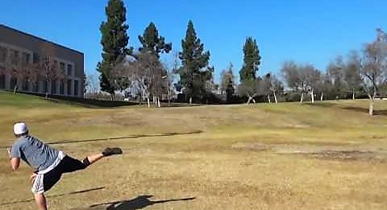

Aymen Al-Lali HIP/SLICE “Fix-It” PPT
Draught

Slide 2
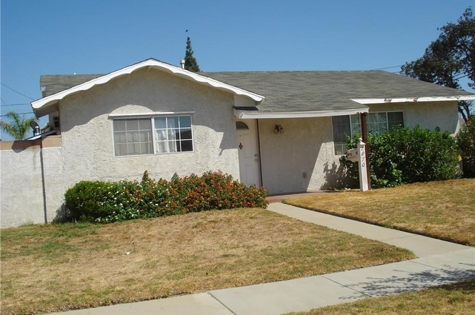

Slide 3
