Slide 1

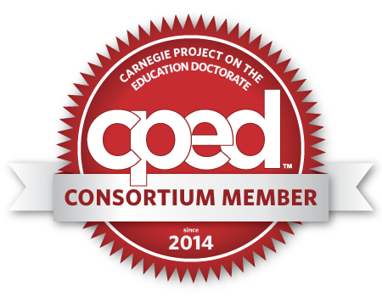

Measuring “College Readiness” thru High Impact Practices:
Assessing a Journal to Article English Composition activity
Presentation by Dean Ramser
KEY WORDS- COLLEGE READY, HIGH IMPACT PRACTICES, CIVIC ENGAGEMENT, UNDERGRADUATE RESEARCH, DIVERSITY & GLOBAL LEARNING, AND SERVICE LEARNING, COMMUNITY-BASED LEARNING.

Slide 2
Research Questions
How does participation in a High Impact Practice activity affect First Year Students’ College Readiness?
How does participation in a High Impact Practice activity affect First Year Students’ Writing?

Slide 3
Overview of the Literature Review
Kuh, G. D. (2008). High-impact educational practices: What they are, who has access to them, and why they matter. Washington, DC: Association of American Colleges and Universities Data set from the Wabash National Study of Liberal Arts Education--a longitudinal, pretest/posttest design--to estimate the effects of participation in the ten "high-impact" educational practices put forth and endorsed by the Association of American Colleges and Universities (AAC&U) on a variety of liberal arts educational outcomes.
Kilgo, Cindy A.; Ezell Sheets, Jessica K.; Pascarella, Ernest T. The Link between High-Impact Practices and Student Learning: Some Longitudinal Evidence
Higher Education: The International Journal of Higher Education and Educational Planning, v69 n4 p509-525 Apr 2015 “When Hope is Subversive” emphasis the importance of educated hope in enabling students to understand and tap into their own potential as citizens and agents of social change.
Giroux, Henry. “When Hope is Subversive.”Tikkun (2004). Simmons argues that we must re-think and re-write community writing projects, that we must explore ways to incorporate extended community writing projects—projects that span multiple courses and often require multidisciplinary expertise and a broad sense of critical inquiry to complete—into our curriculum.
Simmons, Michele. "Encouraging Civic Engagement Through Extended Community Writing Projects: Rewriting The Curriculum." Writing Instructor (2010): ERIC. Web. 11 Nov. 2015. As Moore and Mendez assert, student civic engagement is both a manifestation of an institution’s commitment to community engagement and an “educationally purposeful activit[y]” (Kuh et al., 2007, p. 44) through which students deepen their engagement (Kuh, 2009), and thereby enhance their chances of achieving desired learning outcomes in college, or, in other words, succeeding.
Moore, Tami, and Jesse Mendez. “Civic Engagement and Organizational Learning Strategies for Student Success.” New Directions for Higher Education 2014.165 (2014): 31–40. Riehle and Weiner agree that service learning includes experiential learning, confronting “real-world” problems, applying reflection and knowledge in developing solutions in the context of the subject matter.
Riehle, Catherine, and Sharon Weiner. “High-Impact Educational Practices: An Exploration of the Role of Information Literacy.” College & Undergraduate Libraries 20.2 (2013): 127–143 Lawrence and Snow show that exposing students to controversial issues is critical to their civic engagement development, which can generate high levels of disagreement. That complicated discourse prepares students for the world outside of the classroom.
Lawrence, Joshua and Snow, Catherine. “Teaching urban youth about controversial issues: Pathways to becoming active and informed citizens.” Citizenship, Social and Economics Education 14.2 (2015): 103–119.

Slide 4
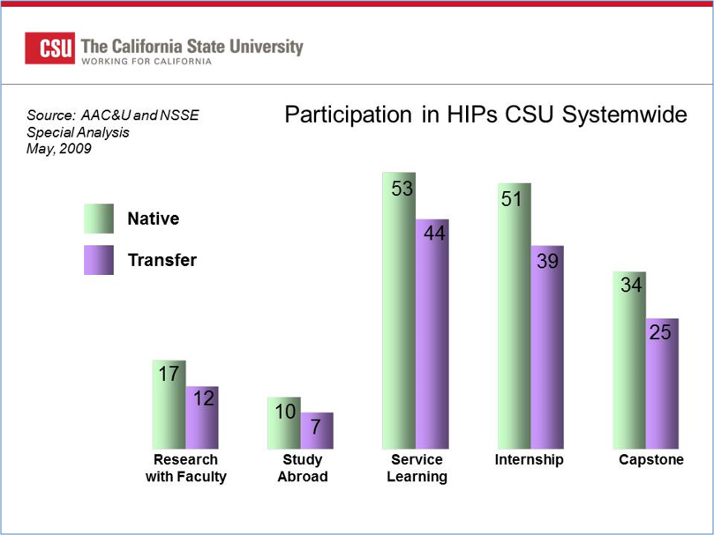
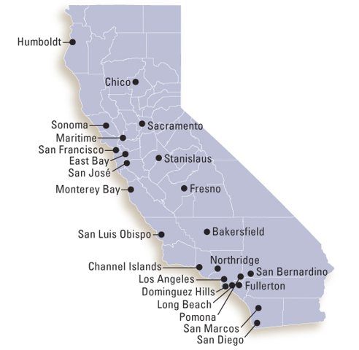
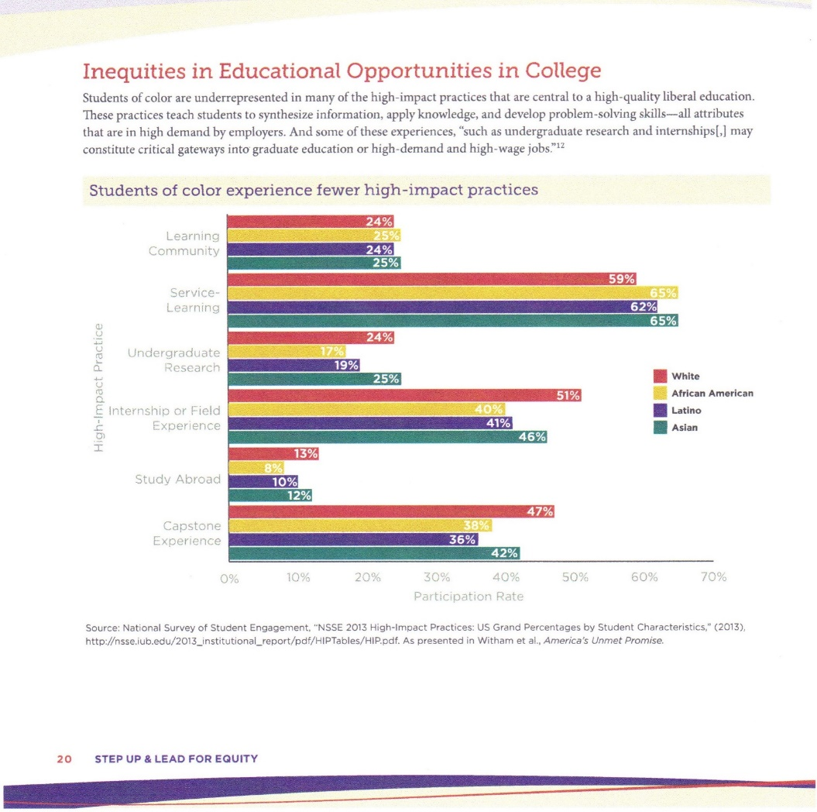
 | baseline | 2025 target
Six-year graduation rate | 51% | 60%
Four-year graduation rate | 16% | 24%
Gap by ethnicity | 14 points | 7 points
Gap by Pell eligibility | 11 points | 5 points
Transfer four-year rate | 70% | 76%
Transfer two-year rate | 27% | 35%
There is scarce data on civic outcomes connected with the experiences of underserved students (underrepresented minorities, first-generation, transfer, and low income); see for example Brownell and Swaner. 2010. Five High Impact Practices: research on Learning Outcomes, Completion, and Quality. Washington, DC: Association of American Colleges & Universities).

Slide 5
Students of color experience fewer high-impact practices: | White | African American | Latino | Asian
Service Learning | 59% | 65% | 62% | 65%
Undergraduate Research | 24% | 17% | 19% | 25%
Internship or Field Experience | 51% | 40% | 41% | 46%

Slide 6


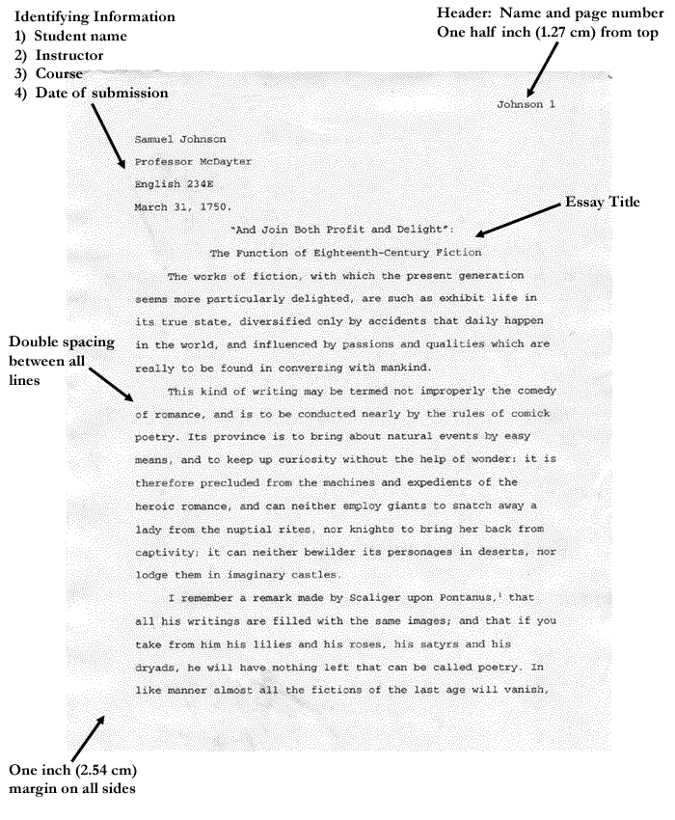

HIP/SLICE Journal to Article English Composition activity
Keys to College Readiness- David T Conley (2011) Defining and Measuring College and Career Readiness
High Impact Practices (HIP): Critical Thinking Decisions
THINK
Assignment (Key Cognitive Strategies)
Service Learning Internship Community Engagement (SLICE): students journal about their experiences
KNOW
Journal Activity (Key Content Knowledge)
First Year Undergraduate Research: students research their SLICE topic
GO
Making Concrete Abstract Ideas Developed Through Community Engagement: students prepare essay for submission to scholarly journal
ACT
Submission to Scholarly Journal (Key Transition Knowledge and Skills)
Research Essay (Key Learning Skills and Techniques )
Notes:
College and Career Readiness Defined ACT has long defined college and career readiness as the acquisition of the knowledge and skills a student needs to enroll and succeed in credit-bearing first-year courses at a postsecondary institution (such as a two- or four-year college, trade school, or technical school) without the need for remediation. ACT’s definition of college and career readiness was adopted by the Common Core State Standards Initiative, which serves as validation of our extensive research and ACT’s College Readiness Standards™.
Measuring academic performance in the context of college and career readiness—focusing on the numbers and percentages of students meeting or exceeding the ACT College Readiness Benchmarks—provides meaningful and compelling information about the academic readiness of students. The Condition of College & Career Readiness highlights that information.

Slide 7
STEPS:
1. Diagnostic Test on Writing and Grammar Skills & Memory Essay
2. Pre-test on HIP skills (Lickert scale)
3. HIP/SLICE journal (20 page of observations & intervies)
4. HIP/SLICE Research Paper (5 pages with HIP journal as primary sources & 4 secondary sources)
5. Submission to Journal- Journal of Undergraduate Research and Scholarly Excellence is a peer-reviewed, undergraduate journal registered with the Library of Congress that accepts submissions of any subject, from any undergraduate institution.
6. Survey Monkey Post-Test on HIP skills (Narrative; Open-Ended)
10. Mastery Test on Writing and Grammar Skills & Memory Essay
11. Text Anlysis (WriteLab, Turnitin.com, & Textalyser) comparison of HIP/SLICE Research essay from first year students at Cerritos Community College and at California State University Dominguez Hills (both HIS)

Slide 8
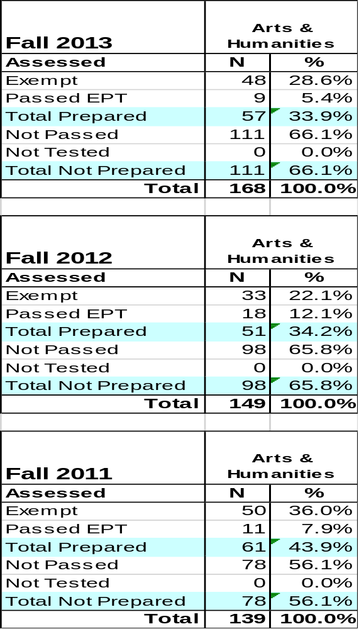
Setting
California State University, Dominguez Hills (CSUDH)
- a Hispanic Serving Institution and public university founded in 1960
-part of the 23 school CSU system
45[6] majors for a Bachelor's degrees; 22 different Master's degrees
17 types of teaching credentials
2015 enrollment of 14,635 students; 12,562 undergraduates (85.3%)
-2,073 post baccalaureates (14.1%)
767 faculty; 303 were full time and tenure track
Dominguez Hills ranked #2 in a list of "The 100 Most Affordable Universities in America 2015" by Best Value Schools.[12] It also ranked #29 in the list of "50 Best Value Colleges and Universities in California 2015."[13] It is one of the most ethnically-diverse universities in the United States[14][15][16] and has a large population of first-generation college students.[17]
Cerritos College - a Hispanic Serving Institution and public comprehensive community -offers degrees and certificates in 87 areas of study in nine divisions
-Cerritos College ranks second in the state for Mexican-American/
Latino student transfers to California State Universities.
-595 full-time employees (263 faculty); 934 part-time employees (575 faculty)
Both campuses serve predominantly Hispanic students.
Sample
CSUDH –Preparation for College Level English by College
All First-Time Freshmen*

Slide 9
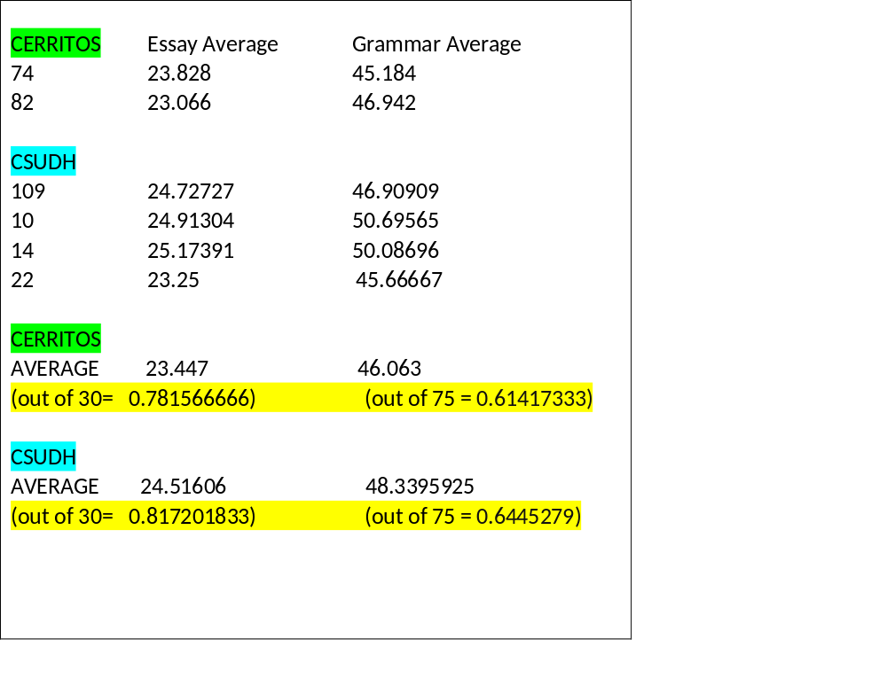
Methodology
Data Collection Procedures
Data Analysis Procedures
1. Diagnostic Test on Writing and Grammar Skills (Diagnostic Tests and Exercises for Touchstones Chris Juzwiak, Glendale Community College, and Julie Nichols Okaloosa –Walton College; BEDFORD/ST. MARTIN’S Boston New York, 2014)
2. Memory Essay
3. Pre-test on HIP skills (Lickert scale)
4. HIP/SLICE journal
5. Professor observation of class
6. HIP/SLICE Research Paper
7. HIP/SLICE journal
8. Submission to Journal
9. Post-Test on HIP skills (Narrative; Open-Ended)
10. Mastery Test on Writing and Grammar Skills
11. Memory Essay
Comparison of first year students’ responses at *Cerritos Community College and at California State University Dominguez Hills
*additional paper

Slide 10
Findings:
Pre-test on HIP skills (Lickert scale)
Part 1-a Least- 1 2 3 4 Greatest-5 Cerritos 0.5 1 4.5 9 11 CSUDH 0 0 2.25 7.25 11.75 part 1-b Cerritos 1 3 6.5 9.5 8 CSUDH 0 0 3.75 8.75 12 part 1-c Cerritos 2.5 1.5 12.5 8 5 CSUDH 0.25 3.5 7.5 8.25 1.75 part 1-d Cerritos 0.5 3 9.5 7 5.5 CSUDH 0 1.75 8.75 9 1.75 part 2-a Cerritos 0.5 1 3.5 10 10.5 CSUDH 1.5 1 3.5 6 9 part 2-b Cerritos 3.5 3 10.5 8 6 CSUDH 1.25 3 8 6.75 4 part 3-a Cerritos 1 2.5 7.5 11.5 5 CSUDH 0.75 1.25 7.25 9.5 3.25 part 3-b Cerritos 1.5 2 8 9 5.5 CSUDH 1 2.25 6.5 6.75 4.5 part 3-c Cerritos 3 4.5 7.5 4.5 7.5 CSUDH 1 2.25 7.75 7 2.5 | Part 1. Undergraduate Research a- Rate on a scale of 1-5 your willingness to consider new or other strategies of reading and writing: 1-5 b- Rate on a scale of 1-5 your level of interest and engagement in the overall process of learning new reading and writing strategies? c- Rate on a scale of 1-5 your ability to generate, investigate, and represent ideas. (For example, do you require specific directions to begin an assignment, or are you able to start the project without additional explanations?) d- Rate on a scale of 1-5 your writing and reading strategies or ideas across the curriculum or other courses or content areas? (For example, in a history or political science class?) CC: 5.20, 5.6, 3.9= 4.9 CSUDH: 4.25, 4.90, 4.25= 4.4667 Part 2. Diversity/Global Learning a- Rate on a scale of 1-5 your level of curiosity or interest to know more about the world? (For example, are you now aware of issues in other parts of the world that you previously did not think about?) b- Rate on a scale of 1-5 your ownership of your actions in relation to global issues, such as diversity, social justice, collaboration, or equity? (For example, in your neighborhood are there action committees organized in response to a recent event or problem? Or, in your classes are there action committees organized to respond to a particular issue?) CC: 5.1, 6.2 = 5.65 CSUDH: 4.2, 5= 4.6 Part 3. Service Learning, Community-Based Learning a- Rate on a scale of 1-5 your ability to adapt to situations, expectations, or demands for reading and writing? (For example, an assignment that is more demanding than anticipated? Or a Pop Quiz? Or an unexpected presentation or group project?) b- Rate on a scale of 1-5 your interest and attention to short term projects? (For example, a weekly assignment?) c- Rate on a scale of 1-5 your interest and attention to long term projects? (For example, a final semester paper or project?) CC: 5.5, 5.2, 5.4 = 5.3667 CSUDH: 4.35, 4.2, 4.1 = 4.21667

Slide 11
Conclusions

