Slide 1
Graffiti Art
By: Sergio Chavez

Slide 2
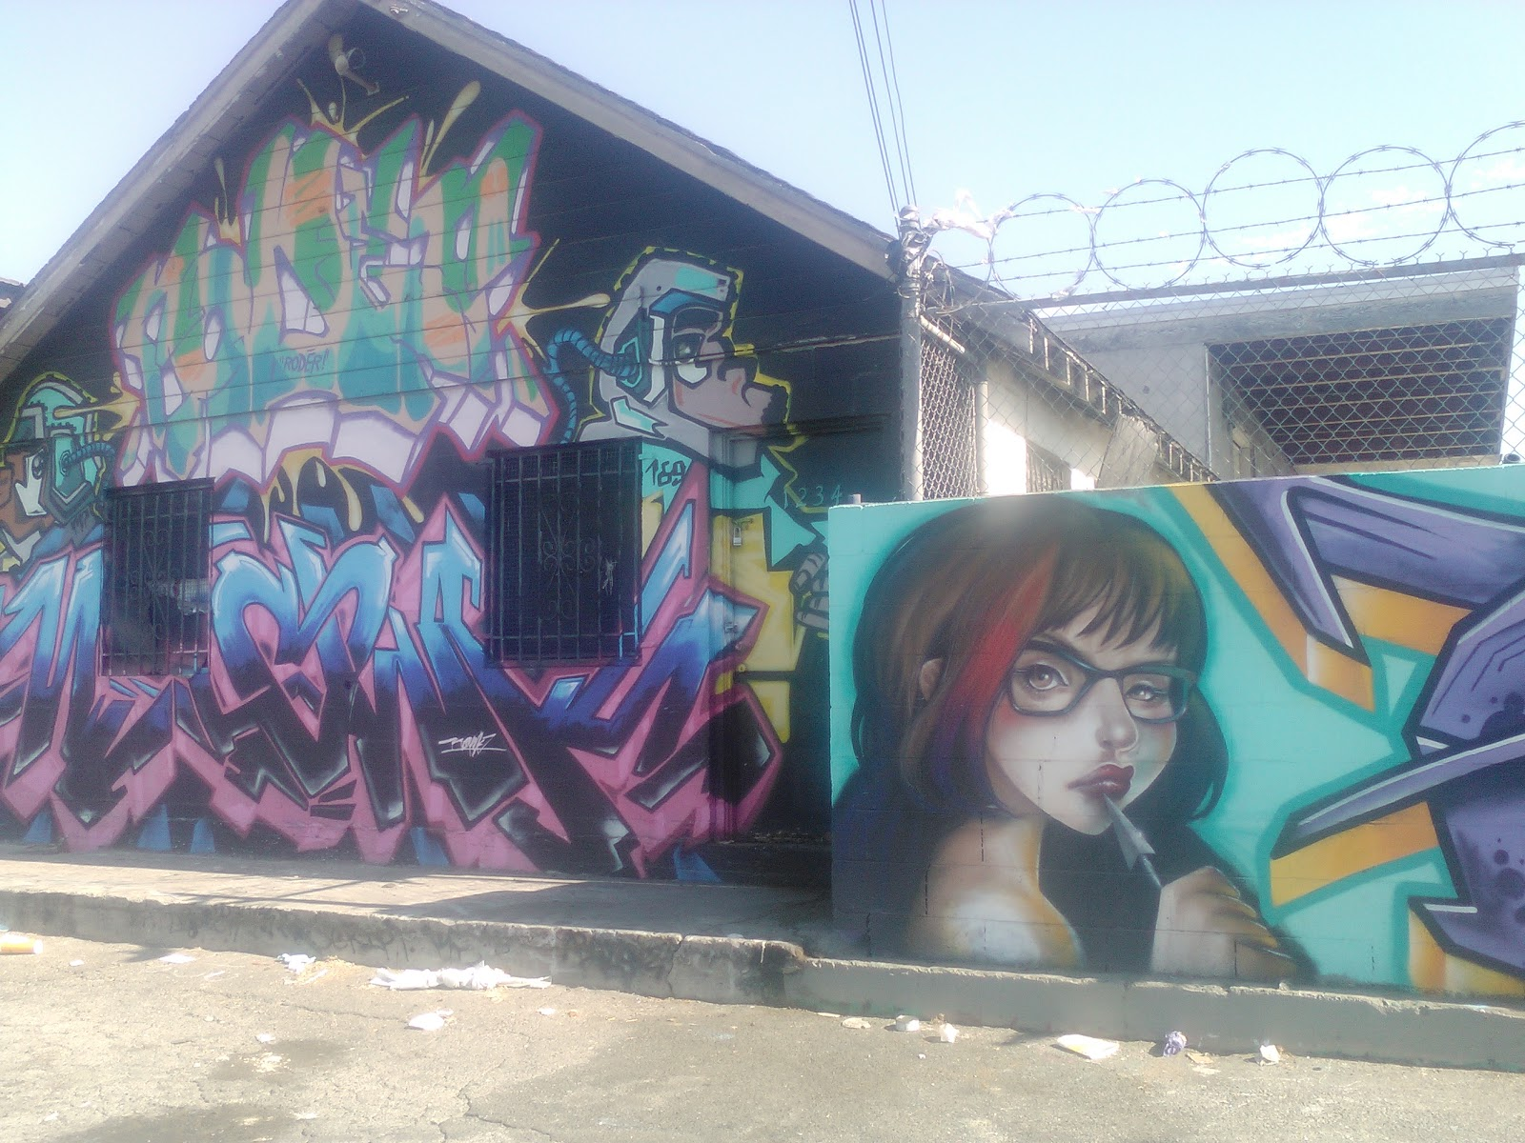
Number 1

Slide 3
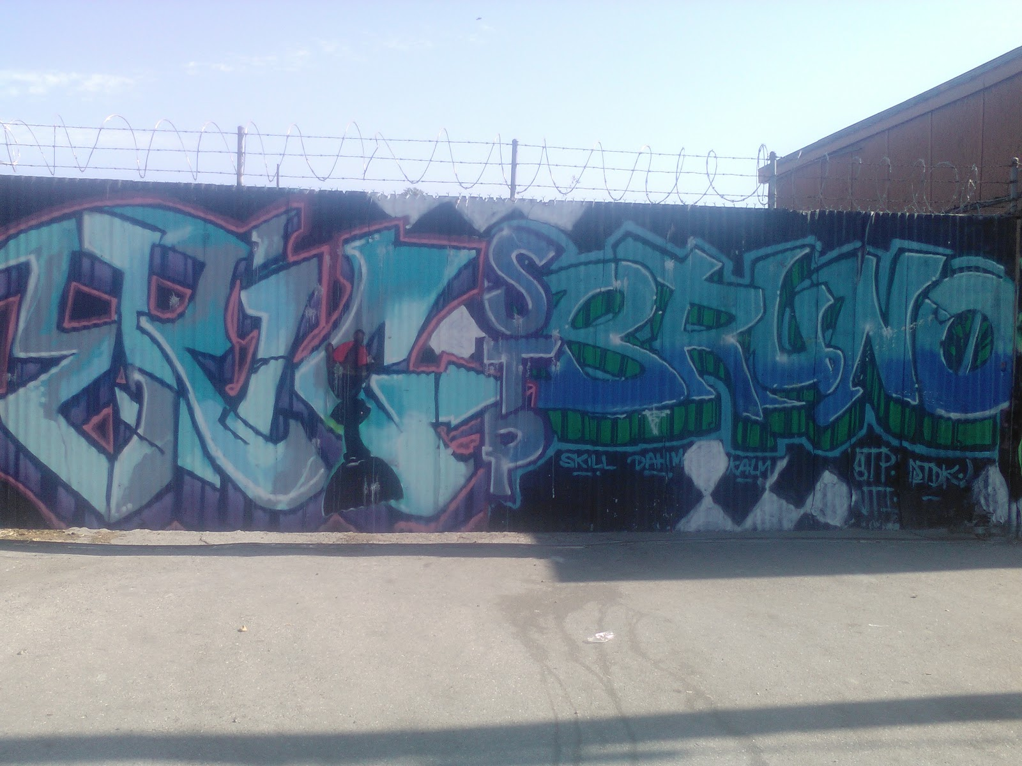
Number 2

Slide 4
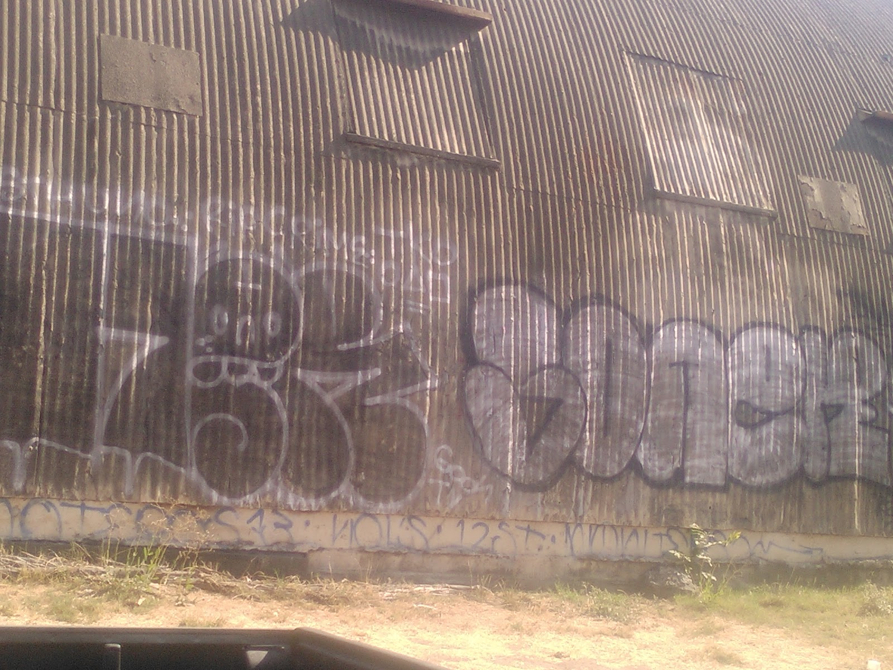
Number 3

Slide 5
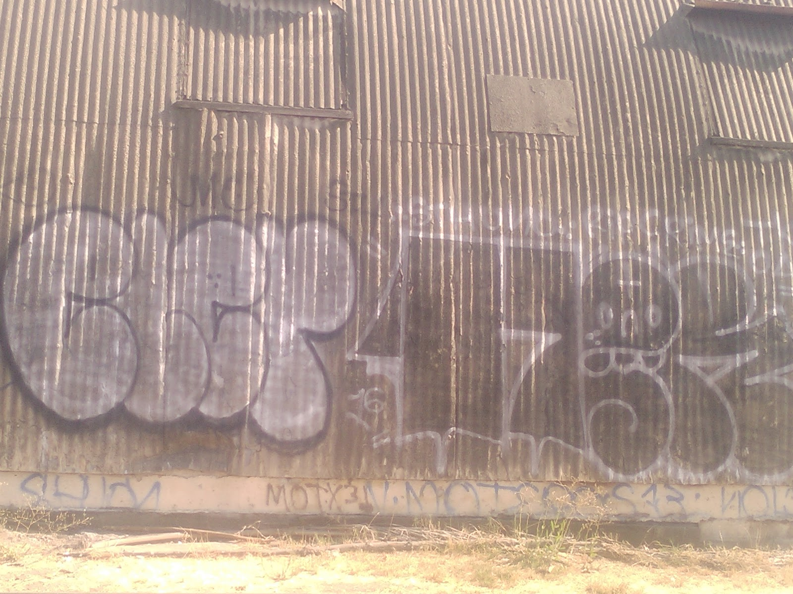
Number 4

