Slide 1
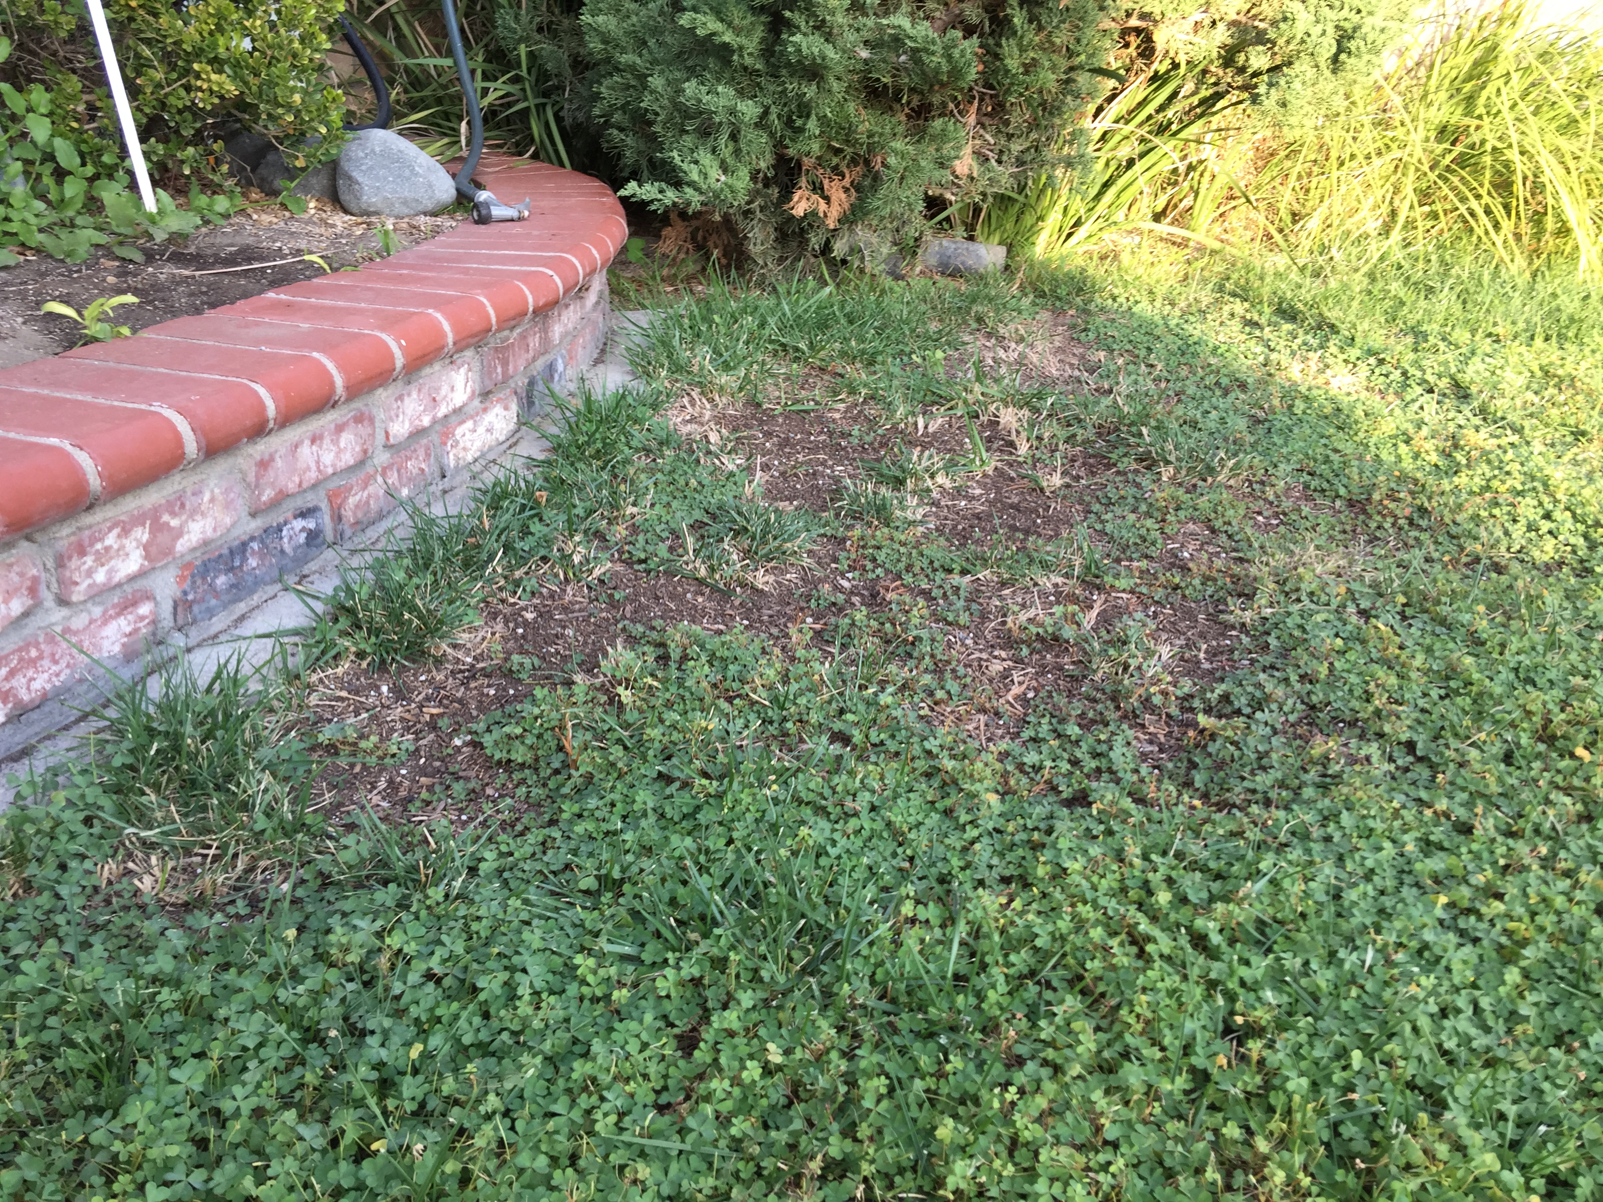
(Kevin Domon) HIP/SLICE “Fix-It” PPT

Slide 2
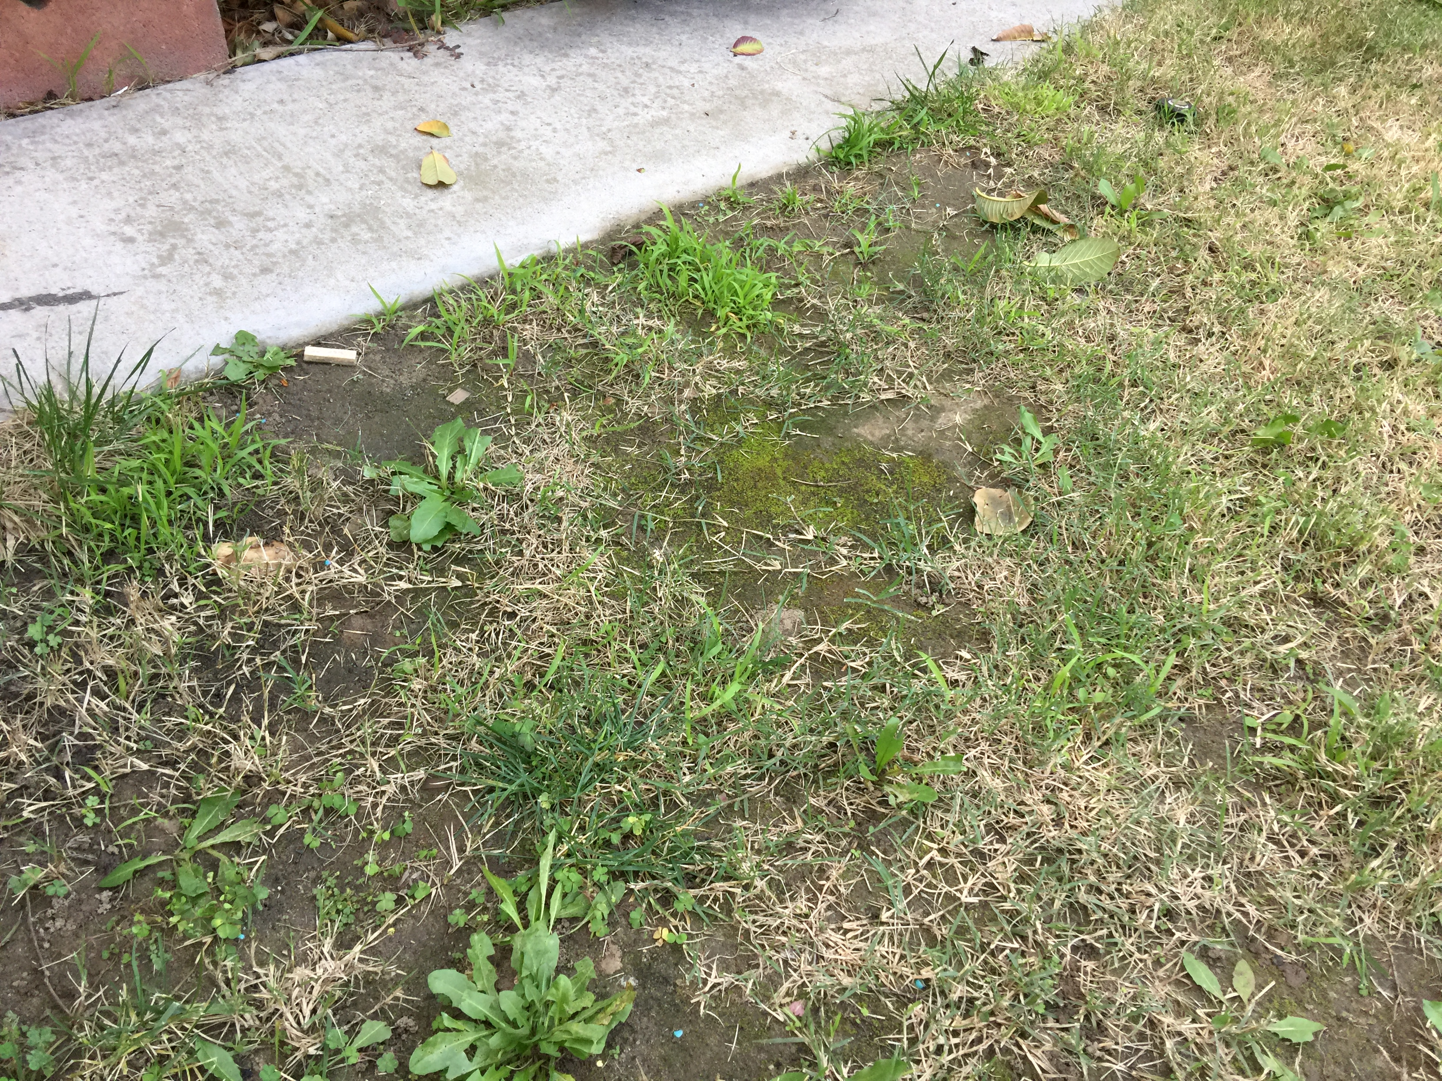
(Kevin Domon) HIP/SLICE “Fix-It” PPT

Slide 3
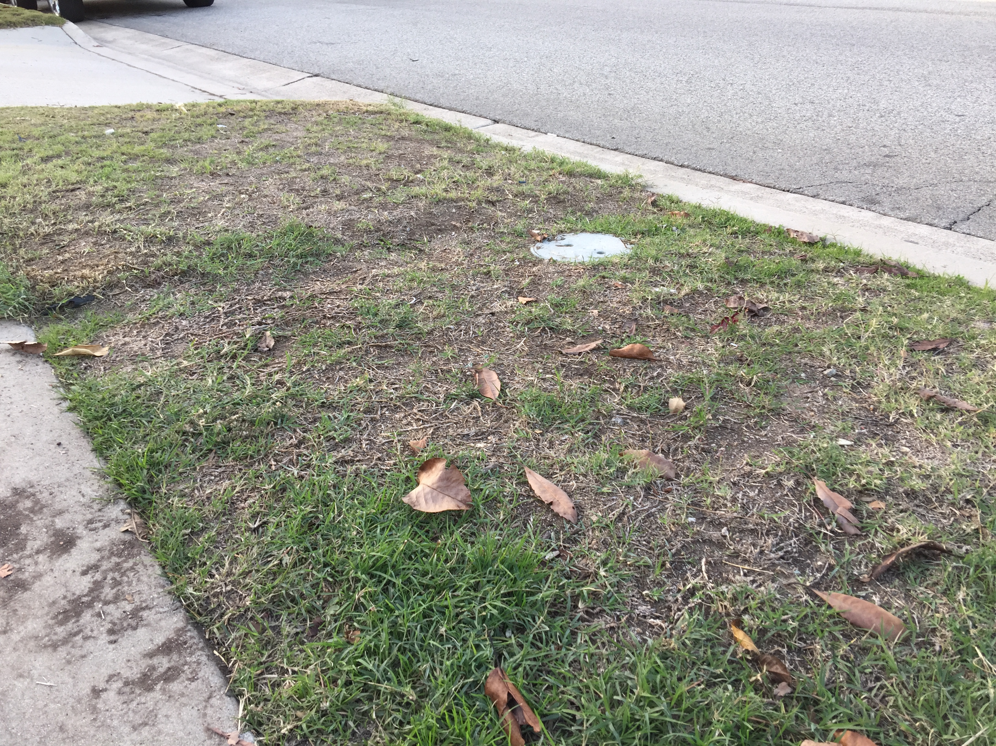
(Kevin Domon) HIP/SLICE “Fix-It” PPT

Slide 4
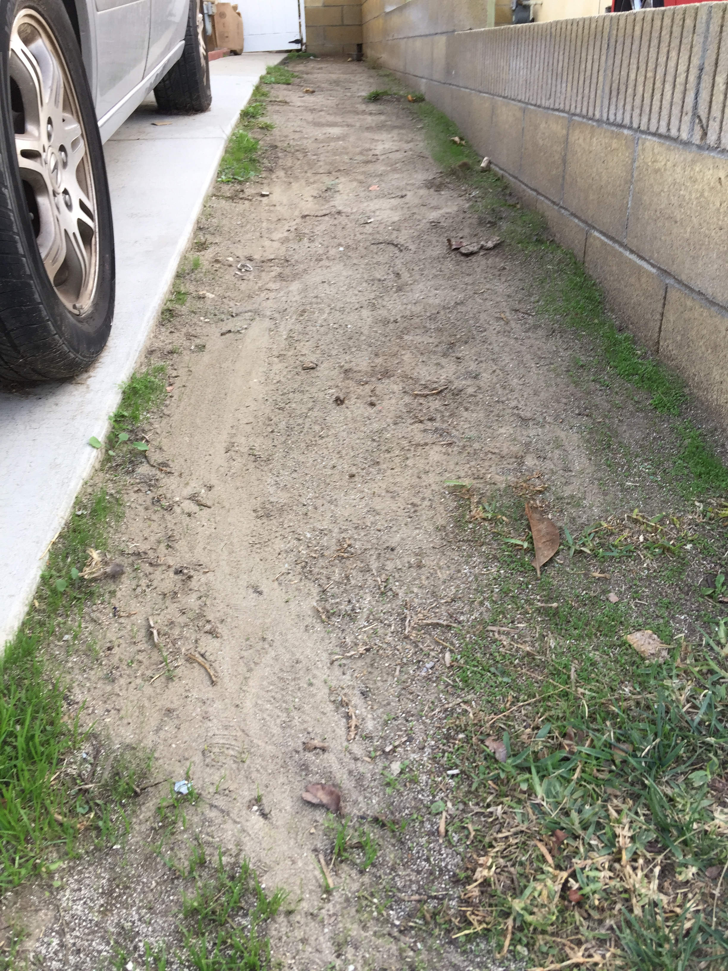
(Kevin Domon) HIP/SLICE “Fix-It” PPT

