Slide 1
Homelessness in
Los Angeles
HIP/SLICE “fix it” ppt
Claudia Aguilar

Slide 2
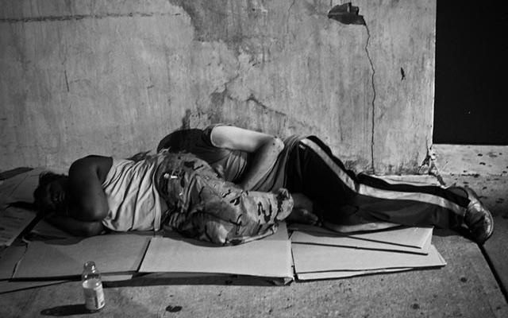
Homelessness on the rise

Slide 3
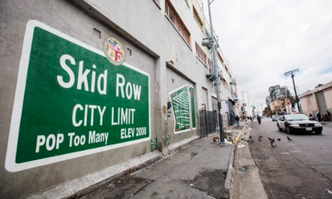
Skid row

Slide 4
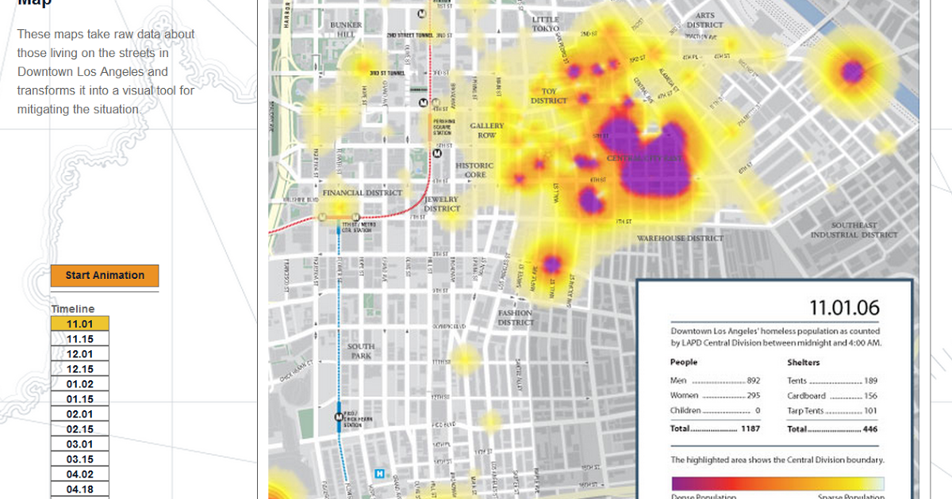
the sad truth

Slide 5
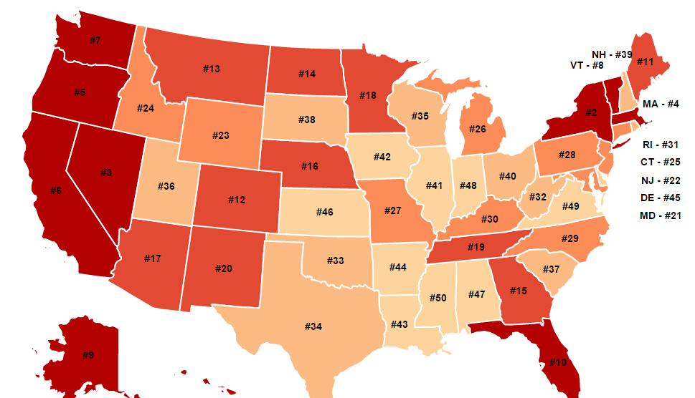
2014 top homelessness states

Slide 6


Ways to help!
Donate clothes
Donate food
Donate time by volunteering in shelter homes
If possible, donate money
Check out Los Angeles Mission, The Crossroads for Hope

